Slide 1
Geological map for the CIS countries territory at 1:1,000,000 scale in OneGeology international project
5.1 - Session 1 - OneGeology and National Geoscience Information Systems
Grigory BREKHOV, Oleg PETROV, Andrey MOROZOV, Eugenia CHEREMISSINA, Victor SNEZHKO, Nikolai BEREZUK, Eugene KOVALENKO, Egor YON
Federal Agency of Mineral Resources of Russian Federation
Russian Geological Research Institute (VSEGEI)
Scientific Research Institute of geological, geophysical
and geochemical systems (VNIIGeosystem)
phone: +7 (812) 321-5706, fax: +7 (812) 321-3023; e-mail: vsegei@vsegei.ru, http://www.vsegei.ru

Slide 2
presentation «Raster State Geological Maps Database for the Russian Federation» was given at the 33 IGC in 2008 in Oslo
phone: +7 (812) 321-5706, fax: +7 (812) 321-3023; e-mail: vsegei@vsegei.ru, http://www.vsegei.ru

Slide 3
GEOLOGICAL MAP FOR THE CIS COUNTRIES TERRITORY AT 1:1,000,000 SCALE
phone: +7 (812) 321-5706, fax: +7 (812) 321-3023; e-mail: vsegei@vsegei.ru, http://www.vsegei.ru

Slide 4
Decision of the XV Session of the CIS Intergovernmental Council
On September 16, 2011 in Cholpon-Ata (Kyrgyz Republic), at the XV Session of the Intergovernmental Council of the Commonwealth of Independent States (CIS), it was decided to prepare a set of geological maps at 1:1 000 000 scale for the territory of the CIS countries for integration into the international project OneGeology.
phone: +7 (812) 321-5706, fax: +7 (812) 321-3023; e-mail: vsegei@vsegei.ru, http://www.vsegei.ru

Slide 5
PROGRAMS of single sheet geological mapping of the former USSR and the Russian Federation
Program on compilation of the State geological map at 1:1,000,000 scale. The first edition. | 1938 – 1966
Program on compilation of the State geological map at 1:1,000,000 scale. The second edition. | 1964 – 1990
Program on compilation of the State geological map at 1:1,000,000 scale. The third edition. | 1995 - continues
Program on compilation of the State geological map at 1:200,000 scale. The first edition. | 1954 - 1975
Program on compilation of the State geological map at 1:200,000 scale. The second edition. | 1988 - continues
phone: +7 (812) 321-5706, fax: +7 (812) 321-3023; e-mail: vsegei@vsegei.ru, http://www.vsegei.ru

Slide 6
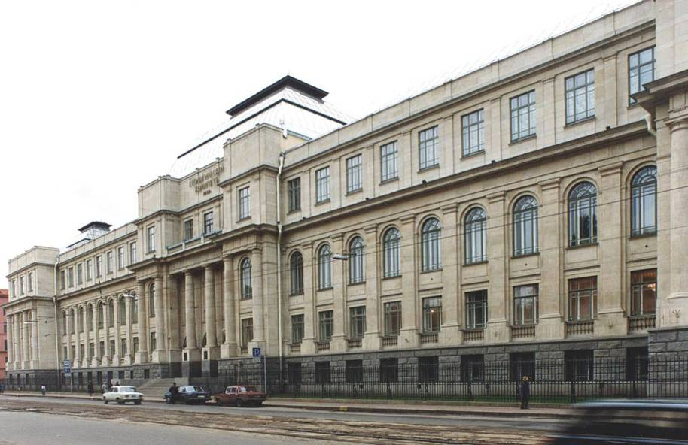
Program on compilation of the State geological map at 1:1,000,000 scale. The second edition
Coordination of the State geological maps compilation and their scientific and methodical support was entrusted to the All-Union Geological Institute VSEGEI.
For this purpose, the Chief Editorial Board of the State geological map at 1:1,000,000 scale was established at VSEGEI.

Slide 7
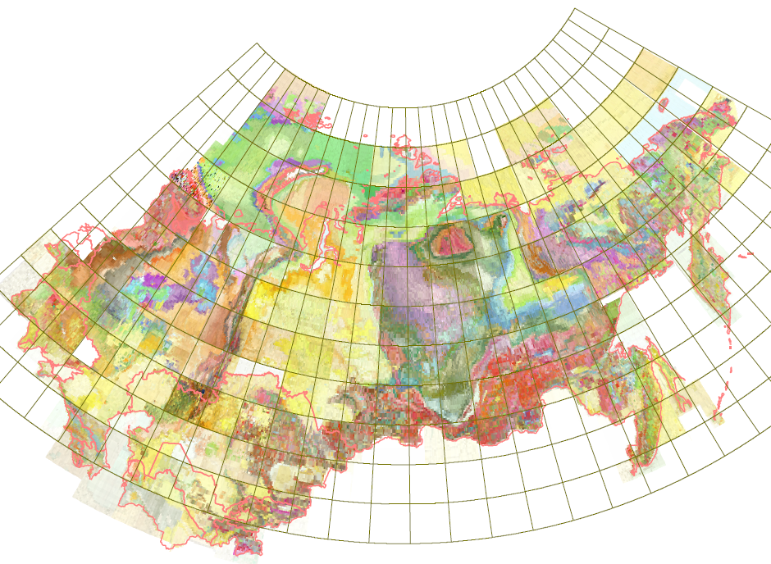
Program on compilation of the State geological map at 1:1,000,000 scale. The second edition
Geological maps cover more than 22 million sq. km of ​​the former Soviet Union.
phone: +7 (812) 321-5706, fax: +7 (812) 321-3023; e-mail: vsegei@vsegei.ru, http://www.vsegei.ru

Slide 8
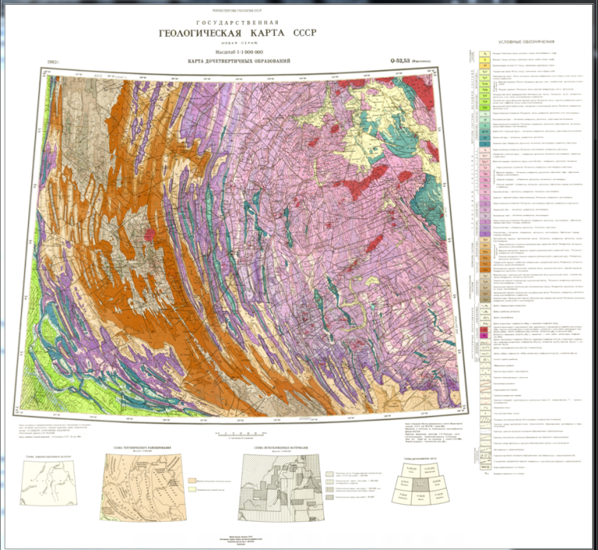
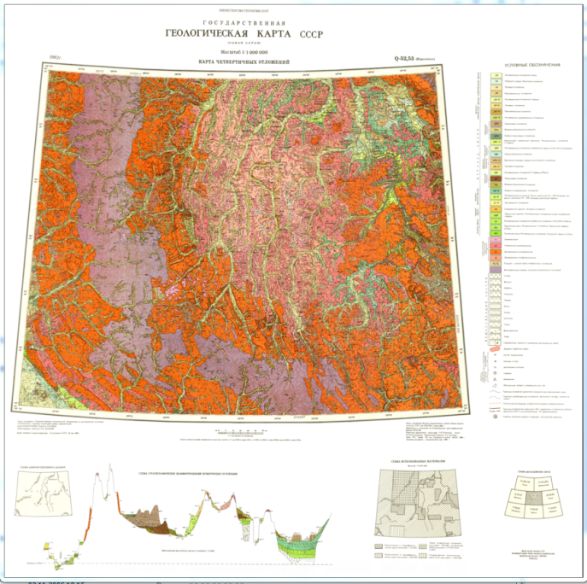
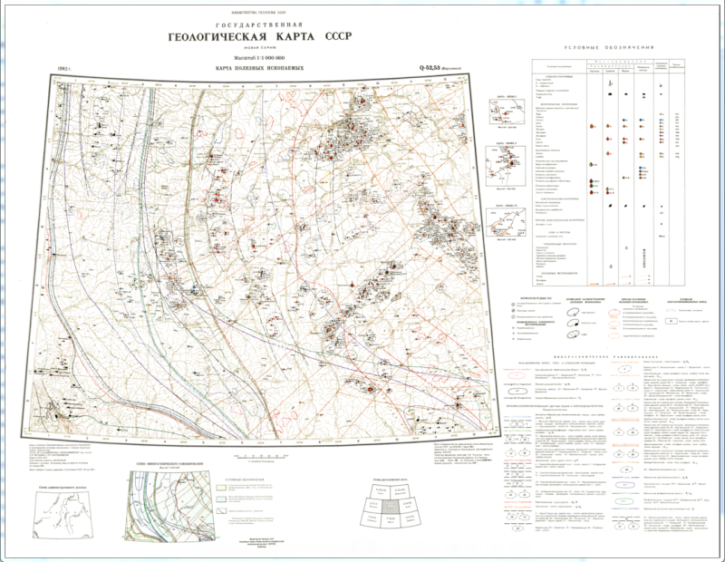
composition of a basic set of State geological map
Program on compilation of the State geological map at 1:1,000,000 scale. The second edition
Bedrock geological map
Quaternary map
Mineral deposits map
phone: +7 (812) 321-5706, fax: +7 (812) 321-3023; e-mail: vsegei@vsegei.ru, http://www.vsegei.ru

Slide 9
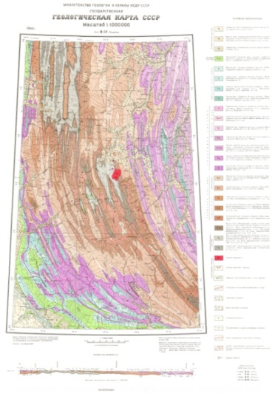
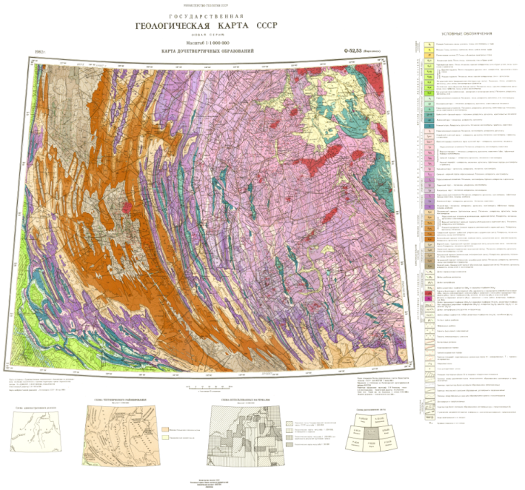
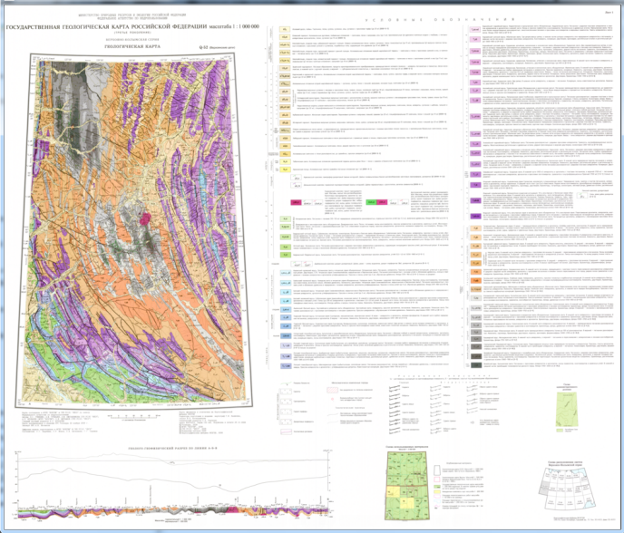
LARGE SCALE SHEET NUMBERING WAS USED FOR COMPILATION OF THE STATE GEOLOGICAL MAPS OF THE SECOND EDITION
Program on compilation of the State geological map at 1:1,000,000 scale. The second edition
State Geological Map
The 1st edition
Sheet Q-52
State Geological Map
The 2nd edition
Sheet Q-52,53
State Geological Map
The 3rd edition
Sheet Q-52
phone: +7 (812) 321-5706, fax: +7 (812) 321-3023; e-mail: vsegei@vsegei.ru, http://www.vsegei.ru

Slide 10
Program on compilation of the State geological map at 1:1,000,000 scale. The second edition
As a result of drawing up the State Geological Map of the second edition, the whole territory of the former Soviet Union was reflected in reliable geological maps. We managed to get a complete pattern of the geological structure of the country.
A reliable geological basis for evaluation of resource potential and prediction of mineral deposits was created.
phone: +7 (812) 321-5706, fax: +7 (812) 321-3023; e-mail: vsegei@vsegei.ru, http://www.vsegei.ru

Slide 11
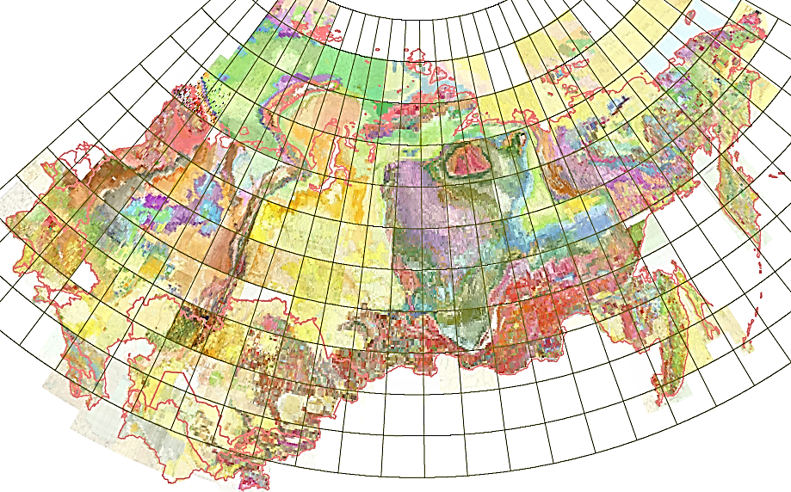
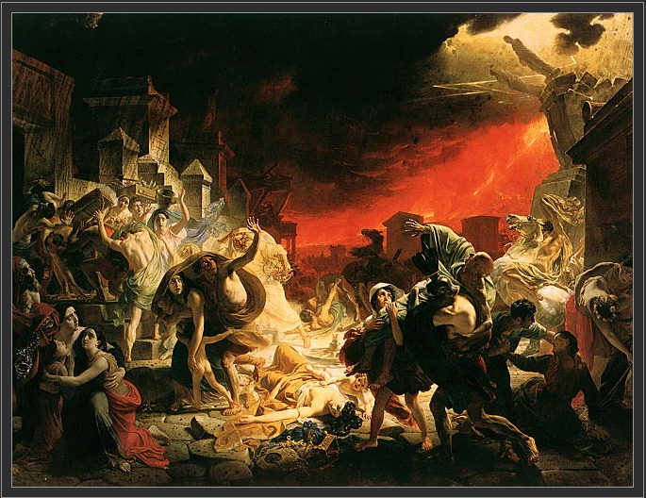
Program on compilation of the State geological map at 1:1,000,000 scale. The second edition
10 м
The State geological maps at 1:1,000,000 scale. The second edition.
Year | 1964-1990
Dimensions | 6 m × 10 m
S=60 м²
6 м
6.5 м
“The Last Day of Pompeii”
Artist | Karl Briullov
Year | 1830-1833
Dimensions | 465.5 cm × 651 cm
Location | State Russian Museum, St. Petersburg
4.5 м
S=30 м²
phone: +7 (812) 321-5706, fax: +7 (812) 321-3023; e-mail: vsegei@vsegei.ru, http://www.vsegei.ru

Slide 12
Interaction scheme of the State Geological Maps Database for the Russian Federation and OneGeology Portal
OneGeology Portal
For integration with OneGeology Portal, a dedicated archive of raster maps integrated into the State Geological Maps Database for the Russian Federation is used.
Brief information on the architecture of Database and its content will be given in the presentation by Dr. V.Snezhko .
INTERNET
WMS
Map server
State Geological Maps Database for the Russian Federation
phone: +7 (812) 321-5706, fax: +7 (812) 321-3023; e-mail: vsegei@vsegei.ru, http://www.vsegei.ru

Slide 13
Interaction scheme of the State Geological Maps Database for the Russian Federation and OneGeology Portal
OneGeology Portal
Experts from Russian Geological Research Institute and State Research Center VNIIGeosystem deployed and configured on the map server a standard WMS service using Oracle FMW MapViewer.
INTERNET
WMS
Map server
State Geological Maps Database for the Russian Federation
phone: +7 (812) 321-5706, fax: +7 (812) 321-3023; e-mail: vsegei@vsegei.ru, http://www.vsegei.ru

Slide 14
Interaction scheme of the State Geological Maps Database for the Russian Federation and OneGeology Portal
OneGeology Portal
INTERNET
WMS
Map server
State Geological Maps Database for the Russian Federation
phone: +7 (812) 321-5706, fax: +7 (812) 321-3023; e-mail: vsegei@vsegei.ru, http://www.vsegei.ru

Slide 15
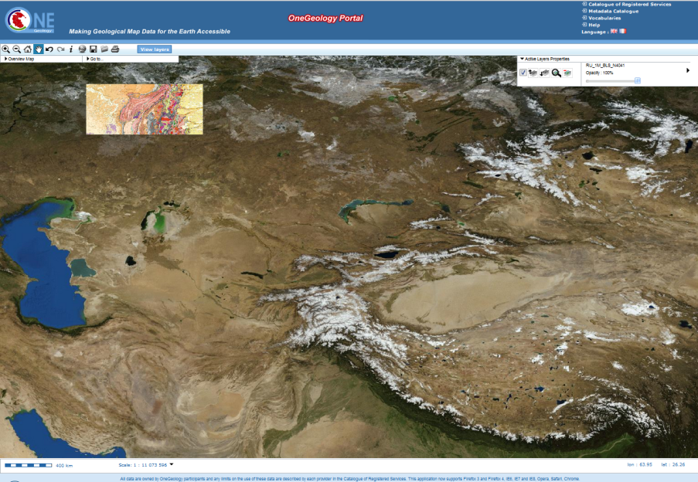
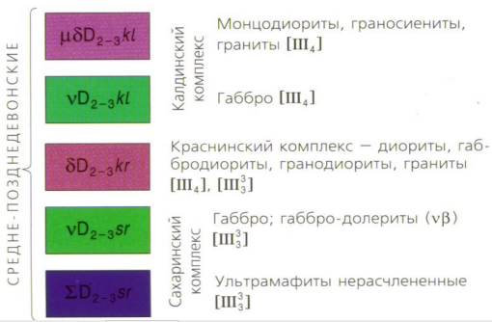
Geological map for the CIS countries territory at 1:1,000,000 scale
Example of visualization of map legend.
Sheet N-40(41)
http://portal.onegeology.org/
http://wms.vsegei.ru/VSEGEI_Bedrock_geology/wms?
phone: +7 (812) 321-5706, fax: +7 (812) 321-3023; e-mail: vsegei@vsegei.ru, http://www.vsegei.ru

Slide 16
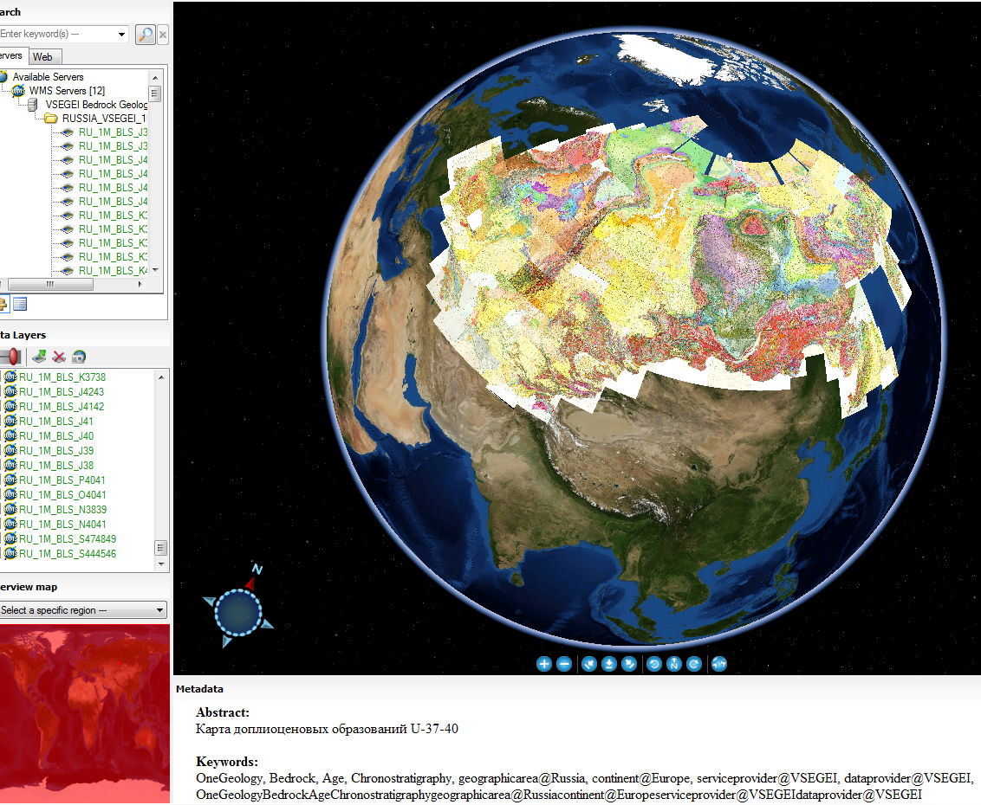
Geological map of the CIS countries on the globe Dapple
phone: +7 (812) 321-5706, fax: +7 (812) 321-3023; e-mail: vsegei@vsegei.ru, http://www.vsegei.ru

Slide 17
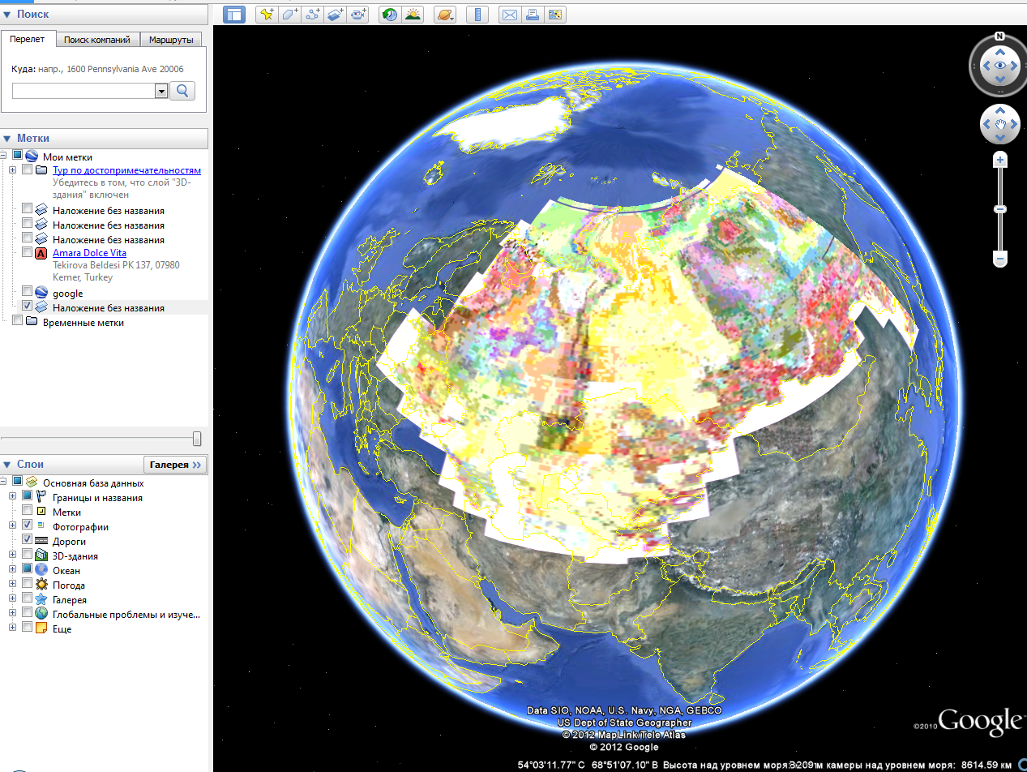
Geological map of the CIS countries on the globe Google Earth
phone: +7 (812) 321-5706, fax: +7 (812) 321-3023; e-mail: vsegei@vsegei.ru, http://www.vsegei.ru

Slide 18
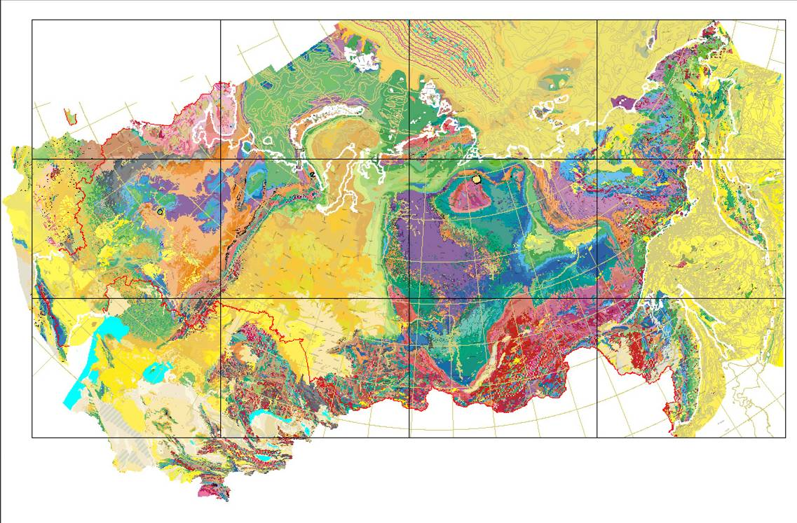
further plans
Geological map of the Commonwealth of Independent States in scale 1:2,500,000 can be represented as a distributed web service, using the data exchange format GeoSciML and WFS.
phone: +7 (812) 321-5706, fax: +7 (812) 321-3023; e-mail: vsegei@vsegei.ru, http://www.vsegei.ru
Notes:
18

Slide 19
Thank you for your attention!

