Slide 1
Database of the State Geological Maps for the Territory of Russia and its Continental Shelf
Victor Snezhko (presenter), Oleg Petrov, Andrey Morozov, Grigory Brekhov,
Nikolay Berezuk, Sergey Strelnikov, Eugeniy Kovalenko, Leonid Chesalov, Egor Yuon
Federal Agency of Mineral Resources of Russia (Rosnedra)
A.P. Karpinsky Russian Geological Research Institute (VSEGEI)
State Research Center VNIIGeosystem (VNIIGeosystem)
phone: +7 (812) 321-5706, fax: +7 (812) 321-3023; e-mail: vsegei@vsegei.ru, http://www.vsegei.ru

Slide 2
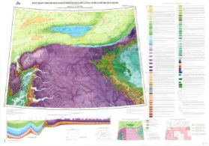
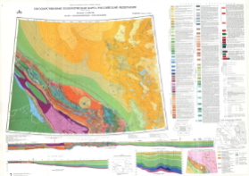
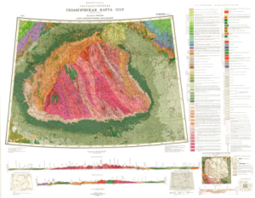
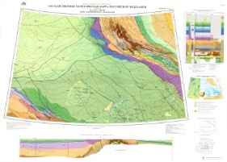
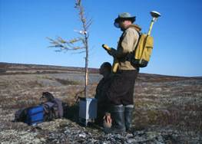
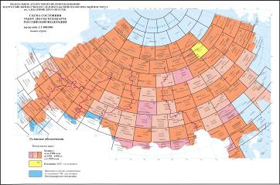
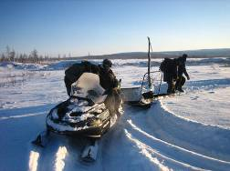
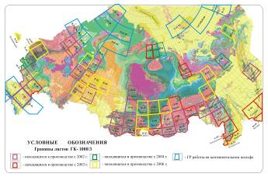
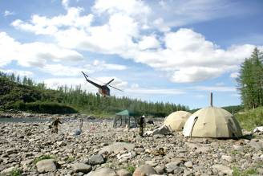
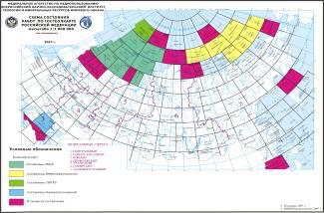
Federal Agency of Mineral Resources of Russia (Rosnedra)
A.P. Karpinsky Russian Geological Research Institute (VSEGEI)
VSEGEI
VSEGEI is responsible for Russia’s representation in major international geological organizations and projects
VSEGEI publishes State geological maps
of the territory of Russia
and its continental shelf
VSEGEI
organizes and supervises all activities concerning the State Geological Mapping in Russia and its Continental Shelf
phone: +7 (812) 321-5706, fax: +7 (812) 321-3023; e-mail: vsegei@vsegei.ru, http://www.vsegei.ru

Slide 3
Database of the State geological maps of Russia
Design Stages
CONCEPTUAL MODEL
prototype NADM-C1
Defining main categories and notions used for the description of geological units of Russian State Geological Maps in 1:200 000 - 1:1 000 000 scale. Developing of the TermBase and hierarchies building
2007-2009
LOGIC MODEL
prototype NADM-GSC (Canada) +
BASE-2000-CAGRE ( Russia)-CentralArcticExpedition
Developing Data Base schemes, adapting the used prototype. Ontologies building based on methodological documents of Russian Geological Survey (Stratigraphic Code of Russia; Petrographic Code of Russia; Russian Geological Glossary).
2008-2010
PHYSICAL DATA MODEL
was fulfilled VSEGEI
Developing general interoperability architecture. Developing of Data Base attributive tables structure taking into account the standards for Digital Models of State Geological Map Digital Models.
2009-2011
Database of the State
geological maps
Checking and reworking existing digital materials. Preparing georeferenced rasters. Uploading geological information into the Data Base. Forming formalized descriptions.
Developing software for preparation and administration of data. Deploying services and interface to data access.
1 phase - 2009-2011; 2 phase -2012-2014; 3 phase –for 2020
phone: +7 (812) 321-5706, fax: +7 (812) 321-3023; e-mail: vsegei@vsegei.ru, http://www.vsegei.ru

Slide 4
National Geological Mapping Information System
Clients (ArcGis, MapInfo, GeoSoft, QuantumGIS, GRASS, Dapple…)
Information Systems (SOBR-Rosnedra, VSEGEI, ONEGEOLOGY…)
WMS
WFS
GeoSciML
CSW
ArcSDE
The level of server applications for data access
Service
WMS
Service
WFS
GeoSciML Wrapper
Service
CSW
Service
ArcSDE
Services to providing the interoperability
the core of system
1.Digital models for State Geological Maps scale 1:200000-1:1000000-1:2500000.
2. Legends of State Geological Map sheets series (schemes, tables, explanatory notes).
3. Georeferenced raster maps and other raster materials.
4. TermBase and ontologies
DataBase of State Geological Maps – ORACLE 11.g
The level of client applications for system management
LoadRastr
MapAdmin
Client applications for uploading data, forming the relationships and ontologies and creating formalized descriptions
Utilites ENTRY
MapLith
MapGet
phone: +7 (812) 321-5706, fax: +7 (812) 321-3023; e-mail: vsegei@vsegei.ru, http://www.vsegei.ru

Slide 5
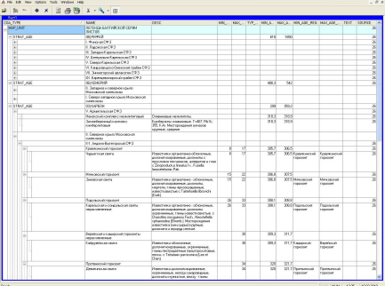
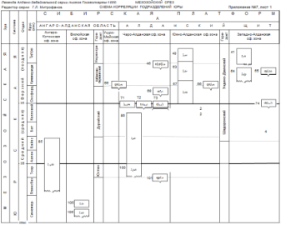
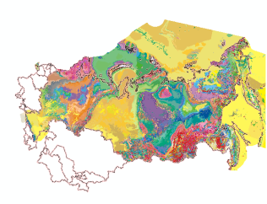
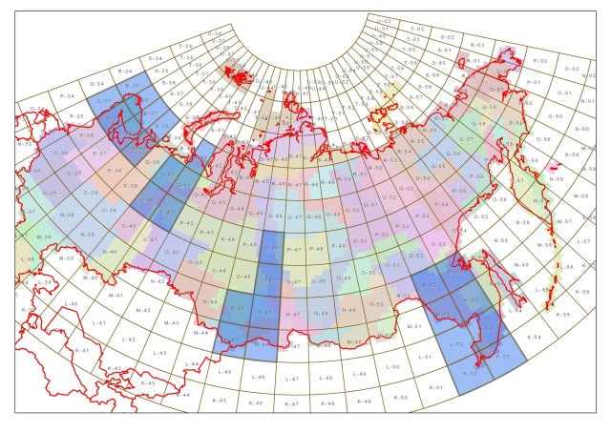
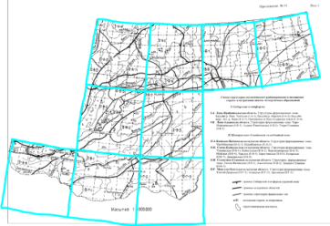
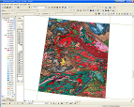
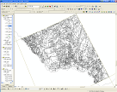
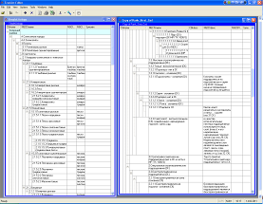
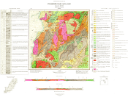
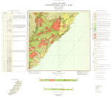
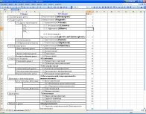
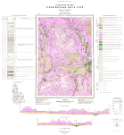
The block of the
Legends of State Geological Map Sheets Series
- 8 Serial Legends for maps scale 1:1000 000
- 3 Serial Legends for maps scale 1: 200 000
- more than 14 000 Geological Units
The block of
Digital Model of State Geological Map Sheets
- 27 sheets scale 1:1 000 000
- 5 sheets scale 1: 200 000
- 4 Seamless fragments of 1:1 000 000 maps for 2 millions sq.km.
- Geological Map for the whole territory of Russia
scale 1 : 2 500 000
Database
of the State Geological Maps
for the territory of Russia
and its Continental Shelf
(SGM DB RF)
Raster Material Block
- GeoRef sets of the 1:1 000 000 Geological map of the USSR (2-nd Edition) for the whole territory of Russia;
- Geological maps (1:200 000 – 1:1 000 000) - more than 1700 maps
Termbase Block
47 dictionaries and about 3000 terms
phone: +7 (812) 321-5706, fax: +7 (812) 321-3023; e-mail: vsegei@vsegei.ru, http://www.vsegei.ru

Slide 6
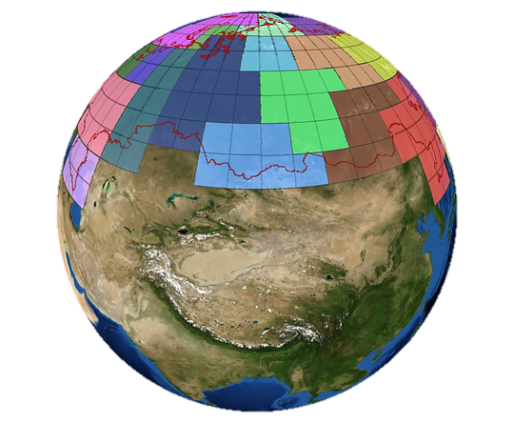
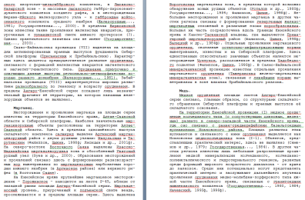
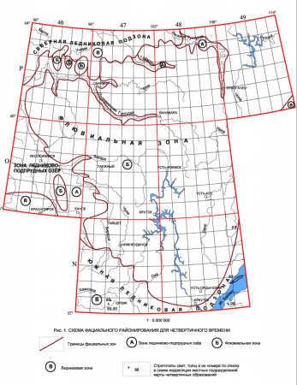
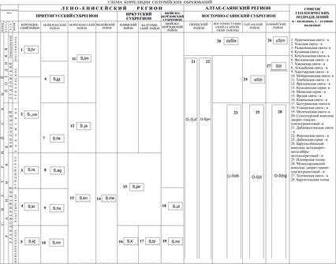
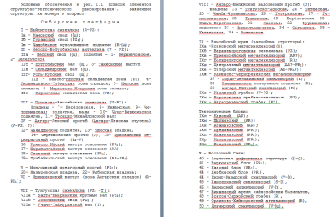
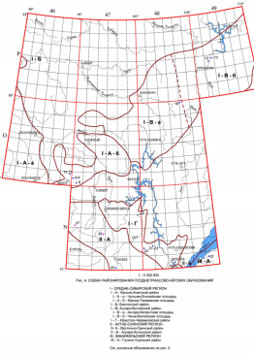
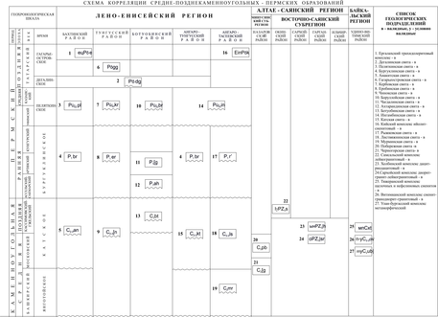
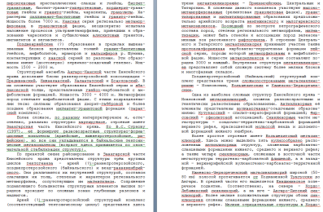
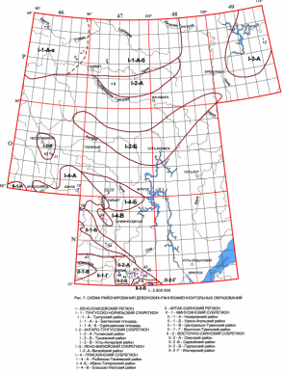
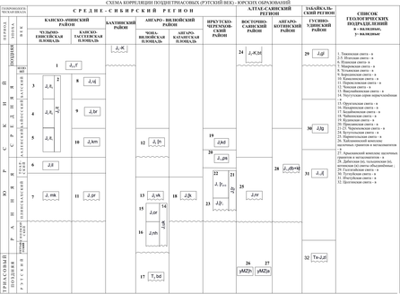
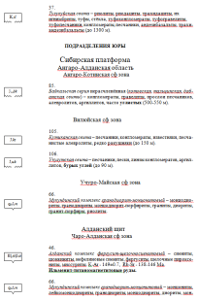
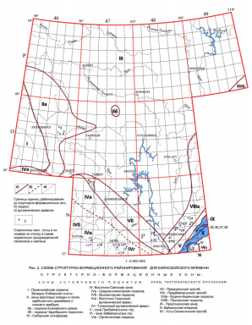
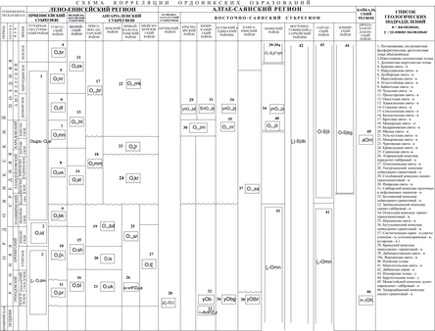
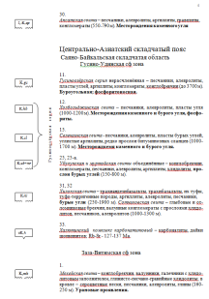
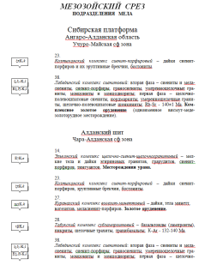
Legends of Series of Sheets for Russian Geological Map 1 : 1000 000
1 | Aldan-Zabaikal
2 | Altai-Sayanskaya
3 | Anabar-Vilyuiskaya
4 | Angara-Yeniseyskaya
5 | Baltiyskaya
6 | Verkhoyansk-Kolymskaya
7 | The Far Eastern
8 | West-Siberian
9 | Koryak and Kurilskaya
10 | Laptev-Sibiromorskaya
11 | Mezenskaya
12 | Norilskaya
13 | Ohotomrskaya
14 | North-Kara-Barents Sea
15 | Scythian (Southern Europe)
16 | Taimyr-Severnaya
17 | Uralskaya
18 | The Central European
19 | Chukotskaya
20 | South Karskaya
21 | The Oceanic
The Legend of Angara-Yeniseyskaya Series of Sheets
text descriptions
zoning maps
correlation schemes
phone: +7 (812) 321-5706, fax: +7 (812) 321-3023; e-mail: vsegei@vsegei.ru, http://www.vsegei.ru

Slide 7
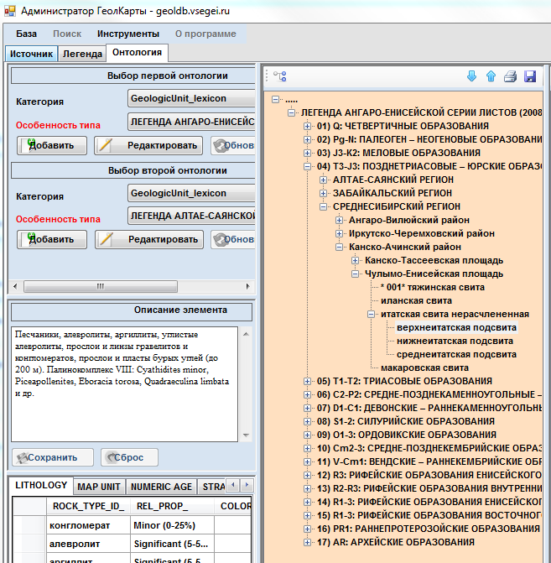
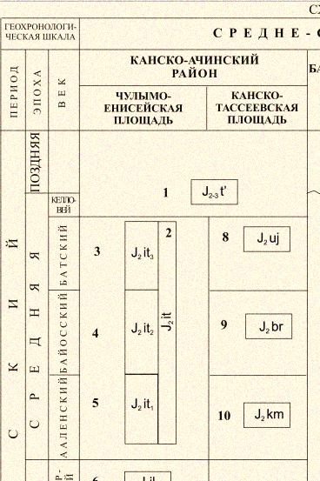
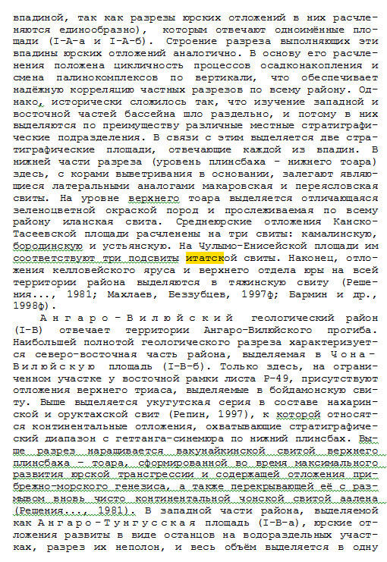
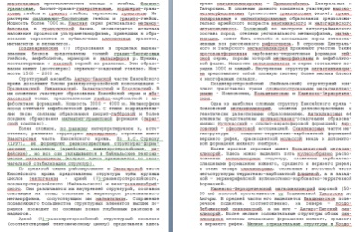
The Legend of Angara-Yeniseyskaya Series of Sheets
Correlation schemes
Late Triassic-Jurassic
Central Siberian region
Kansk-Achinsk District
Yenisei area
Late Triassic-Jurassic
Central Siberian region
Kansk-Achinsk District
Yenisei area
J₂it₃
The Legend of Angara-Yeniseyskaya Series of Sheets
in DataBase (SGM DB RF)
text descriptions from
Explanatory Note
phone: +7 (812) 321-5706, fax: +7 (812) 321-3023; e-mail: vsegei@vsegei.ru, http://www.vsegei.ru

Slide 8
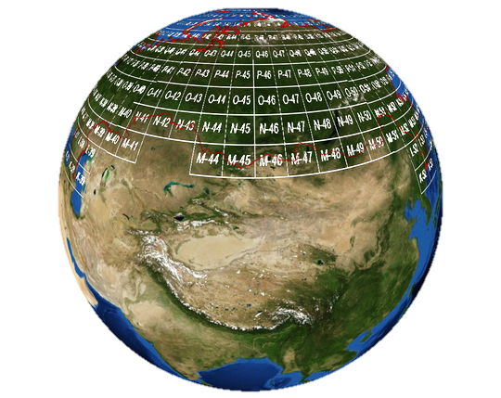
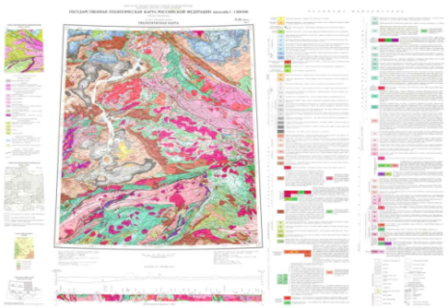
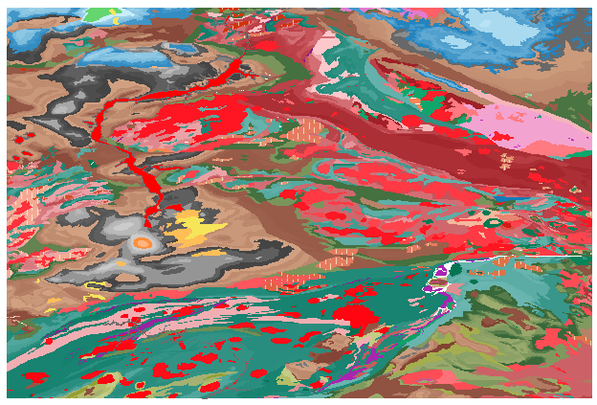
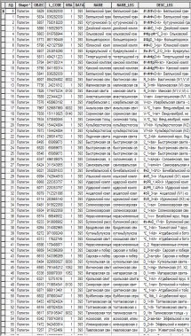
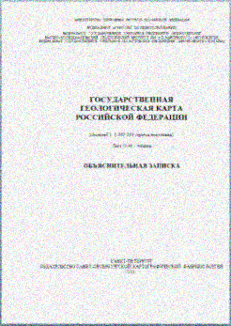
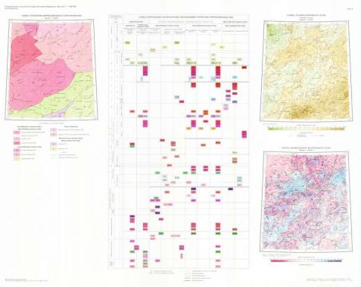
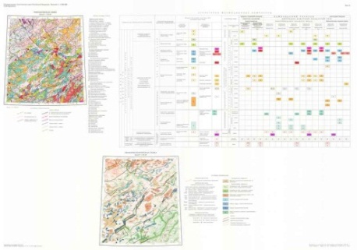
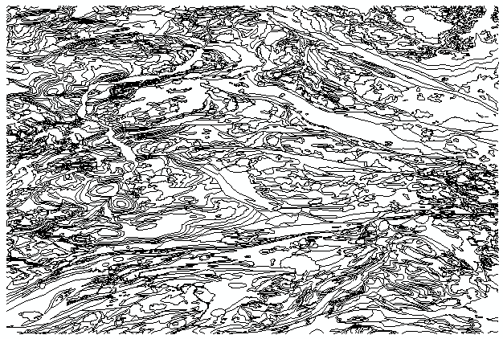
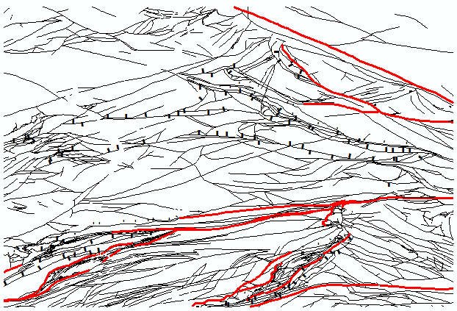
Russian Geological Map 1 : 1,000,000 –Third Generation
sheets
of standard nomenclative
scale 1:1 000 000
6⁰ - for longitude and 4⁰ - for latitude
137 sheets for “Land area”
42 sheets for “Water area”
67 sheets for “Transitional area”
Sheet N-46 - Abakan
State Geological Map Russian Federation, scale 1: 1 000 000 (third generation);
Polygraphic edition
Digital model
Vector data (shp, apr) and attribute data (dbf)
Explanatory Note
phone: +7 (812) 321-5706, fax: +7 (812) 321-3023; e-mail: vsegei@vsegei.ru, http://www.vsegei.ru

Slide 9
The Legend of Sheet N-46 of State Geological Map Scale 1: 1,000,000 (third generation) - Abakan
Legend of the geological map sheet N-46
in
DATA BASE
(SGM DB RF)
Attributive
table
the Explanatory Note
phone: +7 (812) 321-5706, fax: +7 (812) 321-3023; e-mail: vsegei@vsegei.ru, http://www.vsegei.ru

Slide 10
Matching TWO map sheets
“Sheet N-45” + “Sheet N-46”
with
"The Legend of Altai-Sayan
Series of Sheets"
Seamless map
The Legend of Altai-Sayan
Series of Sheets
The Legend of the Map Sheet N-45
The Legend of the Map Sheet N-46
the Geological Map Sheet N-45
the Geological Map Sheet N-46
phone: +7 (812) 321-5706, fax: +7 (812) 321-3023; e-mail: vsegei@vsegei.ru, http://www.vsegei.ru

Slide 11
Terminology Basis for Database of the State Geological Maps for the Territory of Russia and its Continental Shelf (SGM DB RF)
Ontologies SGM DB RF
Sets of Hierarchical Vocabularies
Source Materials for the development of a terminological basis
Earth material,
genetic type,
environment,
chemical description,
physical property,
structure,
texture of rocks (planar),
texture of rocks (volume),
forms of geological bodies, morphology of grains,
size particles,
aggregate grains,
size variability grains,
rank units,
age,
type boundaries,
type of fault,
geological relationships
Etc.
Stratigraphic Code of Russia;
Petrographic Code of Russia;
Sets of procedure manuals;
Russian Geological Glossary ;
Methodical recommendations «Geological mapping»;
Procedure manual on compilation and preparation for publication of sheets of the State Geological Map of the Russian Federation at scale 1:1 000 000 (third generation);
Other procedure manuals and recommendations on geological mapping;
Published literature
phone: +7 (812) 321-5706, fax: +7 (812) 321-3023; e-mail: vsegei@vsegei.ru, http://www.vsegei.ru

Slide 12
The original author's description Onkodinsky complex of rhyolite-dacite. Rhyodacites, rhyolites, dacites and andesites. 67-110 million years (K-Ar). On the the complex associated manifestations of tin, gold, and thorium.
Preparing Formalize Descriptions for Geological Units
Ontology “Genesis”
rock characteristic
Ontology “Chemical Descriptoin”
dacite
Onkodinsky complex
dacite
dacite
Ontology “Physical Property”
Ontology “Earth_Material”
Text definition of the term and the reference to the definition source
Term from dictionary
Ontology “QualitivePSD”
phone: +7 (812) 321-5706, fax: +7 (812) 321-3023; e-mail: vsegei@vsegei.ru, http://www.vsegei.ru

Slide 13
The use of Ontologies allows to create meaningful queries to the database and the automatic generation of Geological Maps from SGM DB RF
4 sheets geological map of scale 1:1 000 000 (M-45, M-46, N-45, N-46) generated in the Serial Legend
Request-
Geological age:
from “Late Cambrian”
to "Jurassic late -Tithonian early”
Request-
Geological age:
from “Late Cambrian”
to "Jurassic late Tithonian early”
+ Genesis:
“Igneous genesis - Plutonic genesis”
+ Chemical properties:
“Silicate_chemistry”
Geological age
Geological zoning
the name of rock
genesis
the window of “MapGet”-tool to generate the request to the database of geological maps
Chemical and physical properties
Request-
Geological zoning:
“Mesozoic coal-bearing basins”
environment
phone: +7 (812) 321-5706, fax: +7 (812) 321-3023; e-mail: vsegei@vsegei.ru, http://www.vsegei.ru

Slide 14
Russian Terms and their equivalents in GeoSciML v.2. Terms
Russian Terms
Equivalent from GeoSciML v.2.
phone: +7 (812) 321-5706, fax: +7 (812) 321-3023; e-mail: vsegei@vsegei.ru, http://www.vsegei.ru

Slide 15
DataBase of the State Geological Maps Raster Block
the Legend
the Map Sheet
Stratigraphic Column
Mosaic of Raster
Geological Section
Scheme
of used materials
WGS
-84
Geological Geophysical Map
phone: +7 (812) 321-5706, fax: +7 (812) 321-3023; e-mail: vsegei@vsegei.ru, http://www.vsegei.ru

Slide 16
A.P. Karpinsky Russian Geological Research Institute (VSEGEI)
State Research Center VNIIGeosystem
(VNIIGeosystem)
Accessing DB through the internet with the use of WFS and GeoSciML
It uses the special subsystem of MGS – based platform (Multi-purpose Geoinformation Server by VNIIGeosystem), which translates user’s request to the Database from the Web-GIS and gives the reply back, adopted to the GeoSciML-view
Main components of the Subsystem:
State geological maps Database service, MapServer WFS-server, GeoSciML-preprocessor, MapServer WFS-client, Web-GIS
Database
of the State Geological Maps
(SGM DB RF)
ORACLE 11
phone: +7 (812) 321-5706, fax: +7 (812) 321-3023; e-mail: vsegei@vsegei.ru, http://www.vsegei.ru
Notes:
СЛАЙД - 601

Slide 17
Database of the State Geological Maps for the Territory of Russia
and its Continental Shelf (SGM DB RF)
For 2011 DB includes
- 27 Sheets of State Geological Map scale 1:1 000 000;
- 4 Regional Fragments (scale 1:1 000 000), total area about 2 million sq.km;
8 Legend of Series of Sheets, 14 000 geological units;
Geological Map of Russia Federation scale 1 : 2.5 M
For 2014 will be include
- 90 NEW Sheets of State Geological Map scale 1:1 000 000;
- 4 NEW Regional Fragments (scale 1:1 000 000), total area about 6.7 million sq.km;
- 13 NEW Legend of Series of Sheets, more than 16 000 Geological Units;
- Upgraded Geological Map of Russia Federation scale 1 : 2.5 M
Ural Region
New Region
“North East Arctic”
North-West Region
New Region
“South European”
Far East Region
New Region
“Middle &South Ural”
Siberia Region
New Region
“South Siberia & Zabaikalsky”
phone: +7 (812) 321-5706, fax: +7 (812) 321-3023; e-mail: vsegei@vsegei.ru, http://www.vsegei.ru

Slide 18
Federal Agency of Mineral Resources of Russia (Rosnedra)
A.P. Karpinsky Russian Geological Research Institute (VSEGEI)
Thank you for your attention
phone: +7 (812) 321-5706, fax: +7 (812) 321-3023
e-mail: vsegei@vsegei.ru, http://www.vsegei.ru

