Slide 1
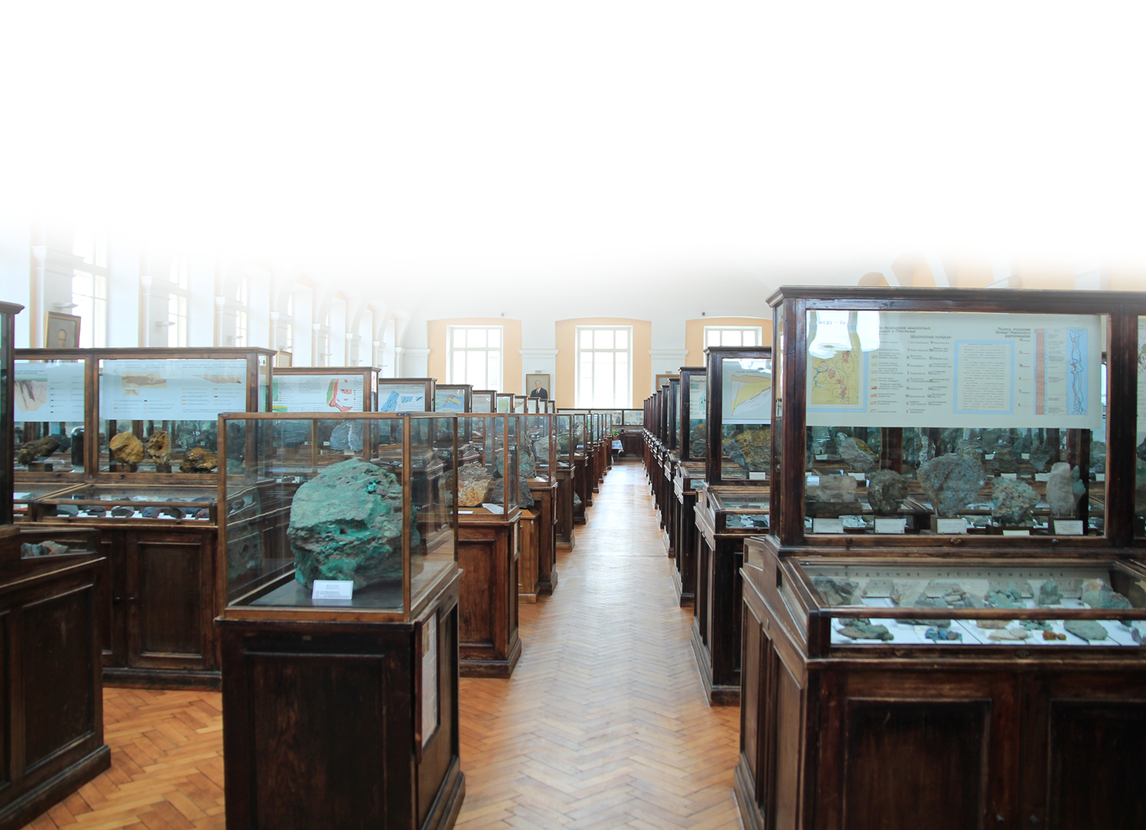
Rosnedra and VSEGEI participation in international projects: Past – Present – Future
UK-Russia Geoscience Cooperation:
Past – Present – Future
VSEGEI, October 27 2017
О.Petrov, E. Kiselev, А. Morozov

Slide 2
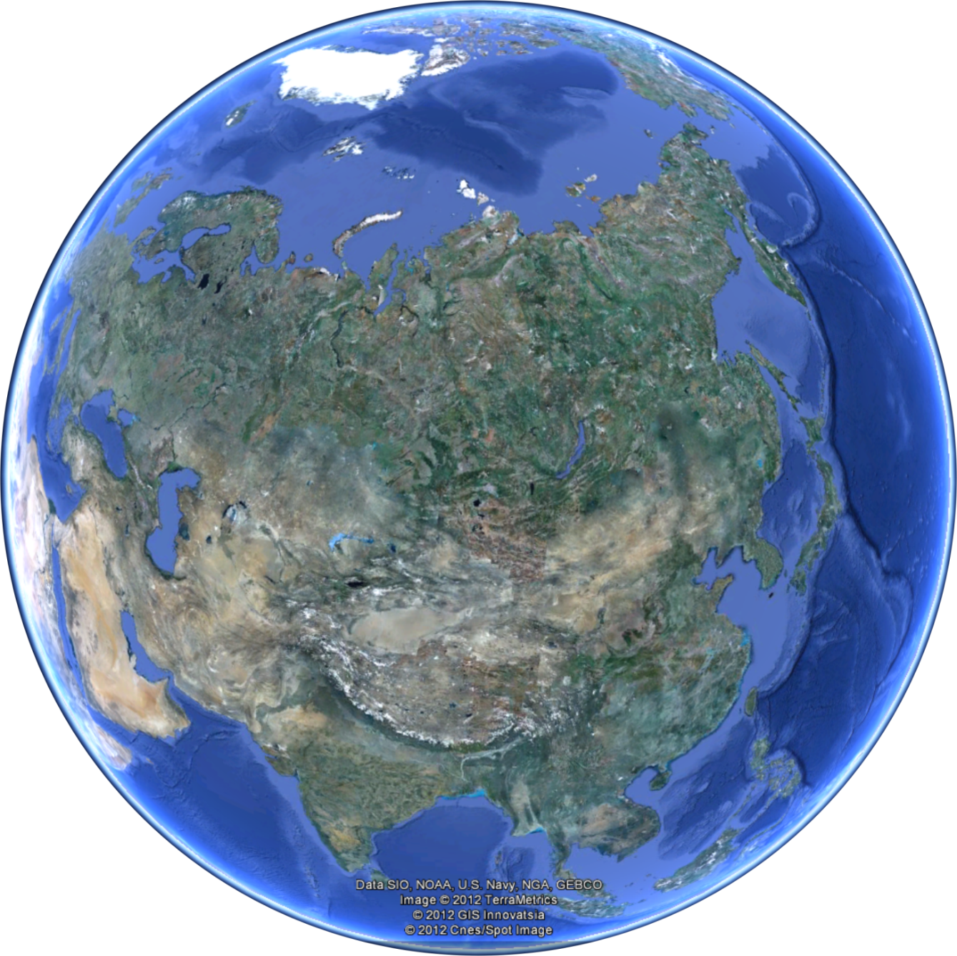

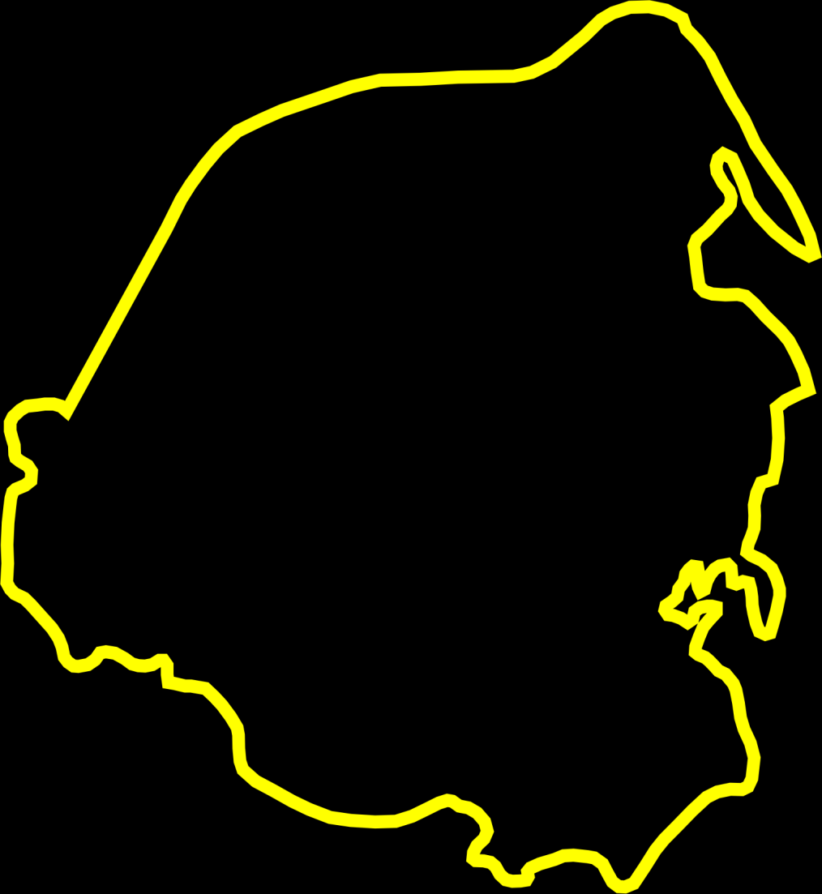


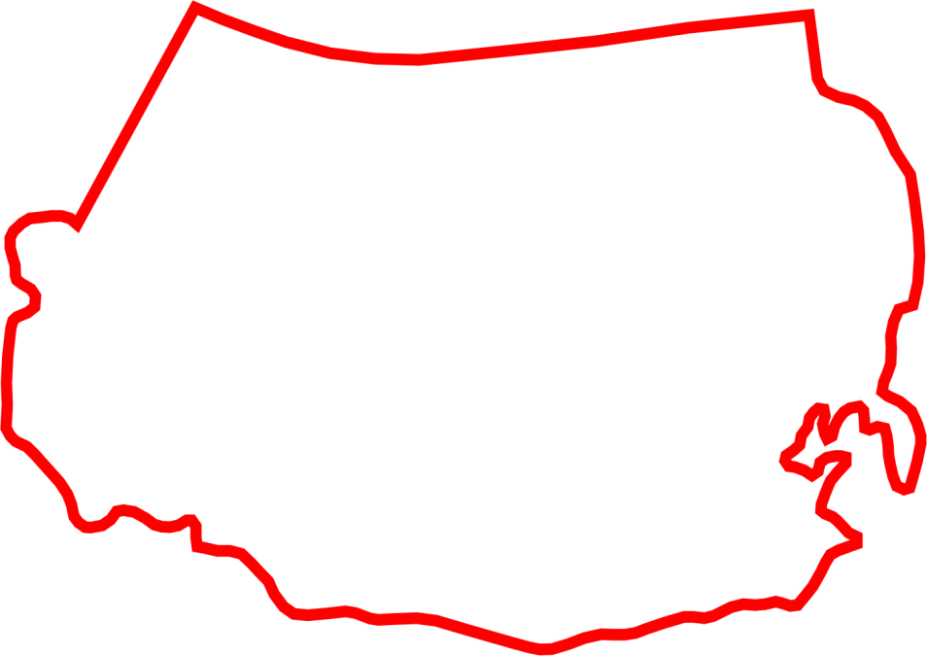
International projects
Circumpolar Arctic
GIS Atlas of Geological Maps of Northern Eurasia (Russia and other CIS countries)
Central,
Northern and Eastern Asia
Atlas of Geological Maps of Central Asia and Adjacent Areas, at 1:2, 500,000 scale Phase I
Atlas of Geological Maps of Central,
Northern and Eastern Asia,
at 1:2, 500,000 scale Phase II)
Russia and other
CIS countries
Atlas of Geological Maps of the Circumpolar Arctic, at 1:5,000,000 scale
Central Asia and
Adjacent Areas
International Geological Map of Asia – IGMA 5000
GIS Atlas of geological maps of the Caspian region at 1:1,000,000 scale
International Geological
Map of Asia – IGMA 5000

Slide 3
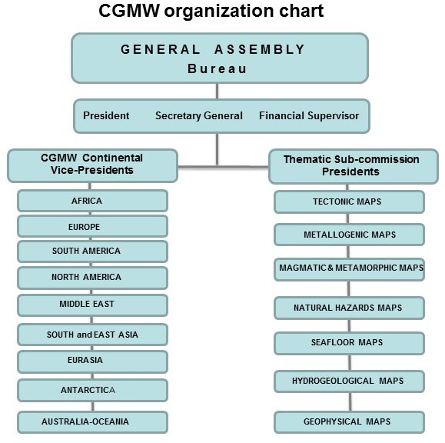


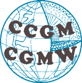
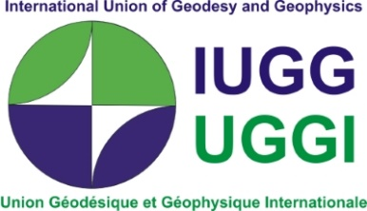
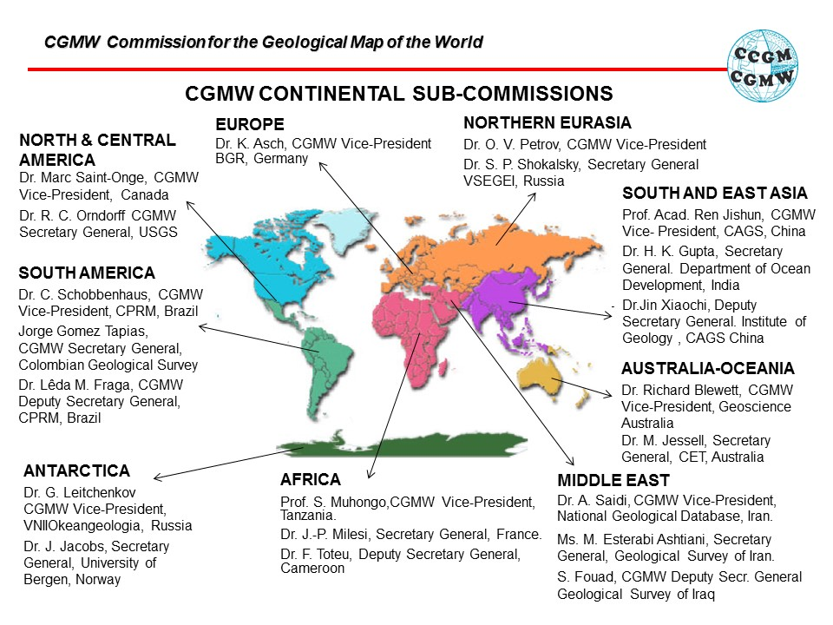
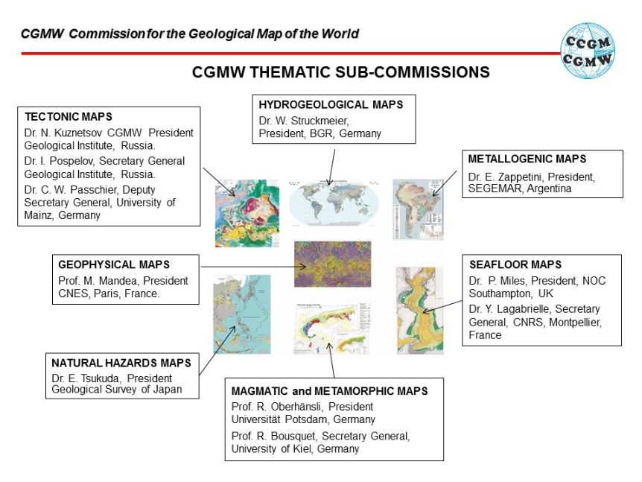
The UNESCO Commission for the Geological Map of the World (CGMW)

Slide 4
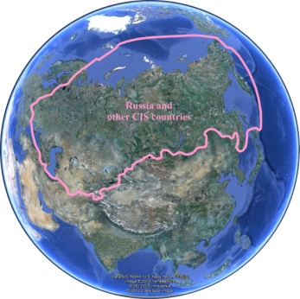
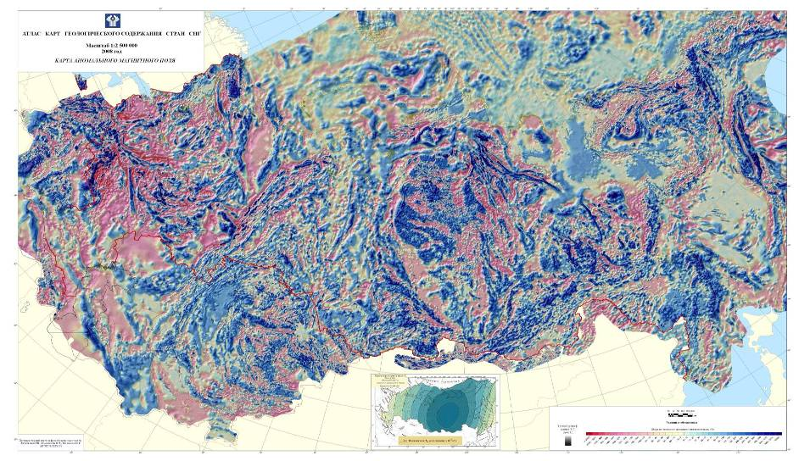
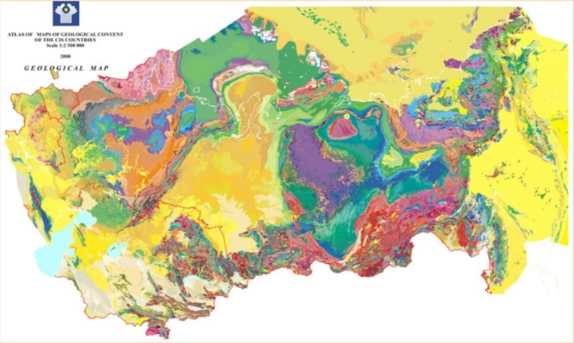
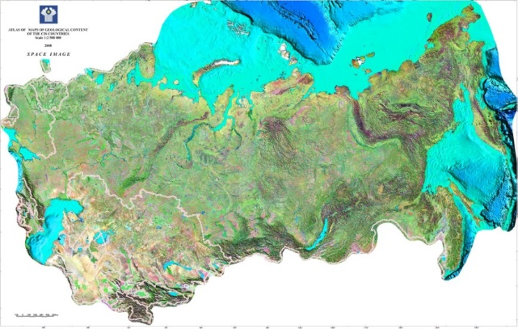
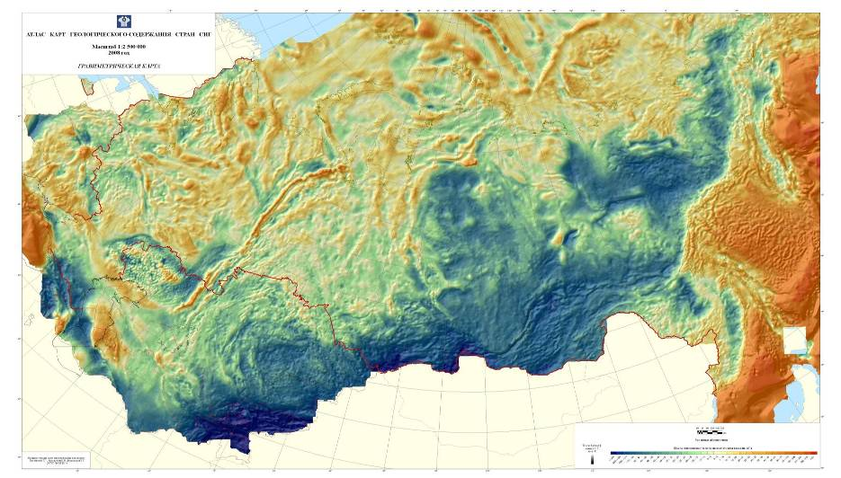
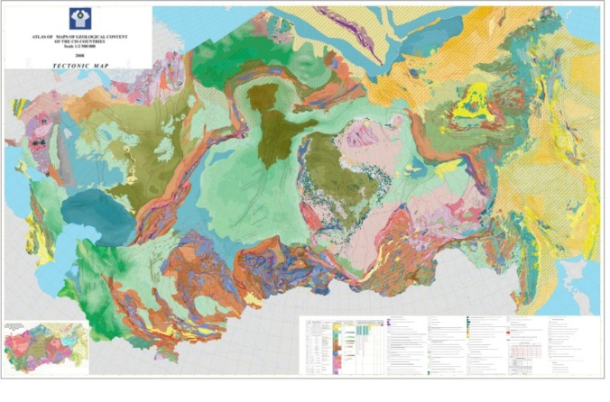
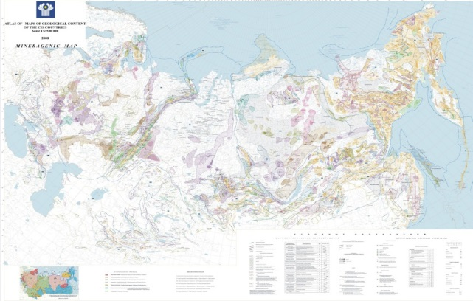
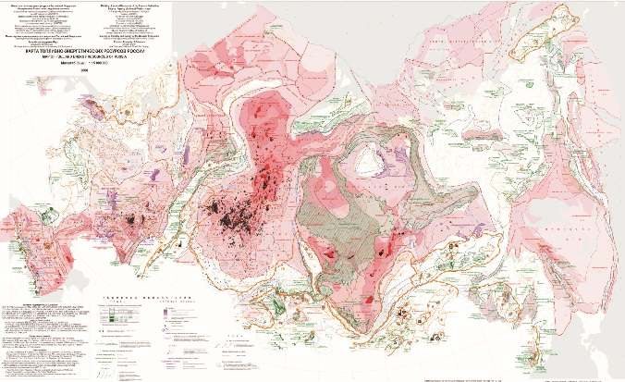
GIS Atlas of Geological Maps of Northern Eurasia
(Russia and other CIS countries)
This projects lies at the heart of
our cooperation and seeks to
create a modern GIS-project that
includes seven thematic “layers”
– maps at 1:2,500,000 scale:
geological, tectonic, forecast
mineragenic map for solid
mineral resources, forecast
mineragenic map for
hydrocarbons, maps of gravity
and magnetic fields and a map of
a space image of the CIScountries’
territory.

Slide 5
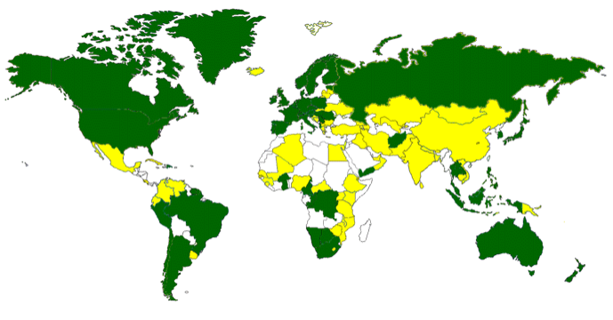


International project OneGeology
A project to make web-accessible the best available geological map data worldwide at a scale of about 1:1 million,
as a Geological Survey contribution to the International Year of Planet Earth 2008
Current status map. Currently 117 nations participating.
OneGeology involves many different stakeholders working together: the network of geological surveys around the world; the international umbrella organizations of the Commission for the Geological Map of the World (CGMW), International Union of Geological Sciences (IUGS).
The concept is a completely modern paradigm: it is planned as a distributed model – a dynamic set of geological map data served mostly on a national basis by individual geological surveys and other bodies (e.g. the polar and marine surveys and research bodies) to a web portal and as such will be frequently updated and improved by them and reflect the most up to date they possess.
Country participating in OneGeology
National data being served
The project is supported by international organizations: International Union of Geological Sciences (IUGS), International Steering Committee for Global Mapping (ICOGS), EuroGeoSurveys, Commission for the Geological Map of the World (CGMW), International Lithosphere Program, UNESCO, etc.

Slide 6
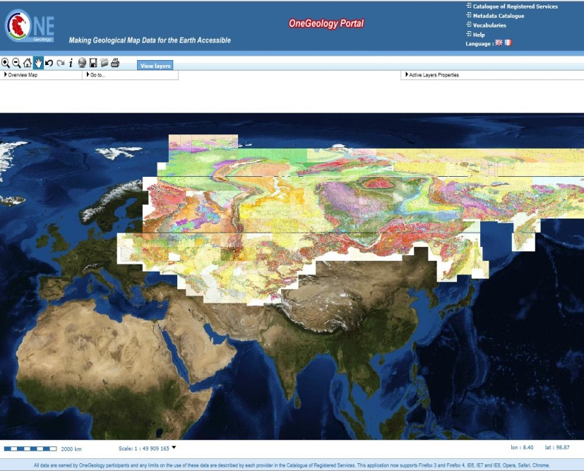

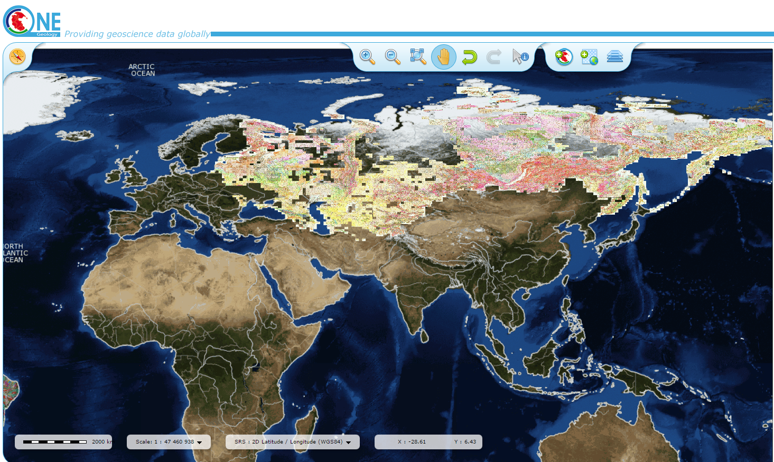
Geological map of Russia and CIS countries
at 1:1 000 000 and 1:200 000 scale on «OneGeology» web site

Slide 7
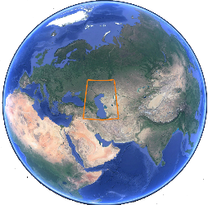
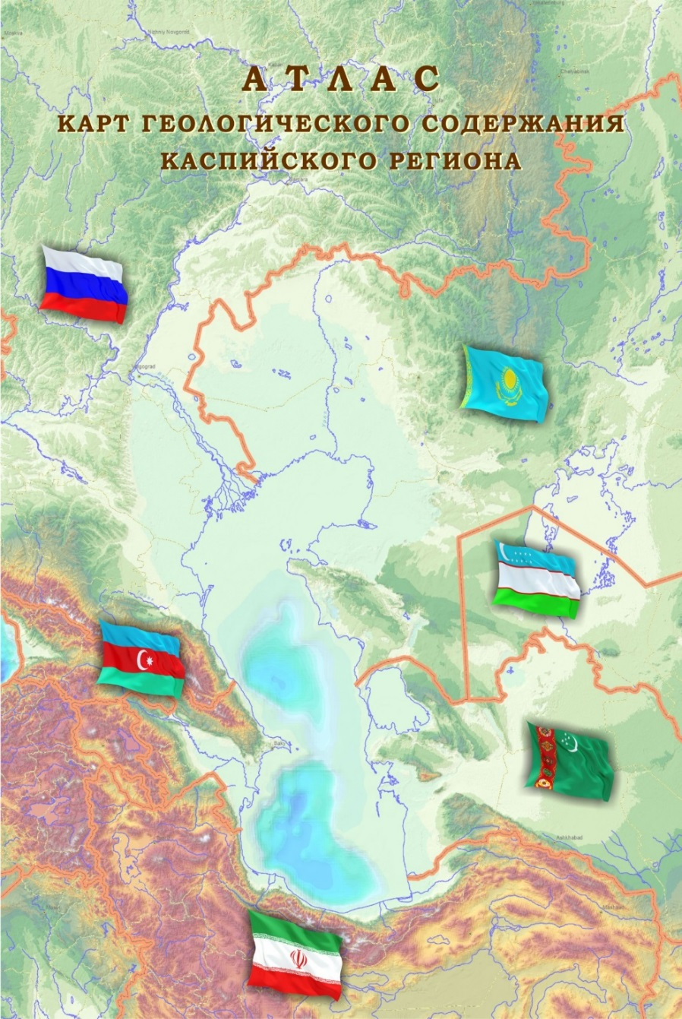
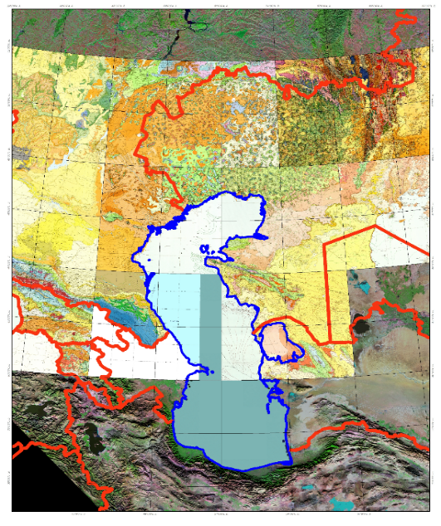
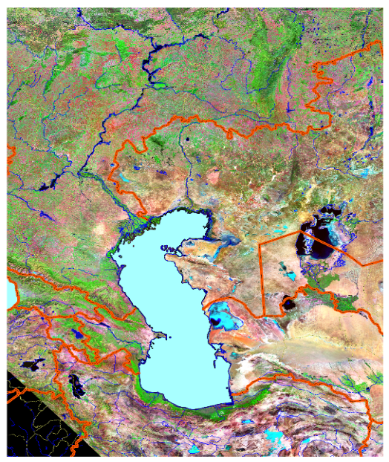
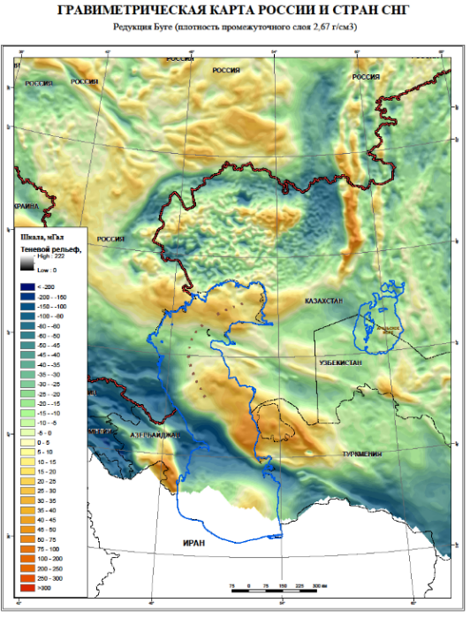
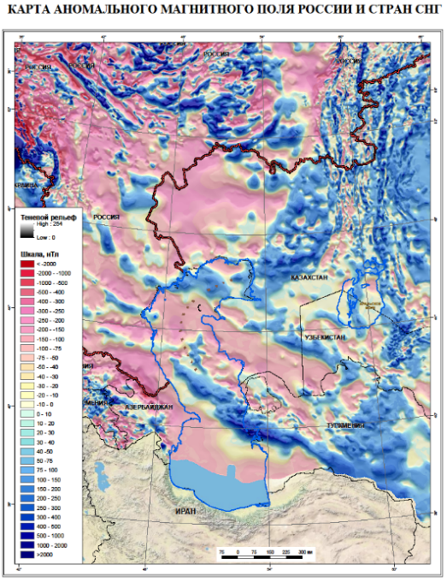
International project “GIS Atlas of geological maps of the Caspian region”
Geological data
Remote sensing data

Slide 8
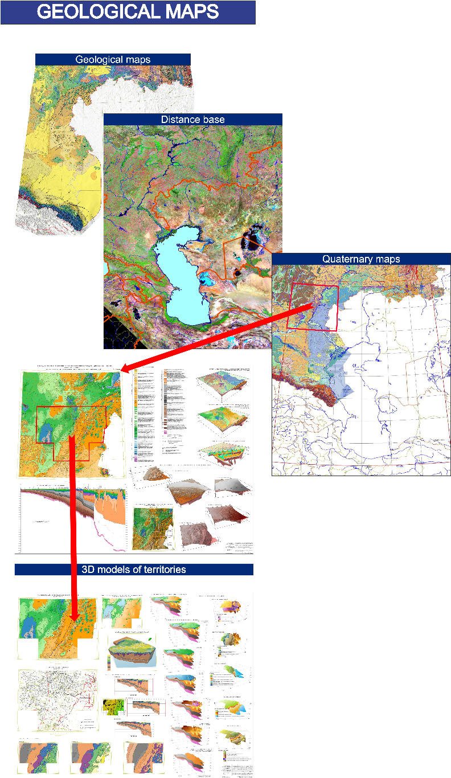
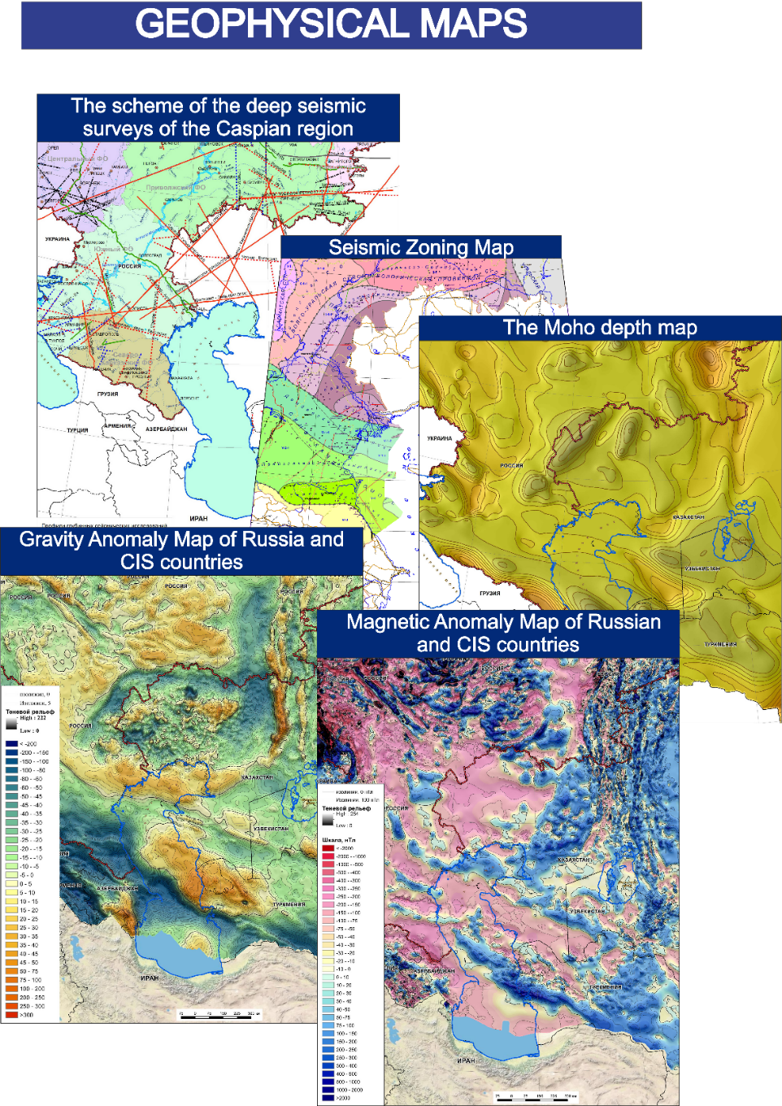
International project “GIS Atlas of geological maps of the Caspian region”
Geological and geophysical maps

Slide 9
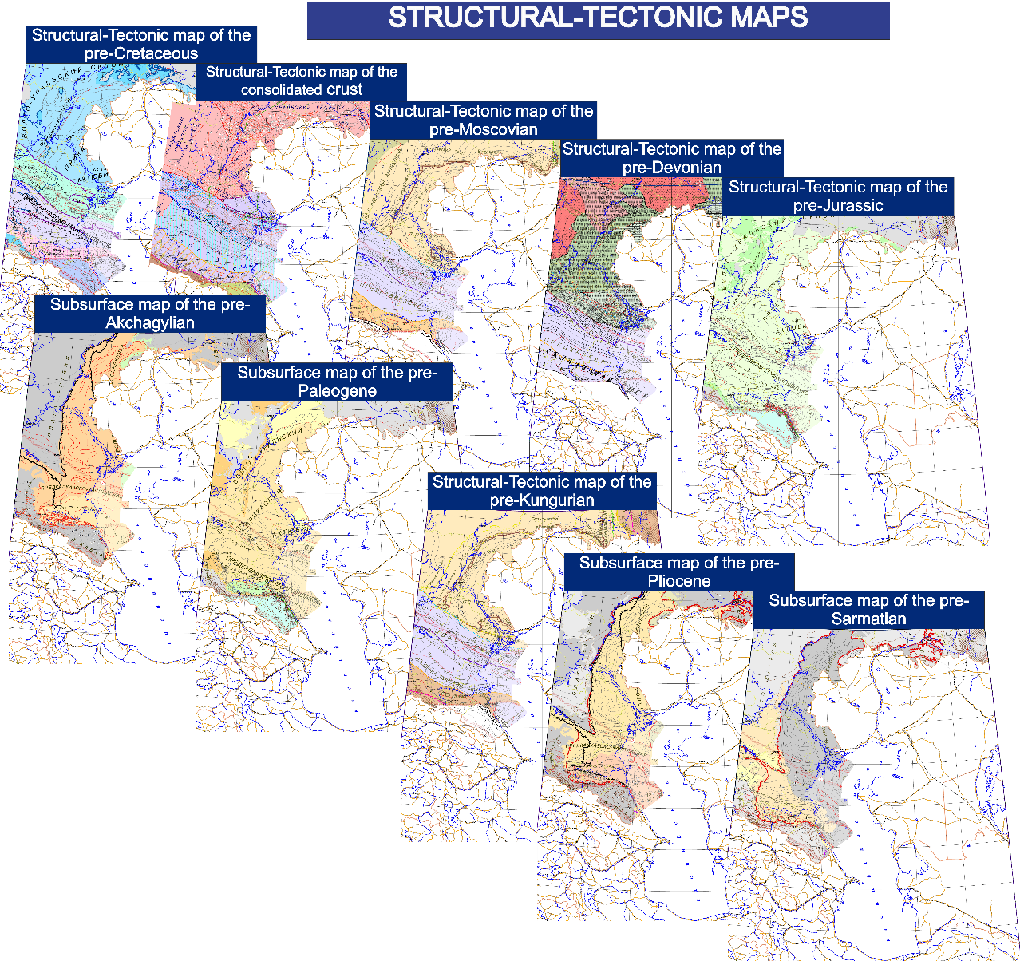
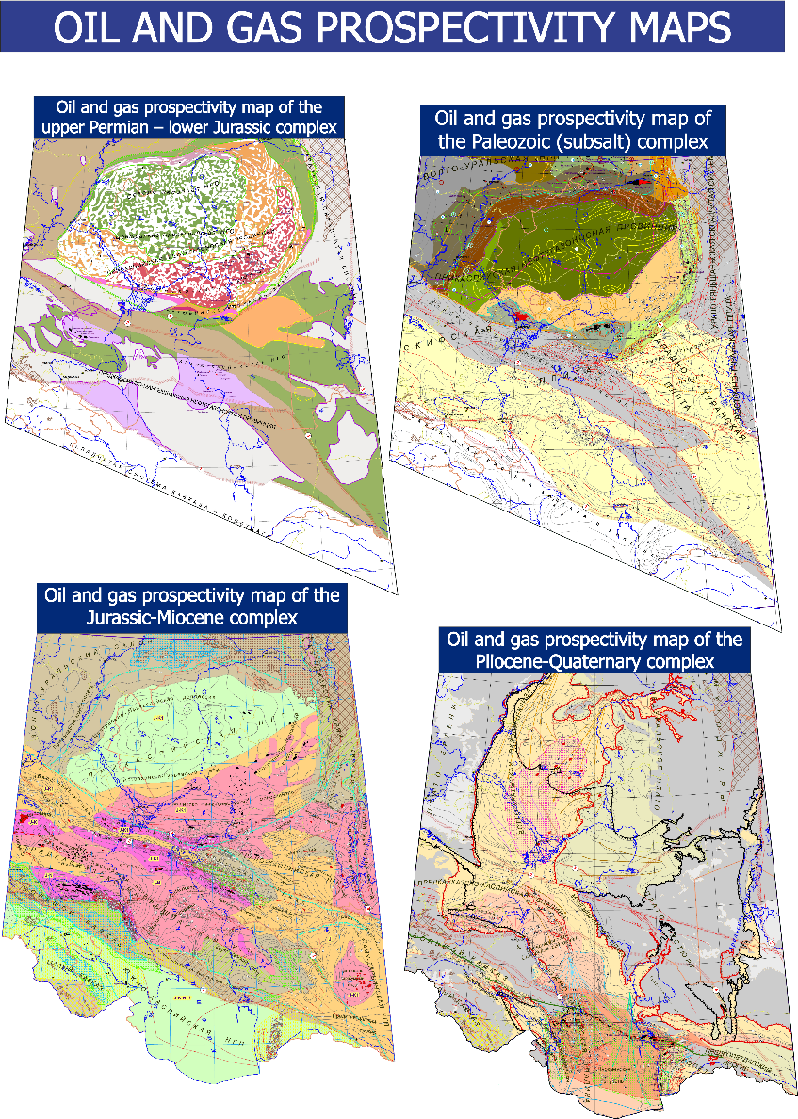
International project “GIS Atlas of geological maps of the Caspian region”
Structural –tectonic and oil and gas prospectivity maps

Slide 10

Atlas of Geological maps of Central-Northern-Eastern Asia and Adjacent Areas
Central-Northern-
Eastern Asia and
Adjacent Areas
Atlas of Central Asia and
Adjacent Areas at 1:2.5M
Central Asia and
Adjacent Areas
Atlas of Central-Northern-
Eastern Asia and Adjacent
Areas at 1:2.5M

Slide 11
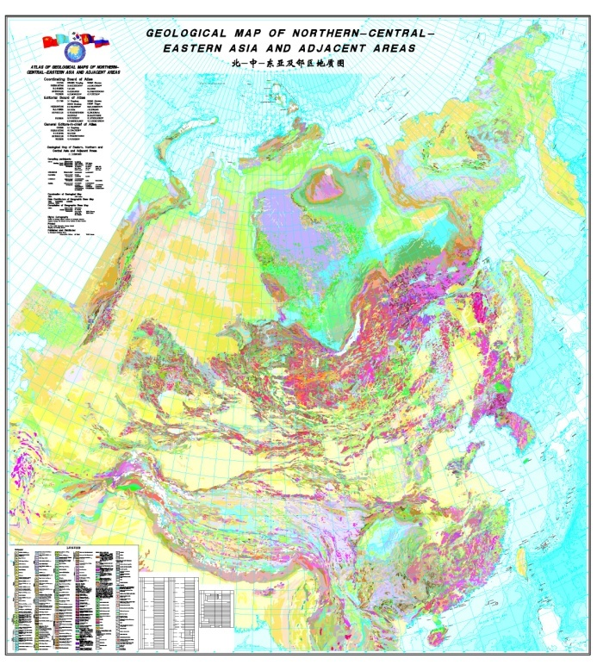
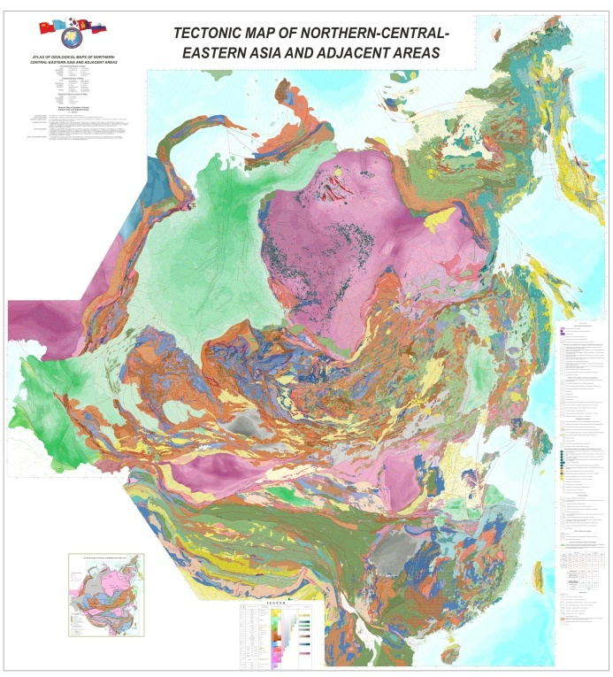
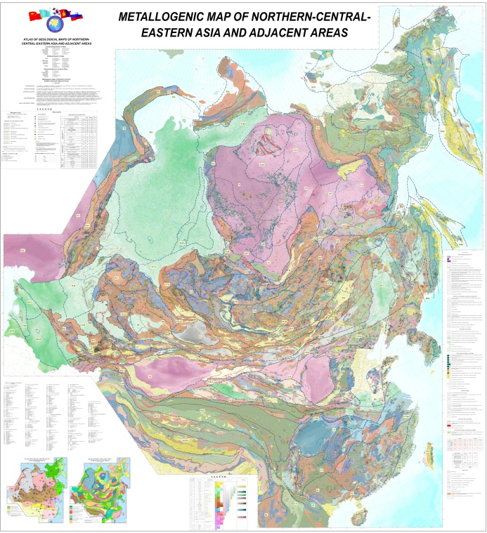
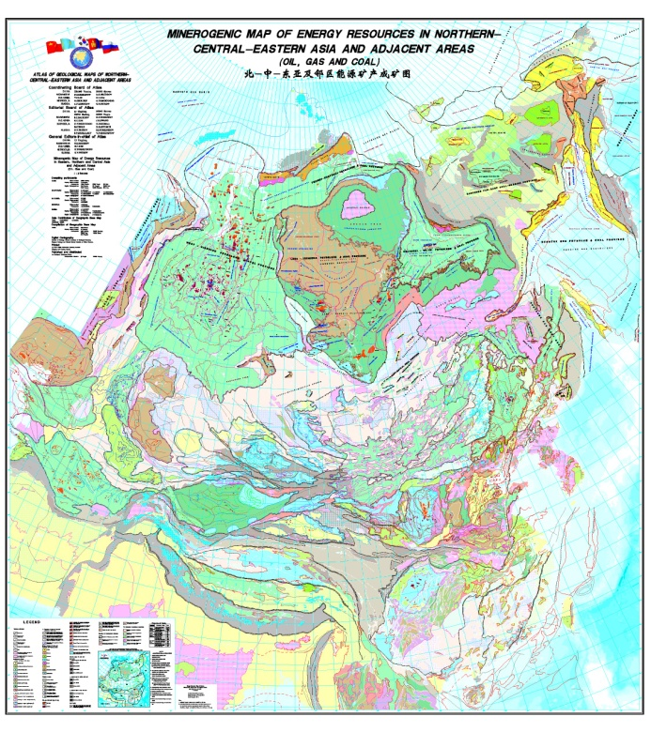
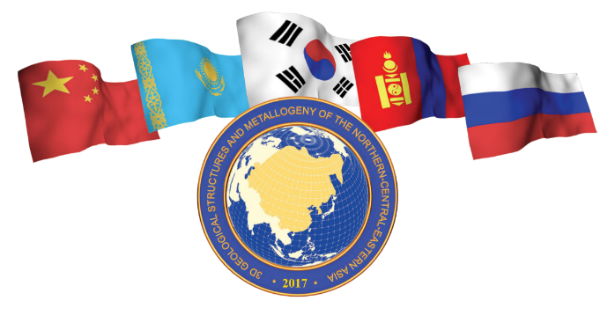
Atlas of Geological Maps of Northern-Central-Eastern Asia
at scale 1:2.5M
Geological Map
Tectonic Map
Metallogenic Map
Map of Energy Resources

Slide 12
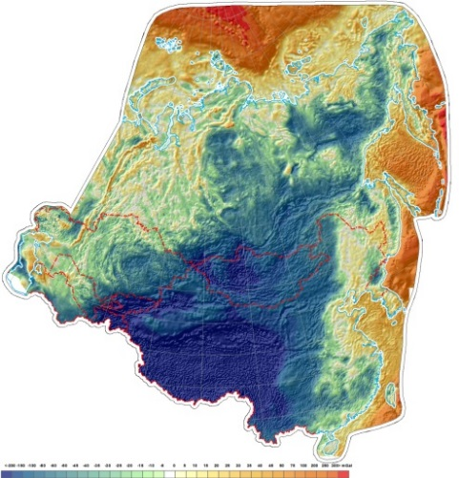
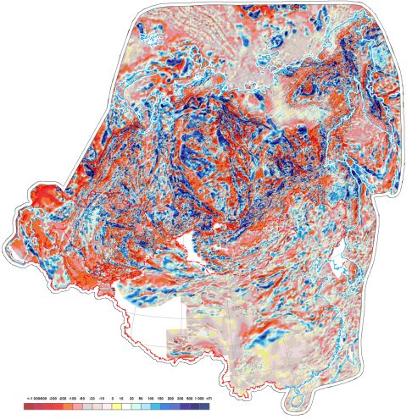
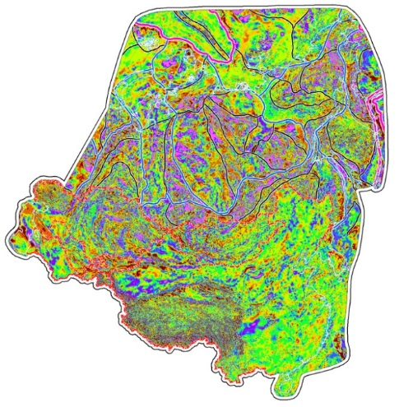
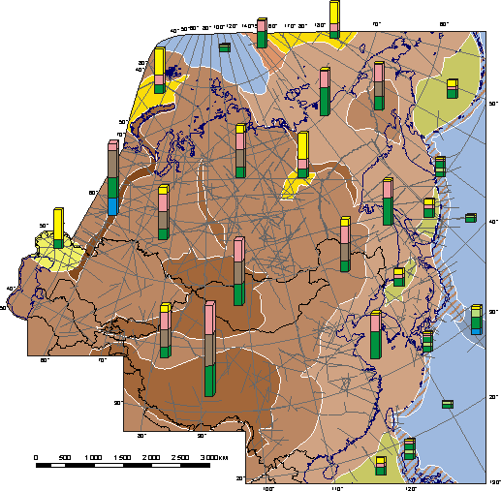
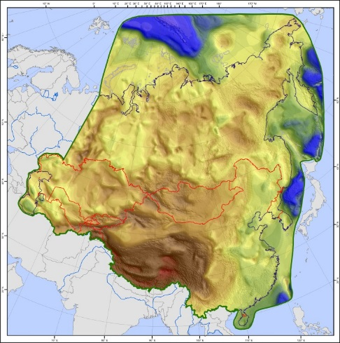
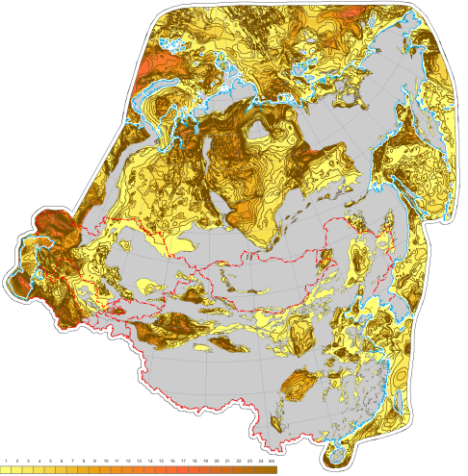
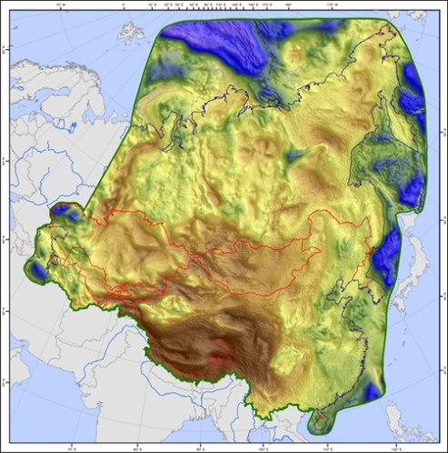
Atlas of Geological Maps of Northern-Central-Eastern Asia
at scale 1:2.5M
AGF
AMF
Map of potential fields zoning
Map of crustal types
Map of Earth’s
crust thickness
Map of sediment thickness
Map of consolidated
crust thickness

Slide 13
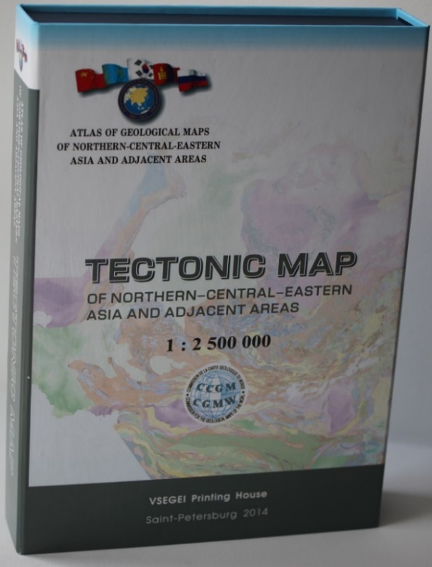
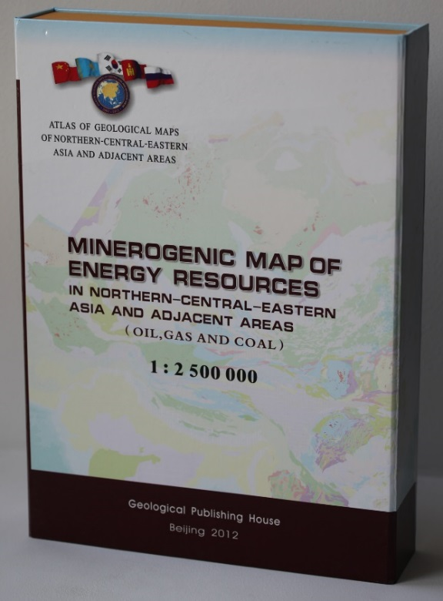
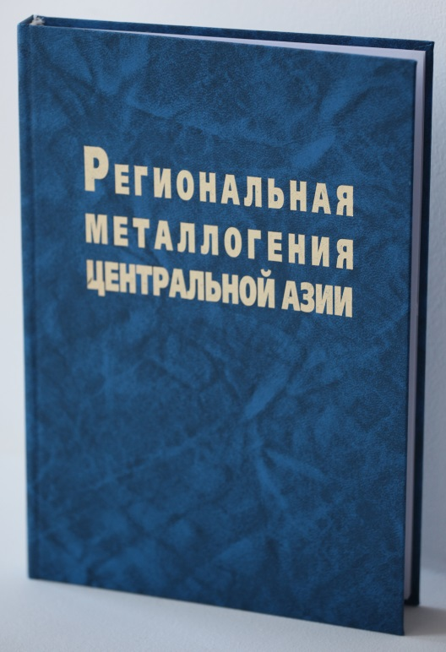
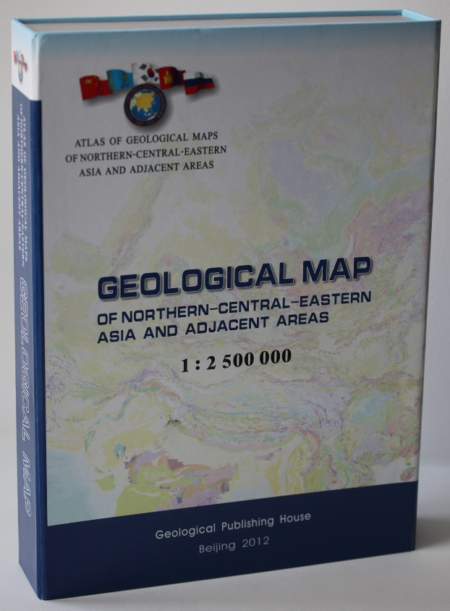
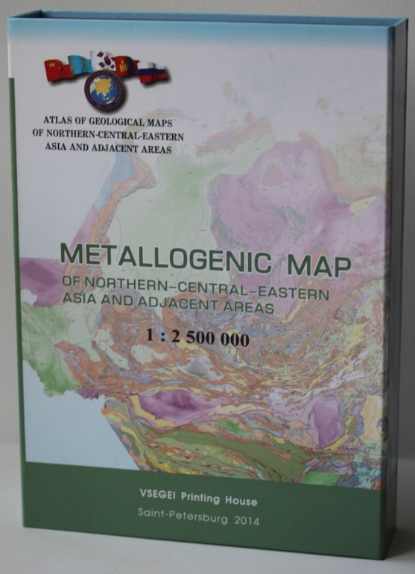
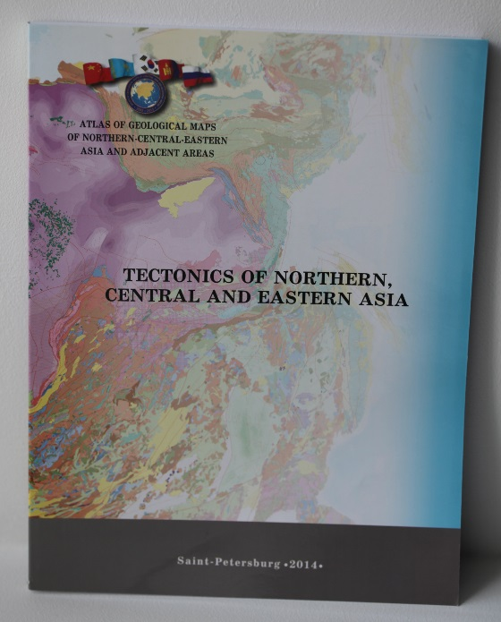
Atlas of Geological Maps of Northern-Central-Eastern Asia
at scale 1:2.5M. EXPLANATORY NOTES

Slide 14
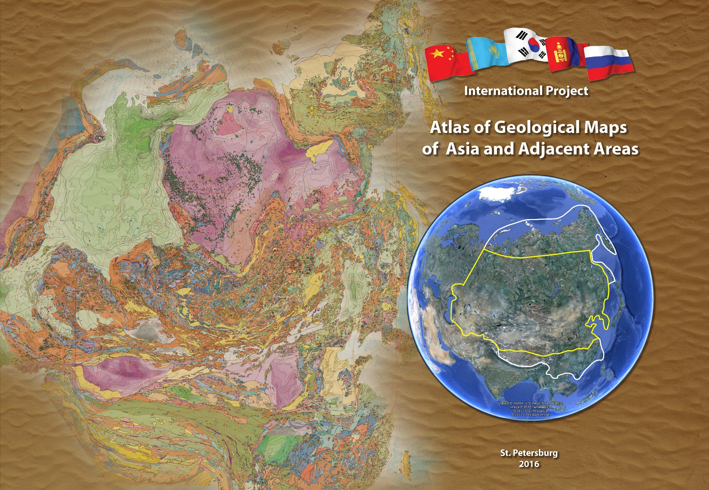
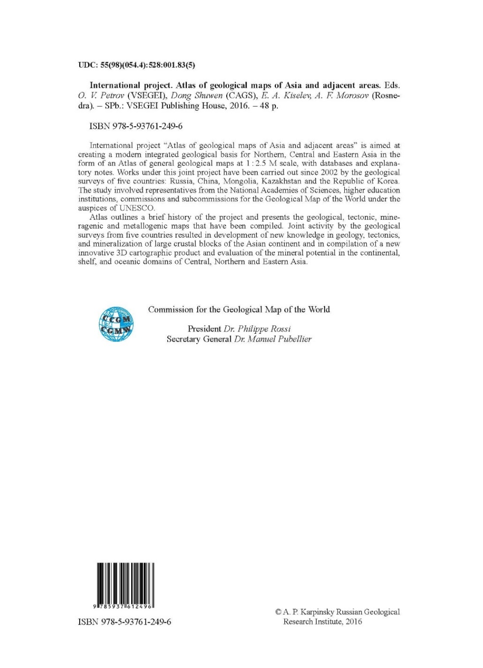
Atlas of Geological Maps of Northern-Central-Eastern Asia
at scale 1:2.5M

Slide 15






15th working meeting of representatives of cooperating countries in
Shenyang in October 2017 hosted by the Institute of Geology
Chinese Academy of Geological Sciences
The following three basic topics of the project development were proposed by the Russian side for discussion:
Deep geophysical investigations
Geochemical investigations
Metallogeny and mineral potential assessment

Slide 16


Geochronological Atlas of the main geological units of Russia
The Atlas includes 6,100 datings of rock samples and minerals obtained by the isotopic U-Pb, Pb-Pb, Sm-Nd, Rb-Sr, Re-Os, K-Ar, Ar-Ar methods at the VSEGEI Institute, laboratories of the Russian Academy of Sciences and some foreign analytical centers
VSEGEI created "Geochronological Atlas of the main geological units of Russia" - GIS project on the basis of the 1: 2.5 Ma Geological Map of Russia (in Russian Language). It have been updated annually

Slide 17

FORECAST METALLOGENIC MAP of Russia,
1:2.5M scale

Slide 18










20 geological excursions were organized including those to Kolyma, Ural,
Southern China, Northern and Central Mongolia, Norilsk area, Kamchatka,
Tibet, lake Baikal and south-eastern Chinese provinces

Slide 19





International Geological Map of Asia – IGMA 5000

Slide 20

Position of the Published Tectonic Maps
on the International Geological Map of Asia – IGMA-5000
Tectonic Map of Arctic 1:5M (TeMAr)
International Tectonic Map of Europe 1:5M
Tectonic Map of Northern-Central-Eastern
Asia and Adjacent Areas 1:2,5M
Tectonic Map of Central Asia and
Adjacent Areas 1:2,5M

Slide 21















Atlas of Geological Maps of the Circumpolar Arctic
The project was initiated in 2003.
It is being implemented by the geological surveys of the Arctic states: Russia, Canada, the USA, Norway, Denmark, Sweden, and Germany with active support from the UNESCO Commission for the Geological Map of the World (CGMW).
Working meetings dedicated to the implementation of the project took place in 2004-2017 in Calgary, Anchorage, Tromsø, Trondheim, Paris, and Saint Petersburg

Slide 22
Atlas of Geological Maps of the Circumpolar Arctic.
Geological map.
Geological Survey of Canada,
2008-2010

Slide 23


Atlas of Geological Maps of the Circumpolar Arctic.
Magnetic and Gravity Anomaly Maps of the Arctic
Geological Survey of Norway, 2008

Slide 24


Atlas of Geological Maps of the Circumpolar Arctic.
Metal and Mineral Deposits Map of the Arctic
Geological Survey of Norway, 2016

Slide 25




Atlas of Geological Maps of the Circumpolar Arctic

Slide 26


Atlas of Geological Maps of the Circumpolar Arctic.
Tectonic Map.

Slide 27


Atlas of Geological Maps of the Circumpolar Arctic.
Tectonic Map. Improvements of the map design
Cratons and foldbelts
Sedimentary basins
and platform covers
Oceanic realms
Updated color palette
in TeMAr legend

Slide 28


Atlas of Geological Maps of the Circumpolar Arctic.
Thickness of the Earth crust
Seismic data
- 300 profiles
- 140 000 km total length

Slide 29

Atlas of Geological Maps of the Circumpolar Arctic.
Map of crustal types in the Arctic
Oceanic crust
Normal oceanic crust of
spreading basins
Thickened crust of
oceanic plateaus and hot spots
Reduced crust of
deep basins
Continental crust
Thinned crust of
submarine rifts and troughs
Thinned crust of
submarine ridges and rises
Slightly thinned crust of
shelves
Normal continental crust of
platforms and folded systems
Thick crust of
shields and collisional areas

Slide 30

Atlas of Geological Maps of the Circumpolar Arctic.
Thickness of the Arctic sedimentary cover

Slide 31

Atlas of Geological Maps of the Circumpolar Arctic.
Structural-Tectonic Zoning of the Arctic

Slide 32







Atlas of Geological Maps of the Circumpolar Arctic.
Set of Maps on Deep Structure of the Circumpolar Arctic
Map of sediment thickness
AMF
hs
Map of Earth’s
crust thickness
Hм
Map of consolidated
crust thickness
hcc
Map of potential fields zoning
Map of crustal types
AGF

Slide 33

New data from the deep sea, shelf and mainland of the Arctic
1 – Novaya Zemlya
2 – Lomonosov Ridge
3 – Severnaya Zemlya, Shmidt Island
4 – Geophysists Spur
5 – Alpha-Mendeleev Rise
6 – Siberian Craton (north)
7 – New Siberian Islands
8 – Wrangell Island
9 –Kolyma Loop and Chukchi Foldbelt

Slide 34

MAP SHOWING THE SEDIMENTARY SUCCESSIONS OF THE ARCTIC REGION
(58°-64° to 90° N) THAT MAY BE PROSPECTIVE FOR HYDROCARBONS
By Arthur Grantz, Robert A. Scott, Sergey S. Drachev and Thomas E. Moore, 2010

Slide 35


Assessment of Undiscovered Oil and Gas in the Arctic
Donald L. Gautier at all, 2009

Slide 36



Atlas of Geological Maps of the Circumpolar Arctic.
The map of Quaternary Deposits.

Slide 37









Tectonostratigraphic Atlases
Tectonostratigraphic Atlas of the North-East Atlantic Region
2014
Tectonostratigraphic Atlas of the Arctic
(eastern Russia and adjacent areas)
2017
The Atlas of Geological History of the Barents Sea
2009

Slide 38










Map of crustal types of Northern, Central and Eastern Asia
Oceanic crust
Deep basins
Oceanic plateaus and hot spots
Transition zone crust
Subduction zone
Backarc basins
Continental crust
Super-deep basins
Deep basins (paleorifts)
Submarine ridges
Marine orogens and continental shelfs
Cratons, mid-orogen massifs, intra-continental basins
Altai-Sayan type folded area
Himalaya type collision orogen
Intra-continental folded-thrust zones

Slide 39



Compilation of modern geological-geophysical
models of Earth crust and upper mantle
Model of deep Earth crust structure and upper mantle based on profile 2-ДВ-М fragment

Slide 40

Paleo-Asia Ocean on the International Geological Map of Asia
IGMA-5000 1:5M scale

Slide 41







International scientific cooperation

Slide 42









Scientific Conference at VSEGEI St. Petersburg, Friday 27 October 2017
«UK-Russia Geoscience Cooperation: past – present – future»

Slide 43




Thank you for the attention!

