Slide 1
State and development prospects of the international project OneGeology in Eurasia
Marko Komac¹, Oleg Petrov², Grigory Brekhov²
¹OneGeology, ²VSEGEI

Slide 2
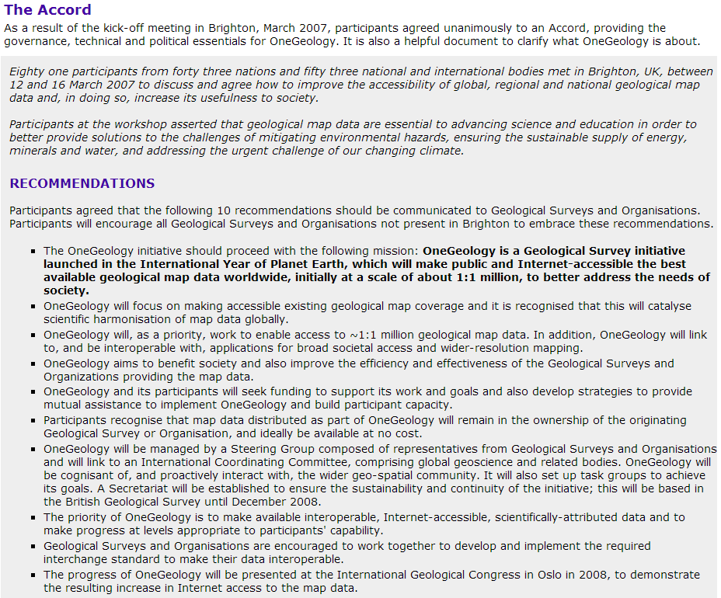
Brighton Accord
81 participants from 43 nations met in Brighton, UK, 12-16 March 2007 to discuss and agree how to improve the accessibility of global, regional and national geological map data and, in doing so, increase its usefulness to society.
Participants agreed unanimously to an Accord, providing the governance, technical and political essentials for OneGeology.

Slide 3
Background
Initiated in 2007 by Geological Survey Organisations from around the globe: national and state/provincial/territorial
Voluntary initiative / no financial obligations for participants
It worked perfectly for several years

Slide 4
Achievements
• OneGeology has been a profound success for the geosciences
It has more than delivered on all of its original goals
It has raised the level of geological survey information delivery across the world
It has spawned many projects and initiatives across the world, some very large (i.e. OneGeology-Europe OneGeology-CCOP)
It has made geology a global leader in the field of SDI & an exemplar of a scientific community working together

Slide 5
Background
Initiated in 2007 by GSO from around the globe: national and state/provincial/territorial
Voluntary initiative / no financial obligations for participants (as BGS & BRGM funded 1G substantially from their budgets)
It worked perfectly for several years, yet it was not sustainable in a long-term
Consequentially, a feasible and sustainable solution was needed!

Slide 6
OneGeology Consortium
In Oct 2013 OneGeology Consortium was formed with:
a clear governance structure,
formally defined rules,
membership commitments, and
ambitious objectives.

Slide 7
OneGeology Consortium
Currently there are 117 Members, 16 Principal Members (and growing!!!)
Two supporting intl. Organisations (IUGS, AAGS)
Also formally supported by UNESCO, ICSU, GEO
Officially recognised as being the global model for open geo-data sharing

Slide 8
OneGeology Governance
OneGeology Board
Chair of the Board
Board members (Africa, Asia, N America, S America, Eurasia, Europe, Oceania)
Science User Group
External funding sources
Managing Director
Operational groups
Inc. 1). Technical Implementation Group 2). Technical Advisory Group
Finance & Secretariat [BGS]
Operations [BRGM]
Consortium Members
Principal Members with Voting rights
Members (who have agreed to the Brighton Accord)
Corporate Members
Associate Members - Non-Geological Survey Organisations

Slide 9
Objectives
To be the provider of geoscience data globally
To ensure an exchange of know-how and skills so all can participate
Use of the global profile of OneGeology to increase awareness of the geosciences and their relevance

Slide 10
Obligations and benefits of being a member of OneGeology Consortium
Membership fee:
Members 2500/5000€; subject to membership type
Corporate Members – subject to negotiation)
Advisory function in strategic matters
Contribution & access to the expertise and experience of international geoscientists and informatics experts

Slide 11
OneGeology is an operational system – it is not an experiment
Internet portal and catalogue allow discover, view, zoom, pan, interrogate, download…. and transfer to Google, or wherever
138 organisations from 117 nations now participating
Many data services: over 250 national and state geological set of maps
Help desk and extensive easy to use documentation
Users in research, education and commerce
25 million visitors globally when launched
Awarded by Geospatial World Forum in 2012 for the Excellence in Geospatial Standards Implementation

Slide 12
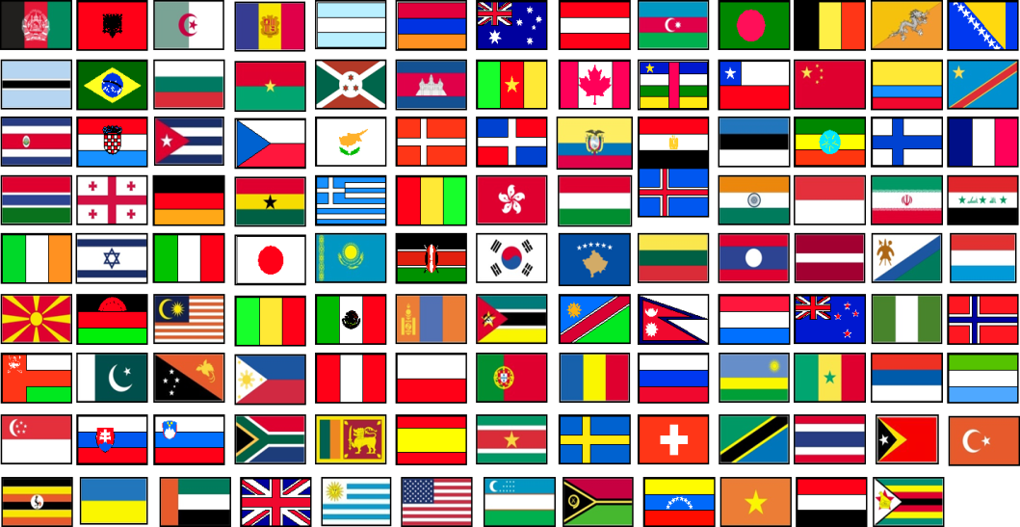
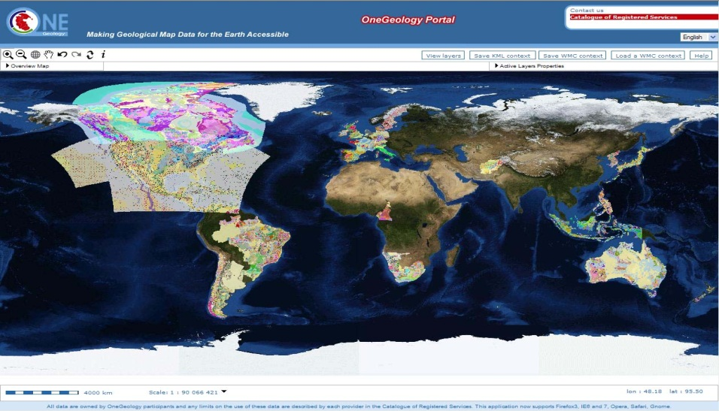
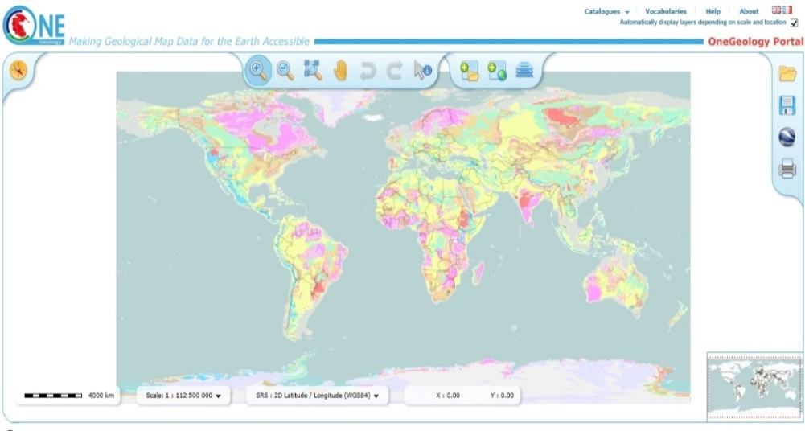
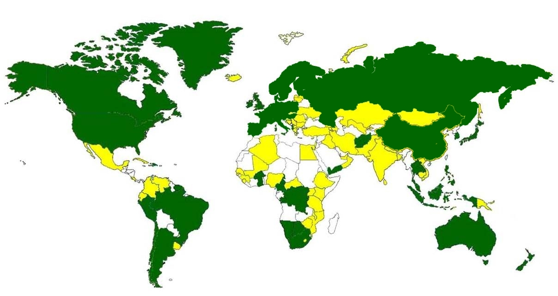
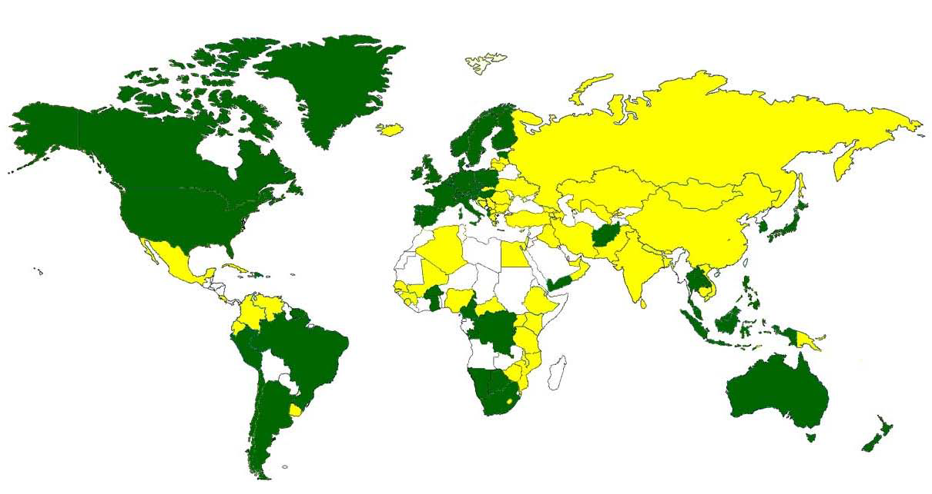
To be the provider of geoscience data globally

Slide 13
Why is OneGeology working? (1)
Short simple mission and vision: 3 simple objectives
Uncomplicated plan: start simple and build up
Inclusivity: all geoscience institutions welcome – different nations have different abilities to participate
Minimal intrusion into local systems

Slide 14
Why is OneGeology working? (2)
1G PORTAL
Server2
Server3
Server4
Server1
ServerX
It‘s a distributed data system – every data provider stays in control of its own data – on their servers!!
GEOSCIENCE DATA
GEOSCIENCE DATA
GEOSCIENCE DATA
GEOSCIENCE DATA
GEOSCIENCE DATA

Slide 15
Data providers need/want/have to share their geoscience data
OneGeology makes it happen
End-users need/want the reliable access to the geoscience data (in one place and updated in the best possible way)

Slide 16
DEFINITION OF SEVEN ONEGEOLOGY CONTINENTAL REGIONS:
Africa
Asia
Eurasia
Europe
North America
South America
Oceania

Slide 17
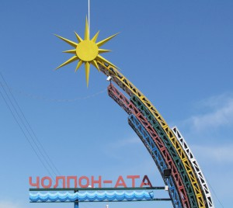
Decision of the XV Session of the CIS Intergovernmental Council
On September 16, 2011 in Cholpon-Ata (Kyrgyz Republic), at the XV Session of the Intergovernmental Council of the Commonwealth of Independent States (CIS), it was decided to prepare a set of geological maps at 1:1 000 000 scale for the territory of the CIS countries for integration into the international project OneGeology.

Slide 18
Geological map for the CIS countries territory at 1:1,000,000 scale in OneGeology international project
Oleg PETROV, Grigory BREKHOV, Andrey MOROZOV, Eugenia CHEREMISSINA, Victor SNEZHKO, Nikolai BEREZUK, Eugene KOVALENKO, Egor YON
Federal Agency of Mineral Resources of Russian Federation
Russian Geological Research Institute (VSEGEI)
Scientific Research Institute of geological, geophysical
and geochemical systems (VNIIGeosystem)
phone: +7 (812) 321-5706, fax: +7 (812) 321-3023; e-mail: vsegei@vsegei.ru, http://www.vsegei.ru

Slide 19
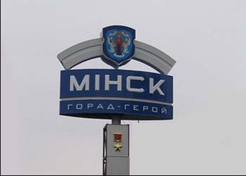
Decision of the XVII Session of the CIS Intergovernmental Council
On November 13-15, 2013 in Minsk (Belarus Republic), at the XVII Session of the Intergovernmental Council of the Commonwealth of Independent States (CIS), it was decided to prepare a set of geological maps at 1:200 000 scale for the territory of the CIS countries for integration into the international project OneGeology.

Slide 20
Preparation for integration into the international project OneGeology
Geological maps of the CIS scale 1:200,000
Atlas GIS geological maps of the CIS scale 1:2,500,000
Geological maps Circumpolar Arctic and Eurasia scale 1:5,000,000

Slide 21
Thank you for your attention!

Slide 22
Thank you for your @10tion!
Thanks to all the OneGeology members for their input (financial and in-kind) and to supporting organisations!
We encourage you to join OneGeology and to visit us at www.onegeology.org/ and portal.onegeology.org
¸onegeology@bgs.ac.uk; marko.komac@geo-zs.si

