Slide 1
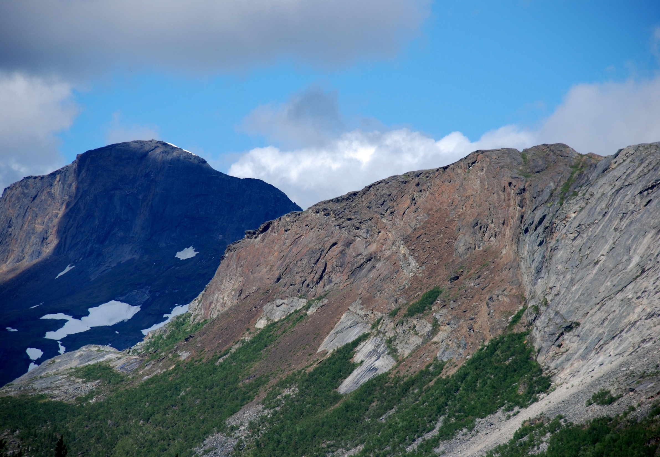
New survey program for mineral resources in Norway
Jan Cramer
Geological Survey of Norway

Slide 2
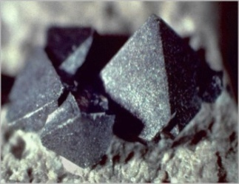
Mineral resources
Norwegian Government actions and policy
2010 – New Mining Act came into force on January 1st , 2010
Easier applications, larger areas, lower fees for the first years
2010 – Reorganised Directorate of Mining
2011 – Additional funding to NGU → MINN
Increased coverage of regional geophysical data and ground follow-up in Northern Norway (€13.5 million for 2011-2014)
2012 – Funding of new professorships at the Norwegian University of Science and Technology and at the University of Tromsø
2013 – Additional funding to NGU → MINS
Increased coverage of regional geophysical data and ground follow-up in Southern Norway (€ 1,35 million start-up for 2013)
2013 – National Mineral Strategy
A set of coordinated policies for the mineral industry by the Ministry of Trade and Industry

Slide 3
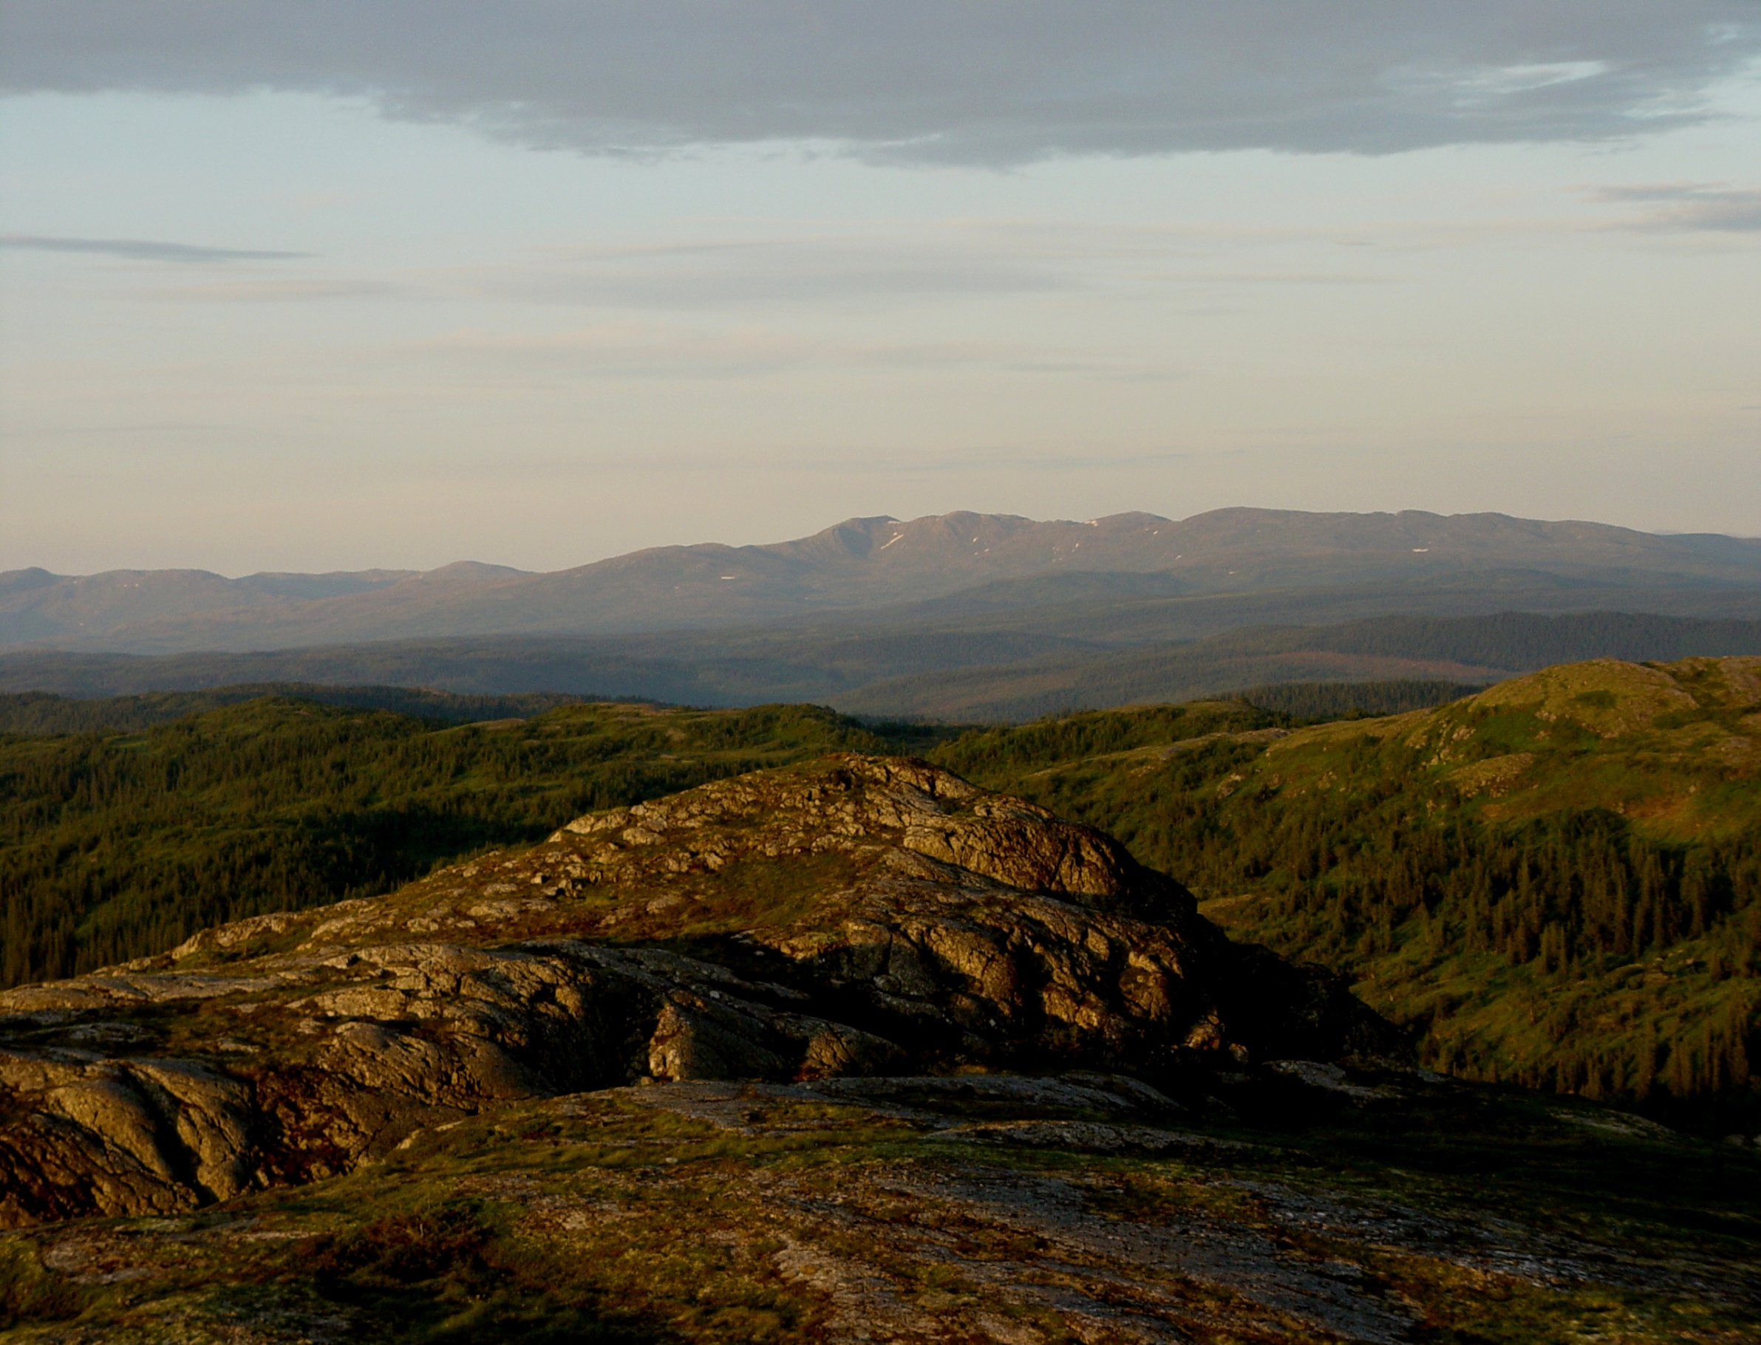
NGU activities in MINN & MINS programs
Airborne geophysical surveys
Geochemical surveys
Focussed geological mapping
Deep seismic surveys
Increased research and development

Slide 4
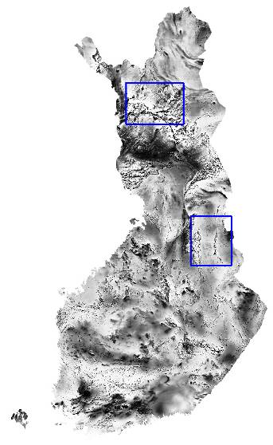
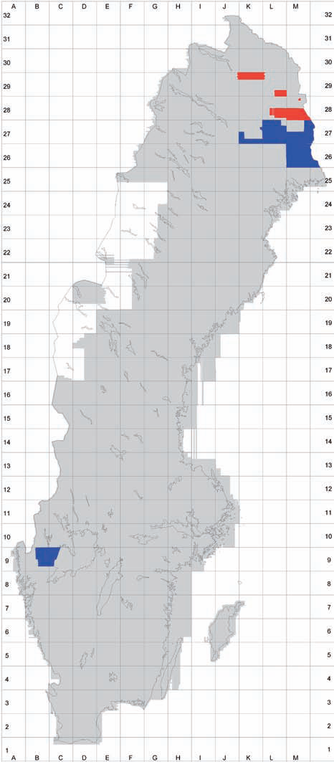
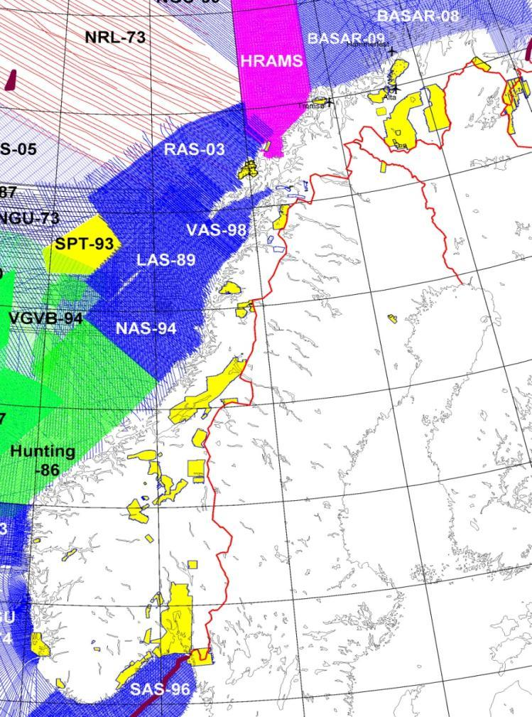
Coverage with good quality magnetic data
Status 2010
Norge 14%
Sverige 90%
Finland 100%
While Norway focussed off-shore on the continental shelf,
Finland and Sweden focussed on terrestrial geophysics.

Slide 5
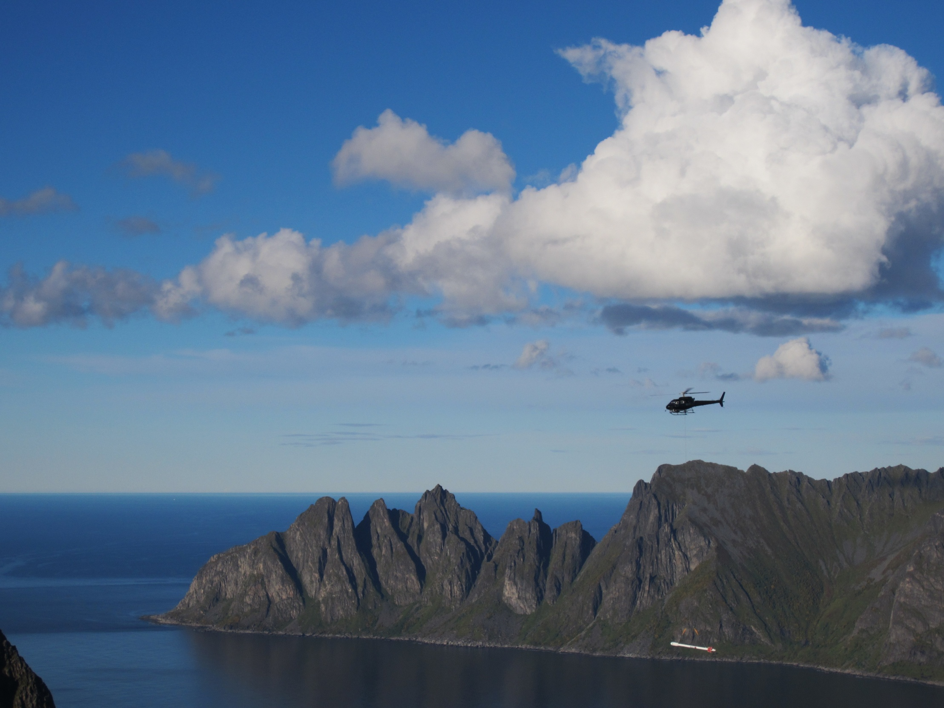
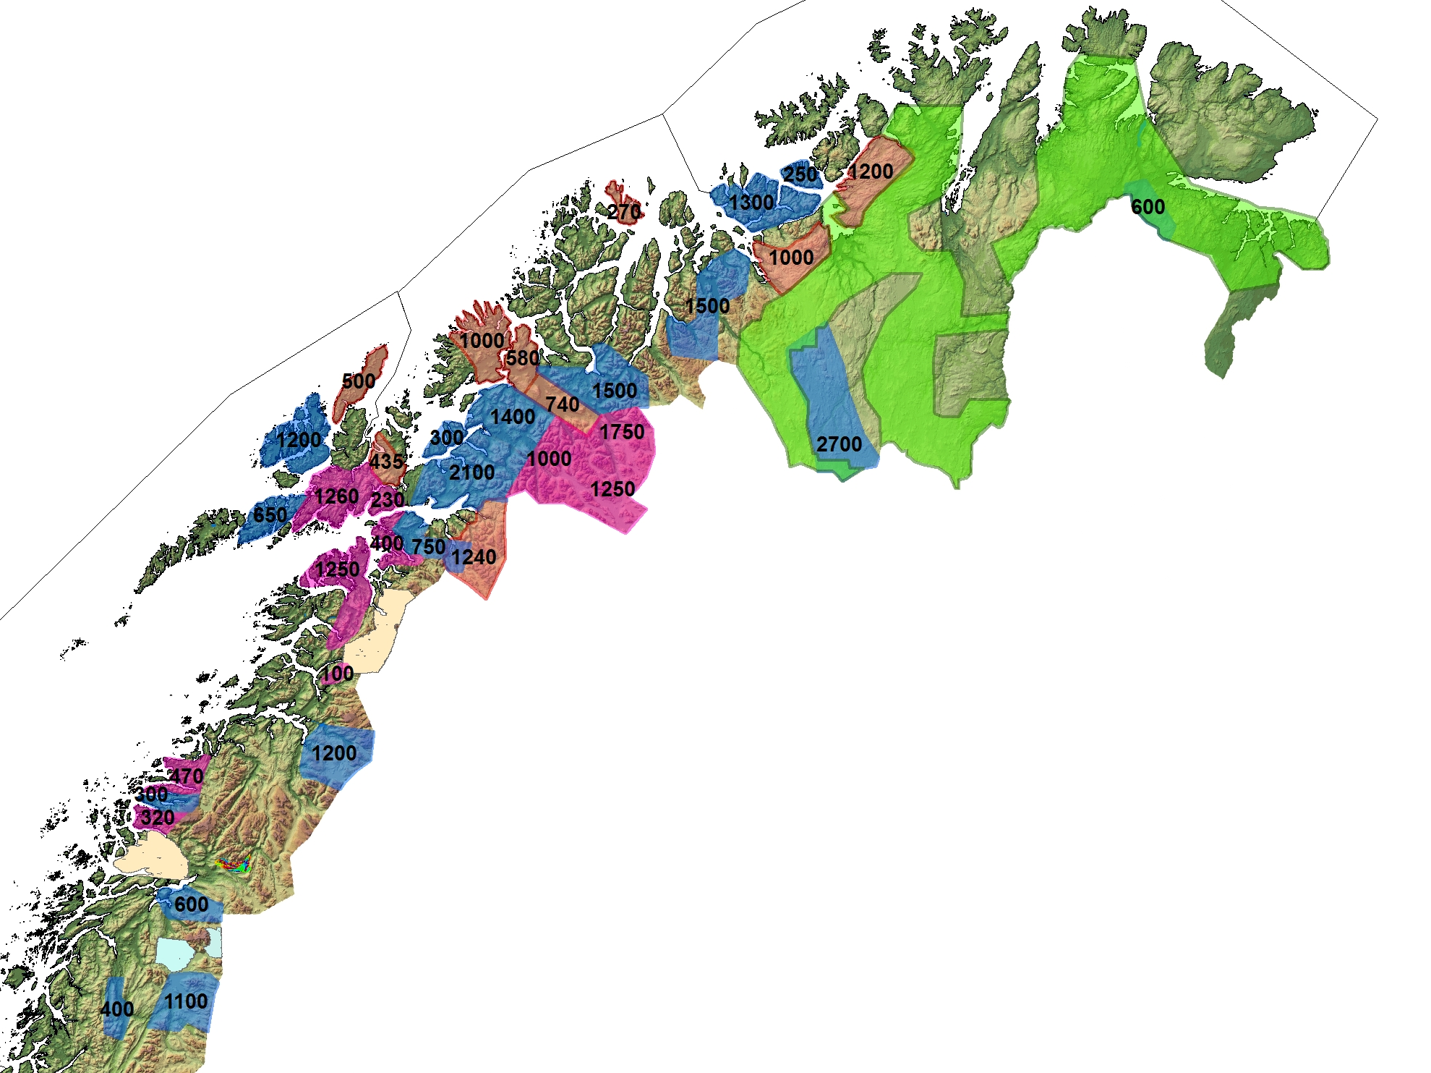
Surveys 2013- 2014:
Helicopter : 10.000 km²
(mag, rad, EM)
Helicopter : 8.000 km²
(mag, rad)

Slide 6
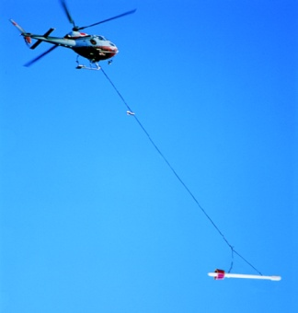
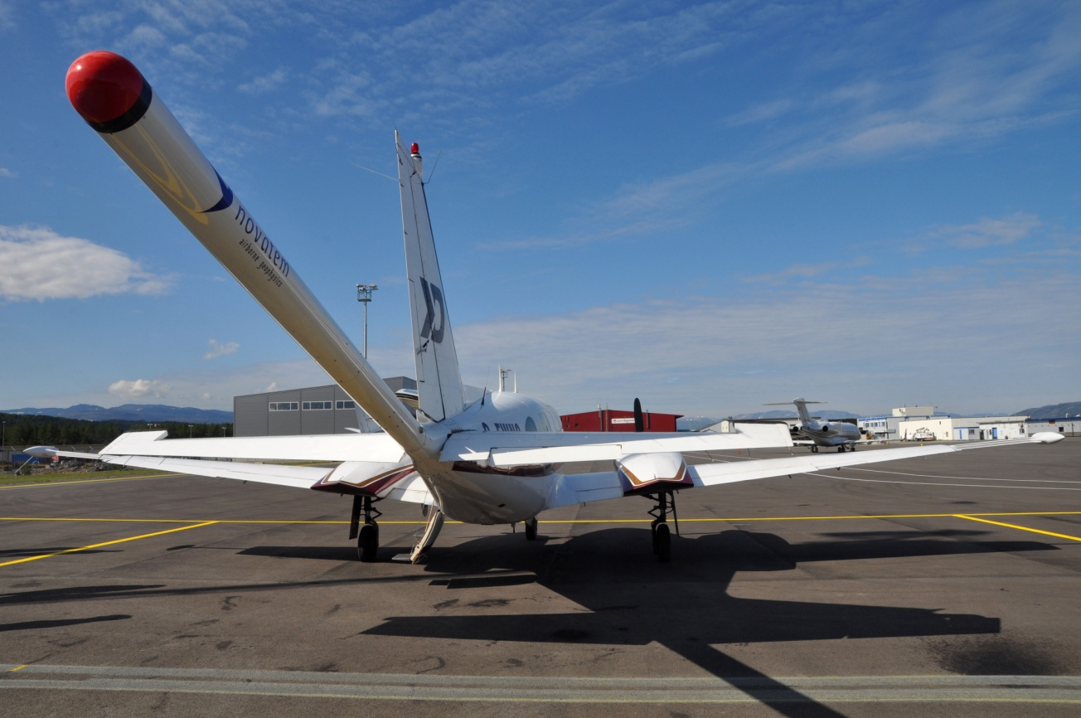
MINN Surveys
Airborne Geophysics
2011-14
Green Plane 2011-12
Red Helicopter 2011-12
Blue Helicopter 2013-14
In 2015: total coverage will be ∼70%
in northern Norway incl. earlier surveys

Slide 7
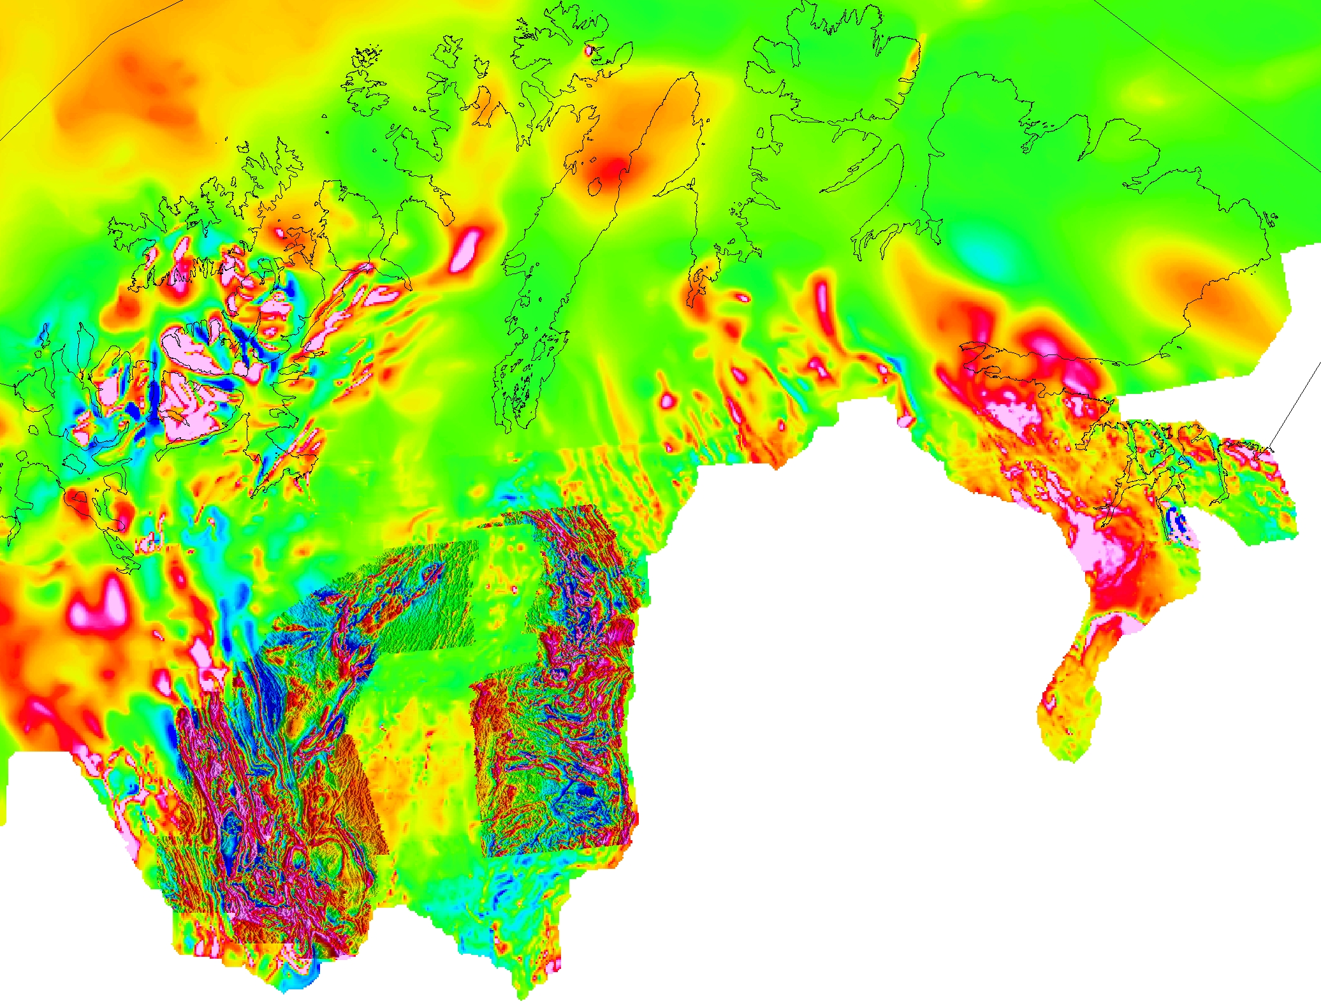
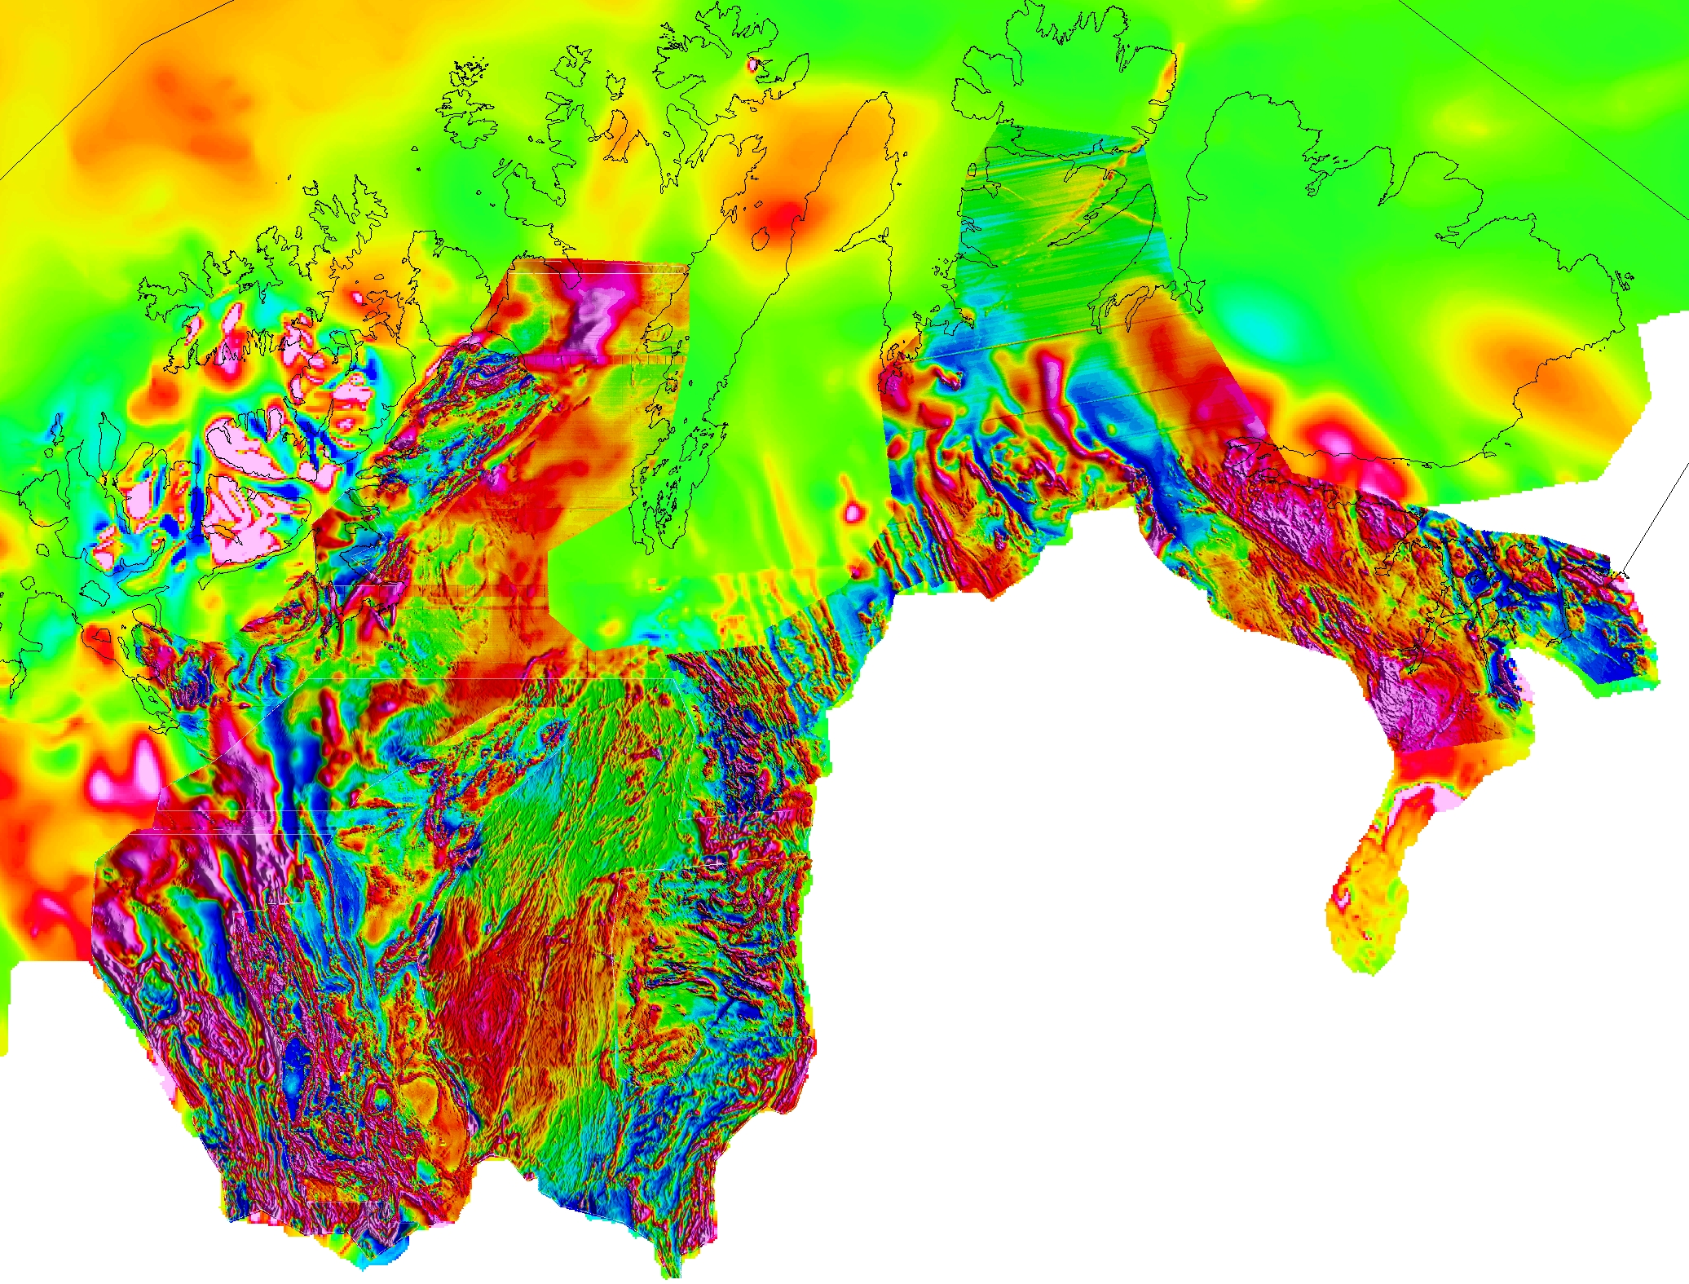
Geophysical data:
Increased coverage and quality
Open access data and reports More than 600 downloads so far …
Hammerfest
Vadsø
Lakselv
Alta
Kirkenes
Karasjok
Magnetic data
from airborne surveys
2010
Magnetic data
from airborne surveys
2012
Kautokeino

Slide 8
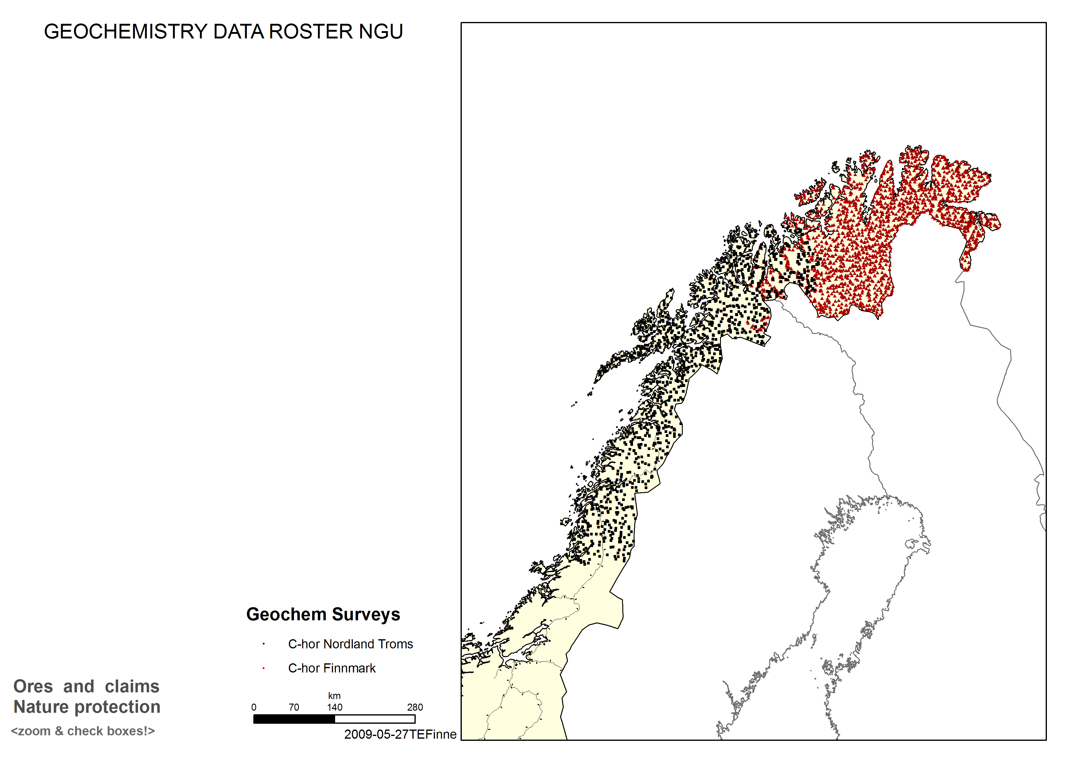
Geochemical analyses
53 elements in 2200 samples of moraine
Published June 2011

Slide 9
Example: Cu
Nussir

Slide 10
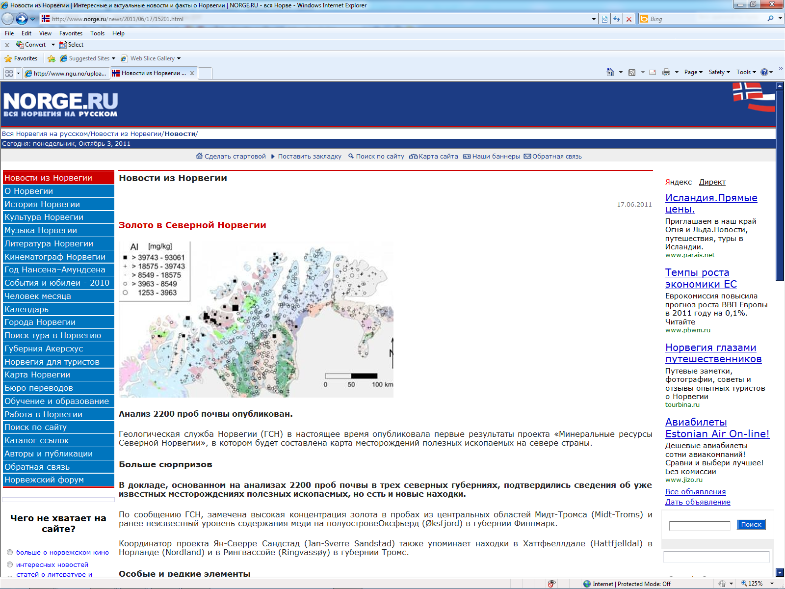
☺

Slide 11
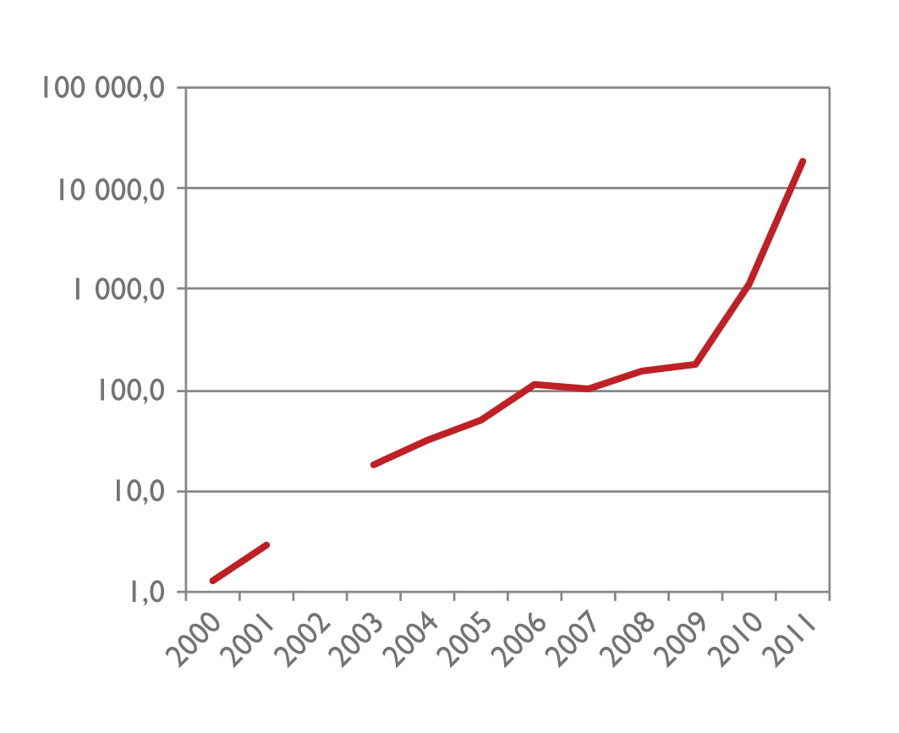
Prospecting picks up:
Directorate of Mining
Claims area by the end of 2012:
30 000 km²
“Mining companies
move into Norway”

Slide 12
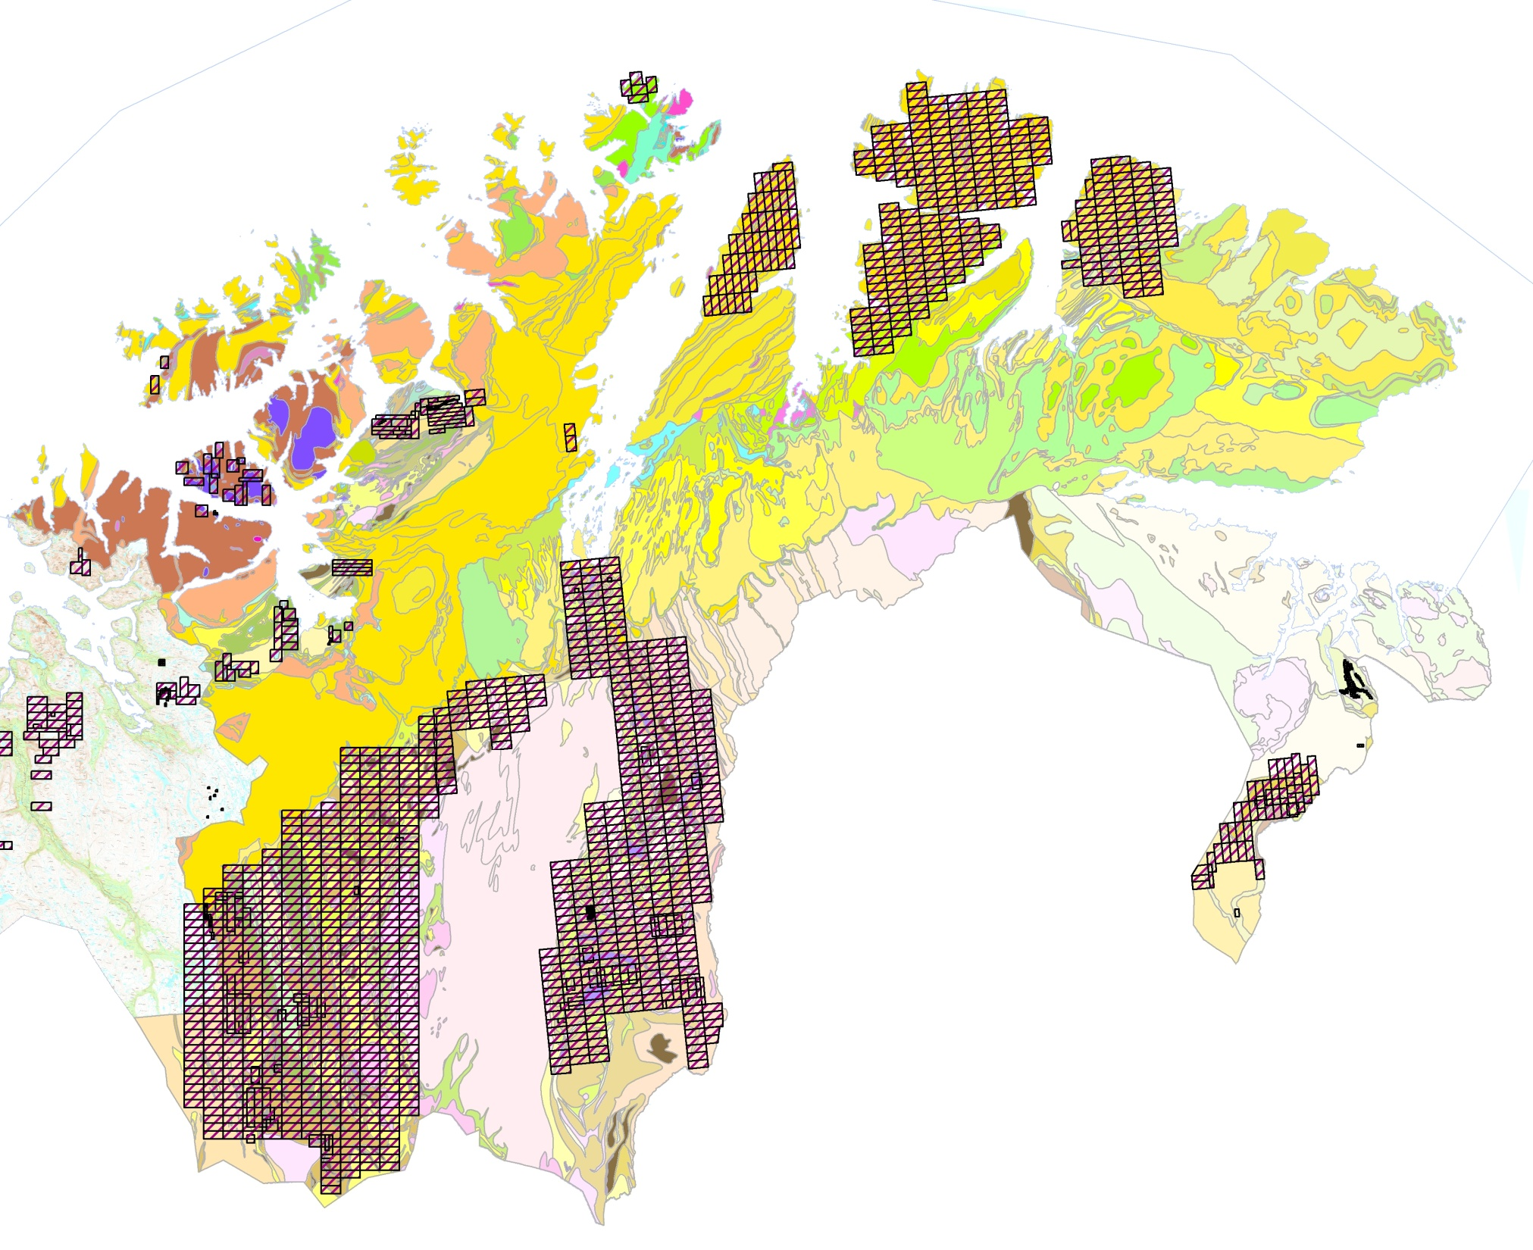
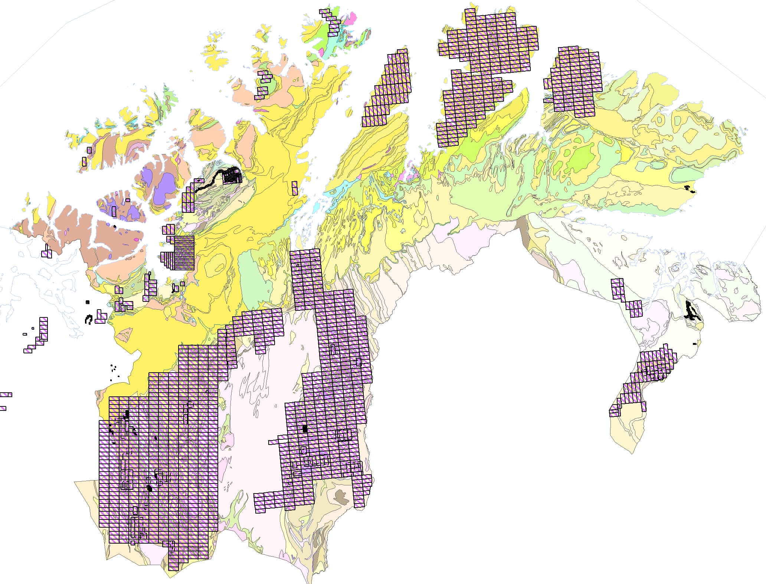
SR
Norseman
Directorate of Mining
REE Mining
NNC
SR
21stN
Nussir,
NMG
Exploration licences (April 2012)
Nordic
Mining
SR, NMG
SR
(Kiruna Iron Ab)
Sydvaranger
SNG, Drake,
NMG
SR,
NMG
Arctic Gold,
Drake, SR,
NMG
SR Scandinavian Resources
NMG Norwegian Minerals Group (Dalradian Resources)
SNG Store Norske Gull
NNC Norwegian North Cape

Slide 13
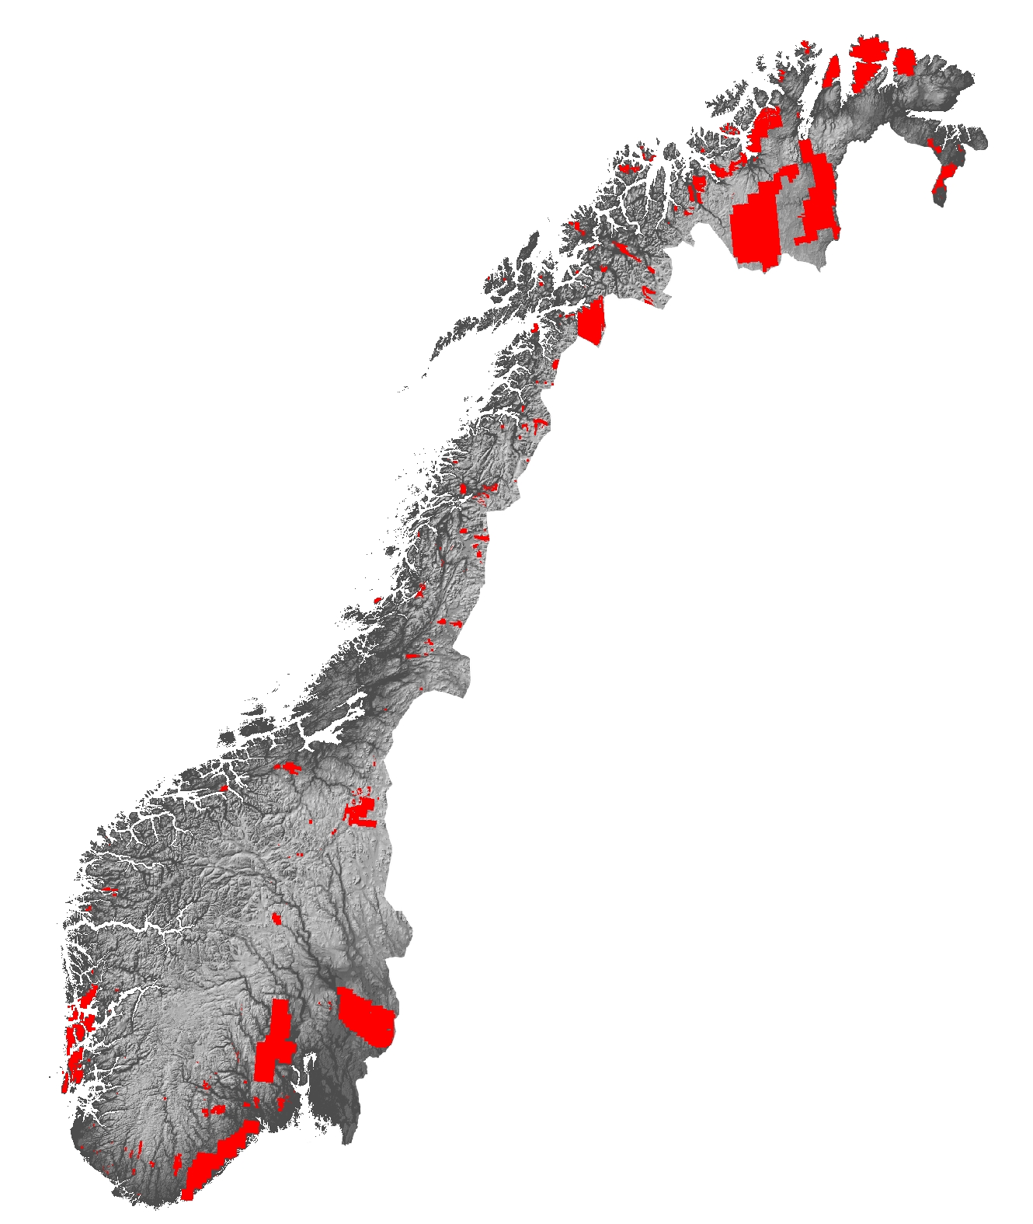
Directorate of Mining
Exploration licences in Norway
by end of 2012 = 10 % of land area
Targets include:
Au-Cu Palaeoproterozoic greenstone belts
Cu-Au Sediment-hosted in Palaeoproterozoic greenstone belts
Cu-Zn-Pb VMS in Caledonides
REE Fen carbonatite, Permian Oslo Rift ++
Ni Caledonide and Palaeoproterozoic mafic intrusives
Fe BIF in Archaean rocks and Caledonides
Ti Rutile in eclogite and ilmenite in mafic intrusions
Mo Permian Oslo Rift and Mesoproterozoic intrusives

Slide 14
Geological mapping in areas with mineral potential
Current focus on
Cu-Au
REE
Mo
Graphite

Slide 15
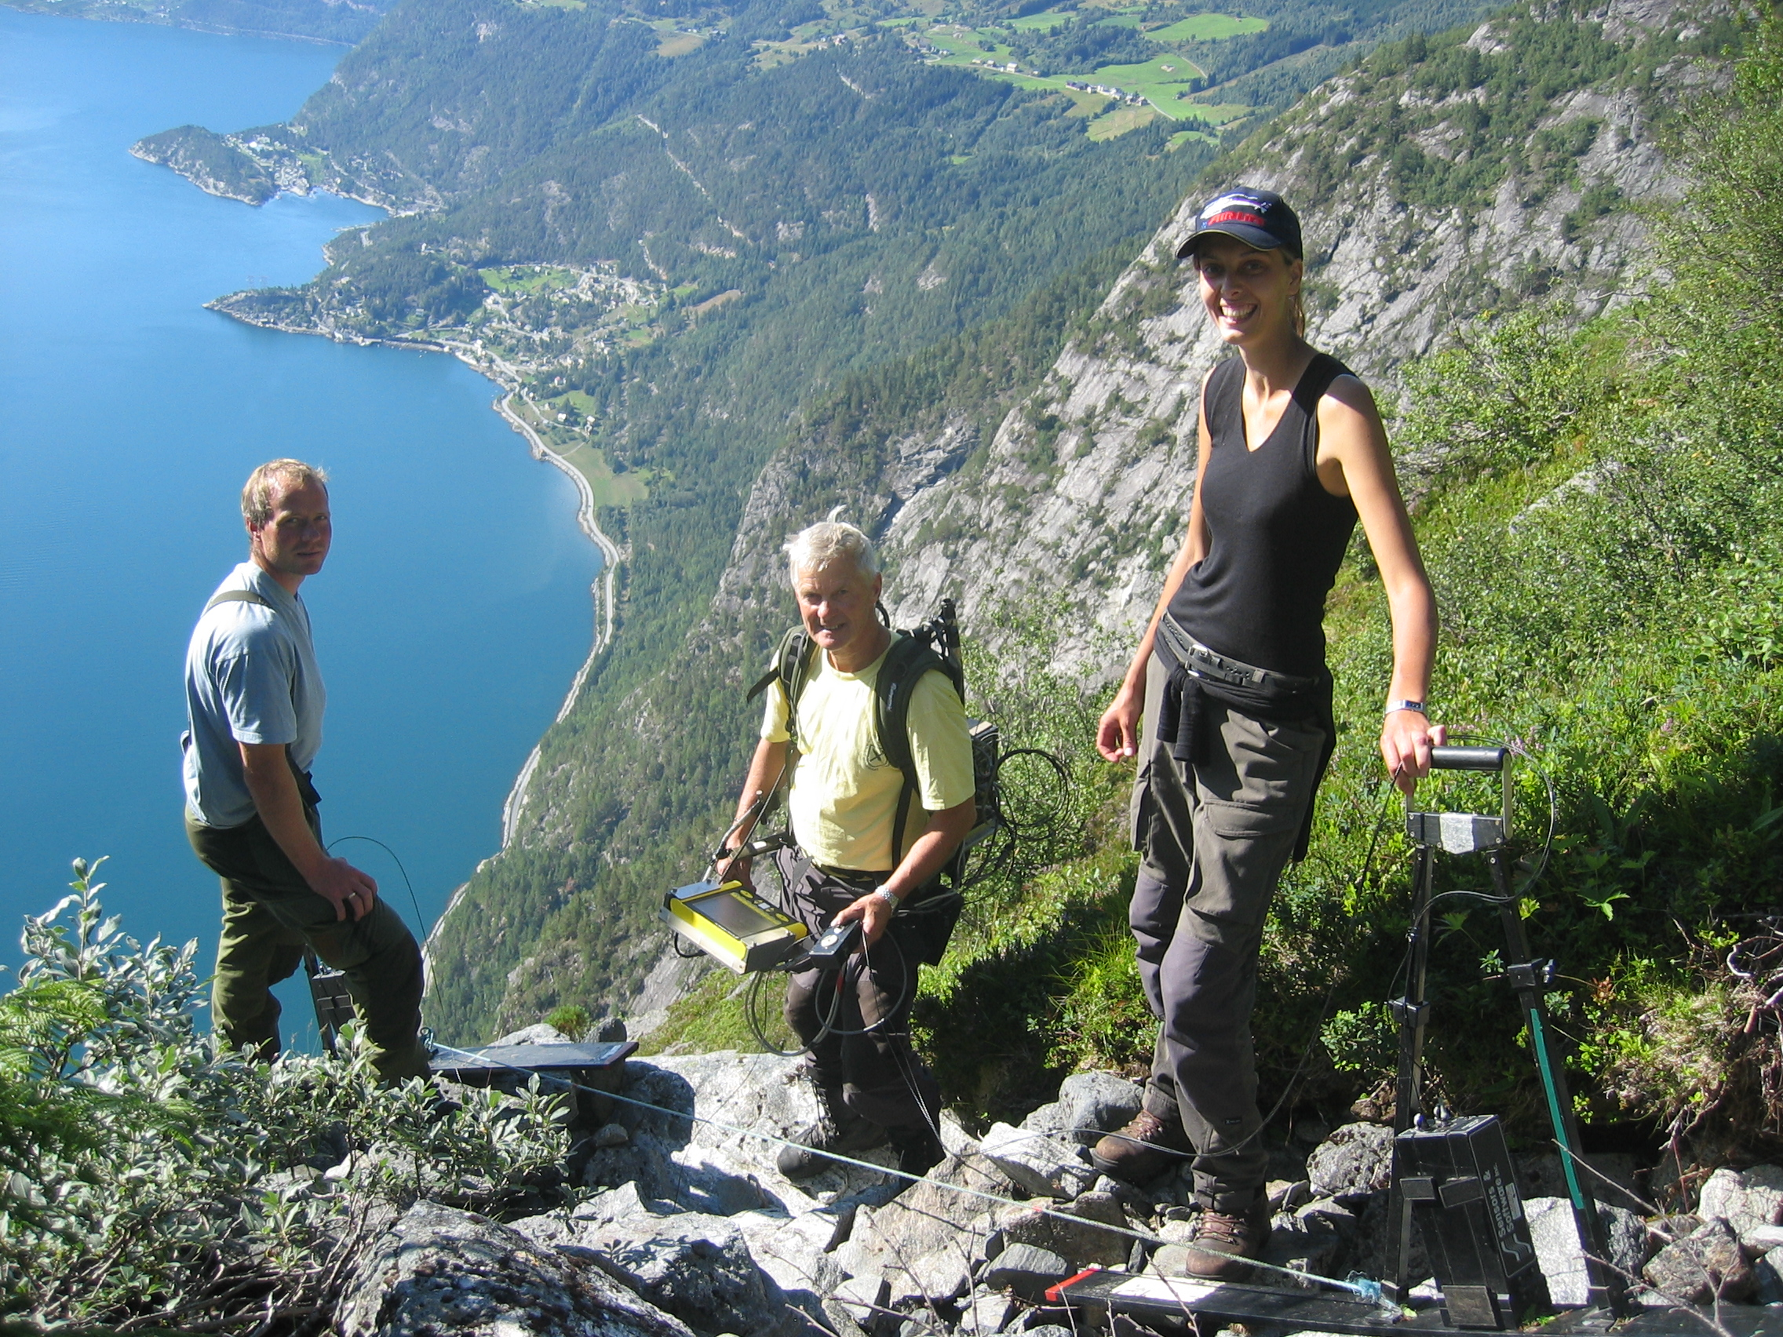
Ground geophysics following up areas of interest

Slide 16
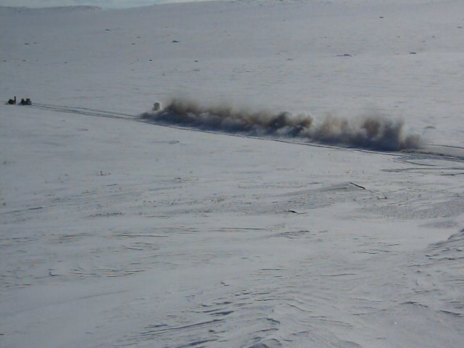
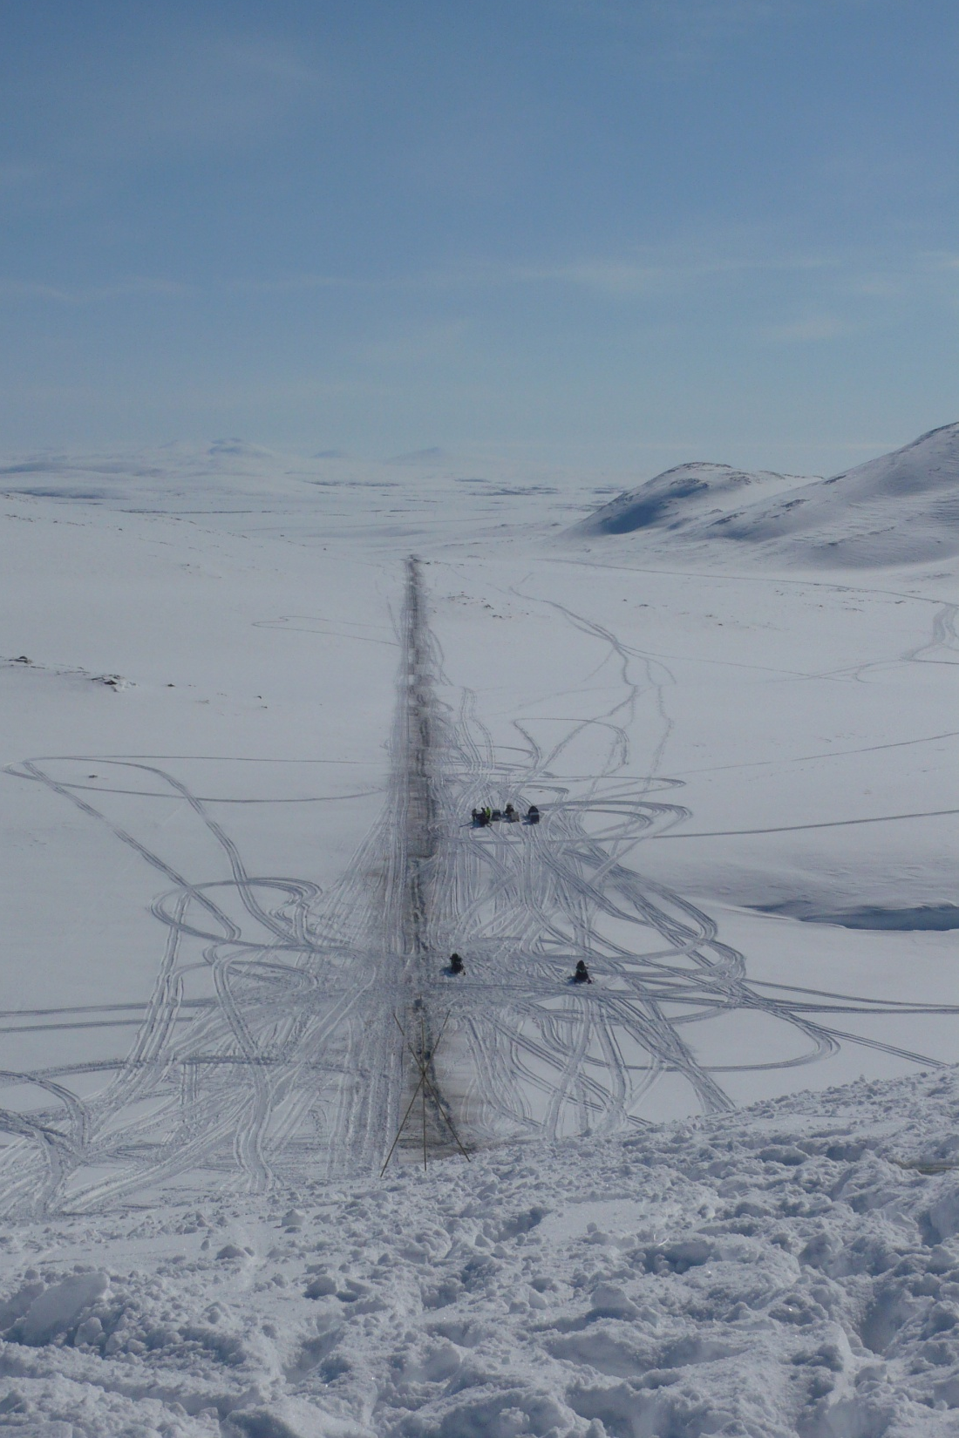
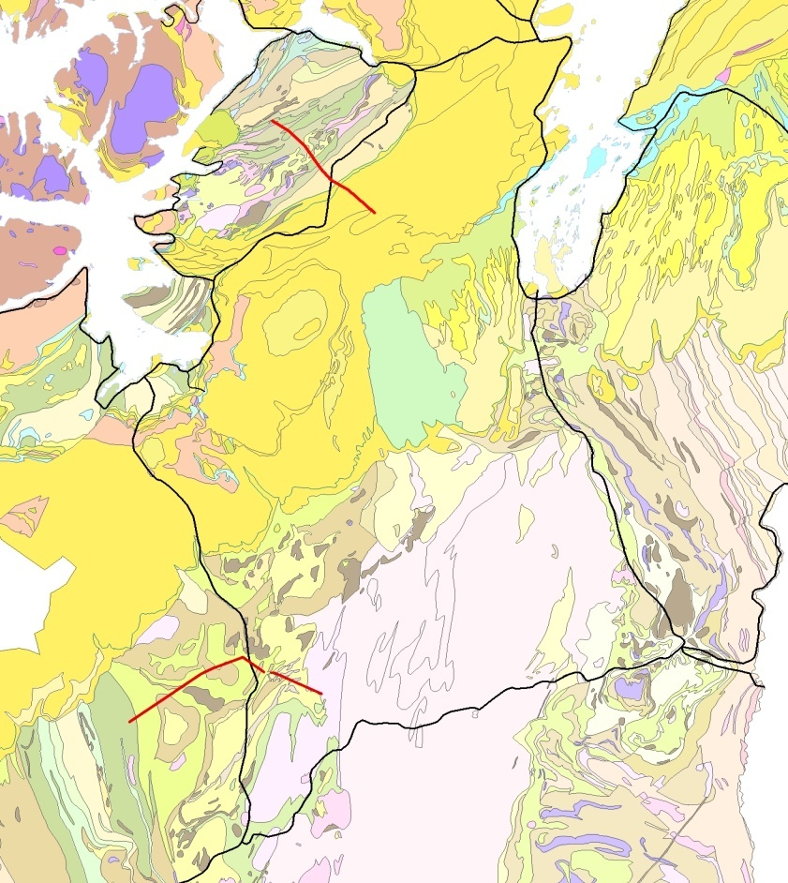
Regional seismic lines 2012 in Finnmark
Skaidi
Lakselv
Alta
Masi
Karasjok
1,5 km long snowstreamer

Slide 17
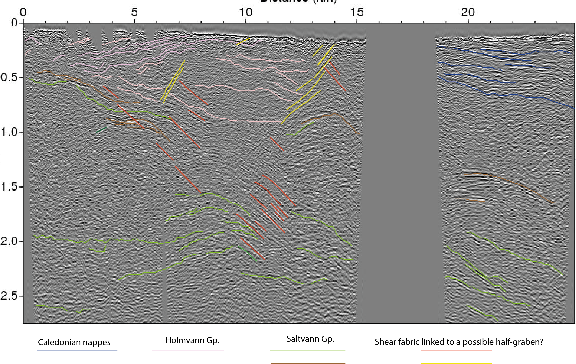
Sennalandet
km
Precambrian Window
Caledonian Nappe

Slide 18
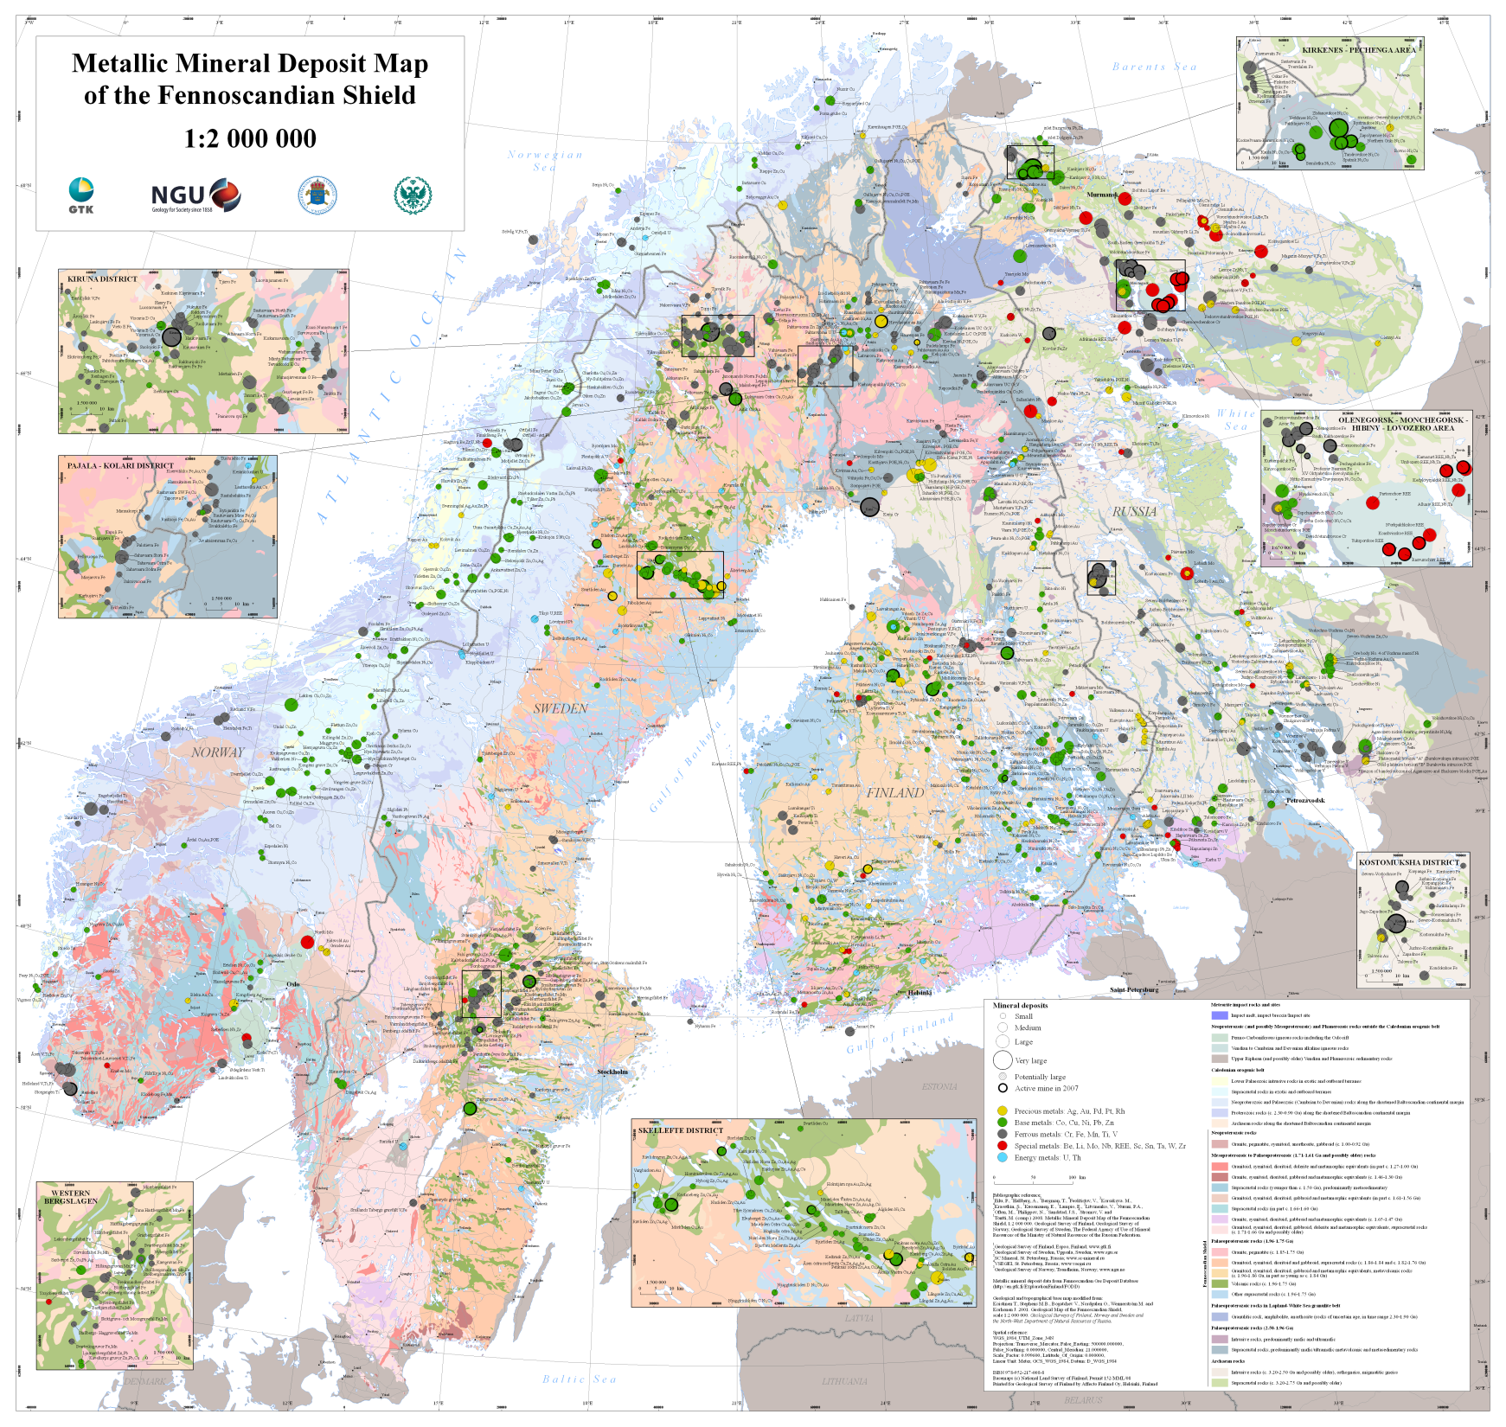
Increased cooperation between Finland, Sweden,
Russia
and
Norway

Slide 19
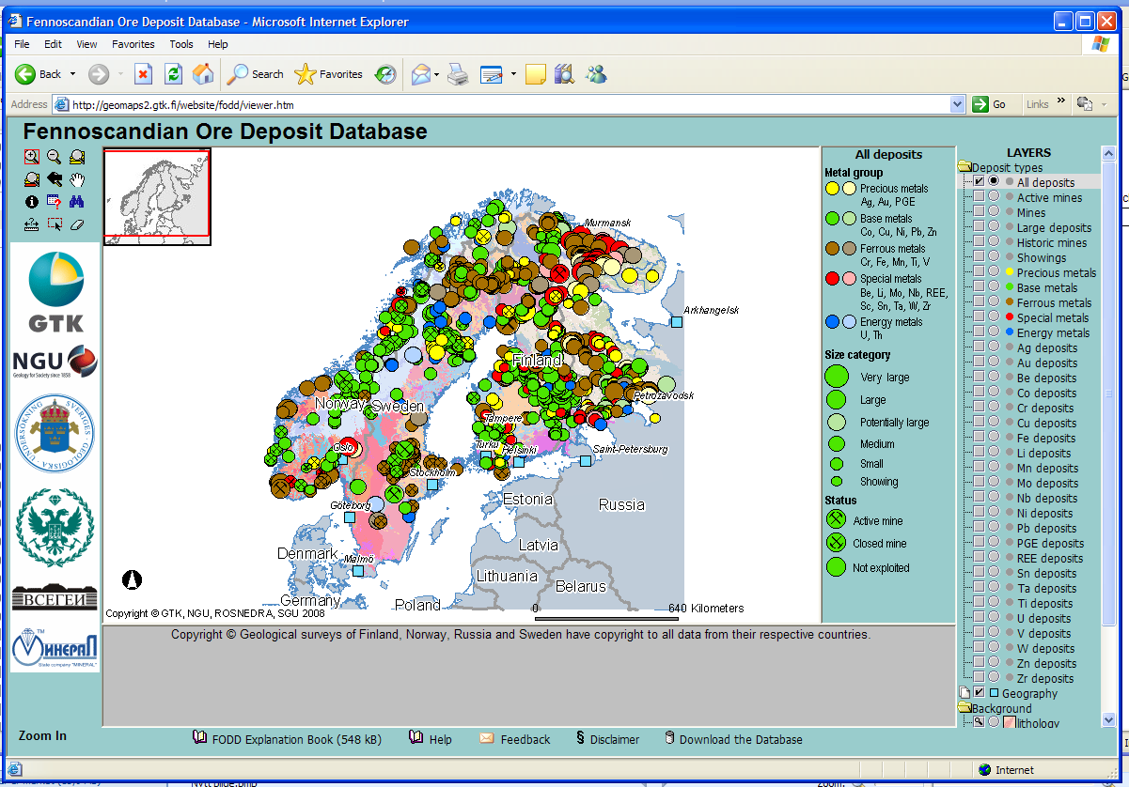
FODD-database:
60% of all occurences have not been studied in detail

Slide 20
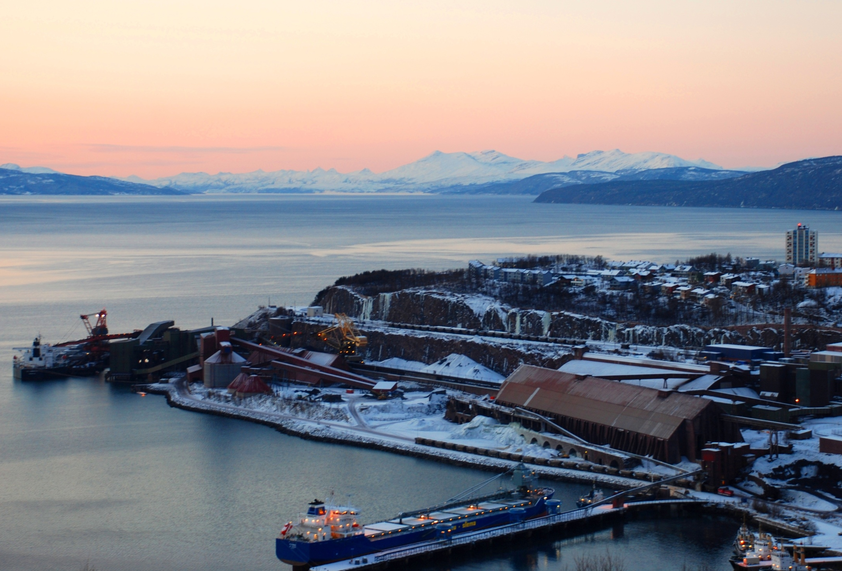
Increased cooperation between
Finland, Sweden, Russia and Norway:
Infrastructure
and transport
“The future lies in ores and mines”
Narvik shipping terminal for iron ore from Kiruna

Slide 21
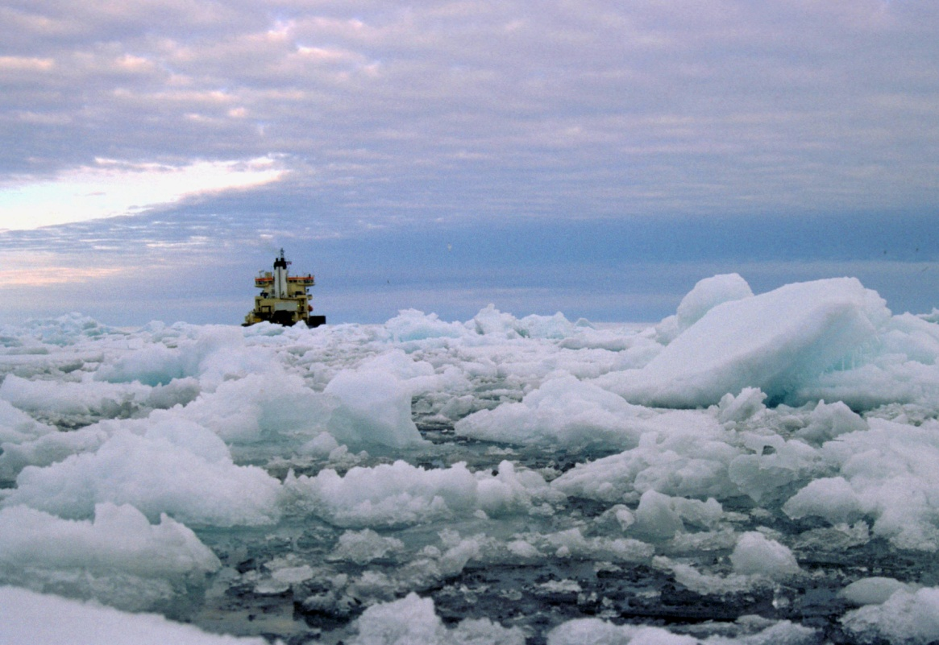
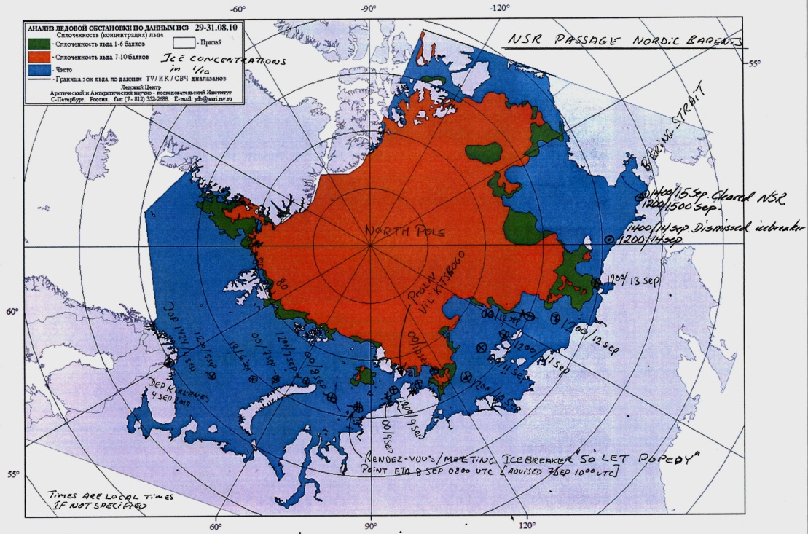
From Rovaniemi (Fin) to Kirkenes (Nor) and all the way to China

Slide 22
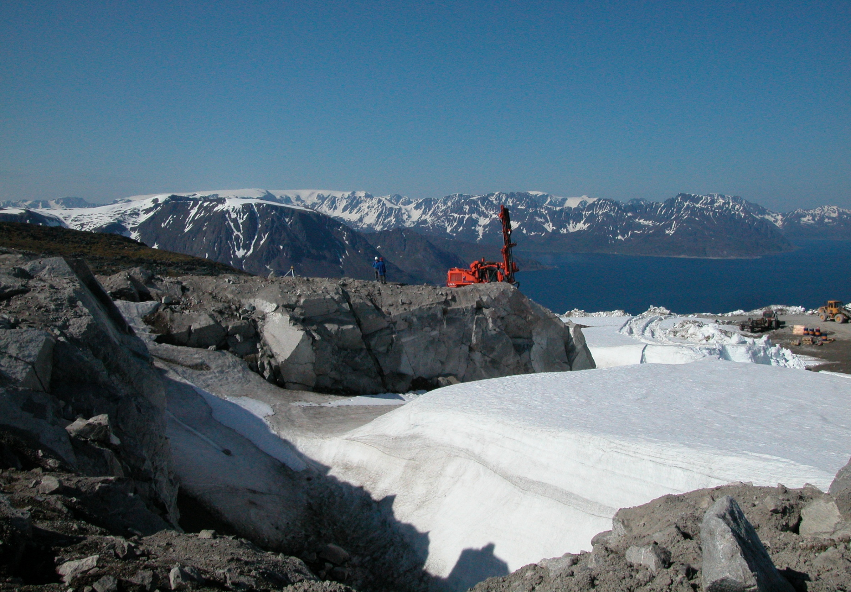
In summary
Renewed government focus on and investment in mineral resources in Norway
NGU’s programs have financing for 5-10 years
Multidisciplinary approach and international cooperation are important
Nefelin syenite, Stjernøy
Foto: H. Carstens

Slide 23
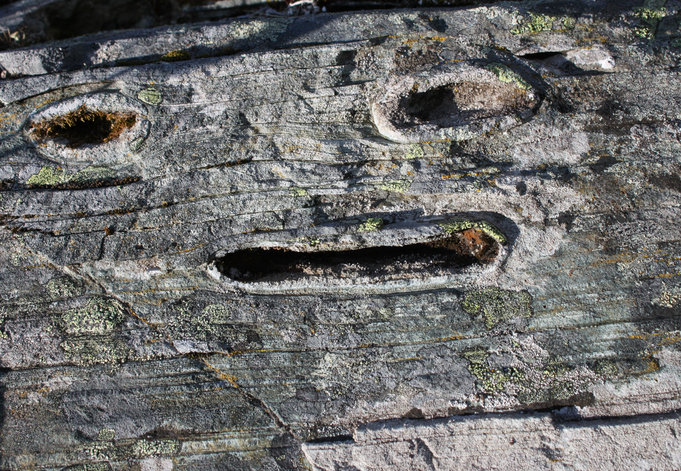
Thank you for your attention.

